Slide 1


Horizon 2020
Marie Skłodowska-Curie Actions
Strasbourg
18-10-2018

Slide 2


H2020: World class Science & Enabling Innovation
80 billion EUR

Slide 3
MSCA - strategic programming approach
    Attract and retain research talent
    Develop state-of-the-art, innovative training schemes, consistent with the highly competitive and increasingly inter-disciplinary requirements of research and innovation
    Promote sustainable career development in research and innovation
    Focus on delivering new knowledge and skills, in line with the key driver identified in the strategic programming approach
    Contribute to a strong partnership with MS via the co-funding mechanism

Slide 4
Key features of the MSCA part
    Open to all domains of research and innovation from basic research up to market take-up and innovation services
    Entirely bottom-up
    Participation of non-academic sector strongly encouraged, especially industry and SMEs
    Mobility as the key requirement - funding on condition participants move from one country to another
    Promotion of attractive working and employment conditions
    Particular attention to gender balance
    Budget 2014/2020 : 6 162 billion €

Slide 5
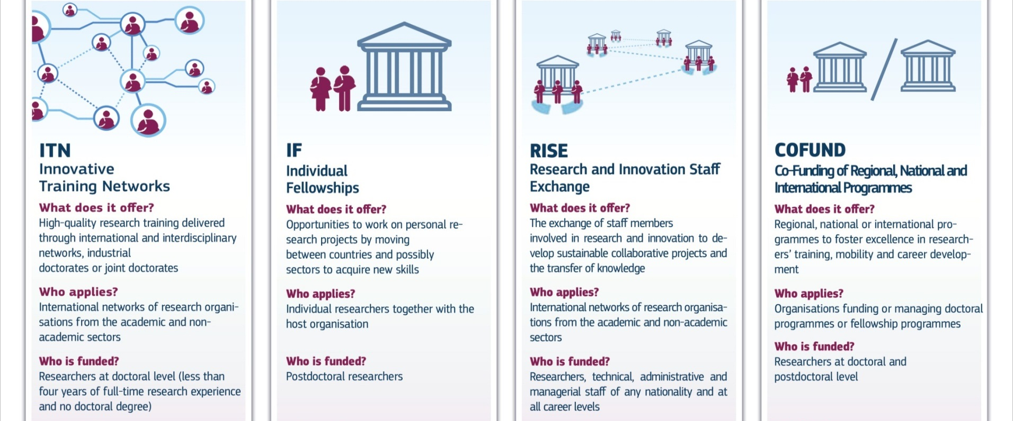

Slide 6
Definitions
Early Stage Researchers
    Shall at the time of recruitment (ITN, COFUND) or secondment (RISE), be in the first four years (full-time equivalent) of their research careers and have not yet been awarded a doctoral degree
Experienced Researchers
    Shall, at the time of the relevant deadline for submission of proposals (IF), recruitment (COFUND) or secondment (RISE), be in possession of a doctoral degree or have at least four years of full-time equivalent research experience
Nationality, residence
    Global fellowships and Reintegration panel in IF are open to nationals or long-term residents of EU Member States and Associated Countries.
    Long-term residence means a period at any time in the past of full-time research activity in the EU Member States or Horizon 2020 Associated Countries, which lasted at least 5 consecutive years

Slide 7
Mobility Rule
    Mobility Rule: researchers must not have resided or carried out their main activity (work, studies, etc.) in the country of the recruiting beneficiary for more than 12 months in the 3 years
      immediately before the recruitment date (ITN)
      Immediately before the call deadline (IF)

Slide 8
Definitions
Who applies?
International networks of organisations
actively involved in research/doctoral training
Academic sector
public /private higher education establishments
awarding academic degrees
public /private non-profit research organisations
whose primary mission is to pursue research
international European interest organisations (e.g. CERN, EMBL)
Non-academic sector
any entity not included in the academic sector:
e.g. large companies, SMEs, NGOs, museums, hospitals
international organisations (e.g. UN, WHO)
Standardised legal validation of entities is applied
to determine the domain of each participant

Slide 9



Definitions
Beneficiary vs.
Partner Organisation
Signs Grant Agreement
Recruits and Hosts Researchers
Trains/Hosts Researchers on secondment
Participates in Supervisory Board
Directly Claims Costs
EU funding

Slide 10
IF : Individual Fellowships

Slide 11
Individual Fellowships
Objectives
      to enhance the creative and innovative potential of experienced researchers
      to provide opportunities to acquire new knowledge, resume a career or return to Europe
      the beneficiary shall be a participant established in EU (MS/AC) and employing the researcher during the project
    Scope
      Trans-national fellowships awarded to the best or most promising researchers
      European Fellowships (12-24 months except for CAR panel : 12-36 months) or Global Fellowships (12-24 months + mandatory return phase of 12 months)
      Career Restart Panel, Reintegration Panel and Society and Enterprise Panel
      Secondments, notably in the non-academic sector
    Expected Impact
      to release the full potential of researchers and development of their careers in both the academic and non-academic sectors

Slide 12
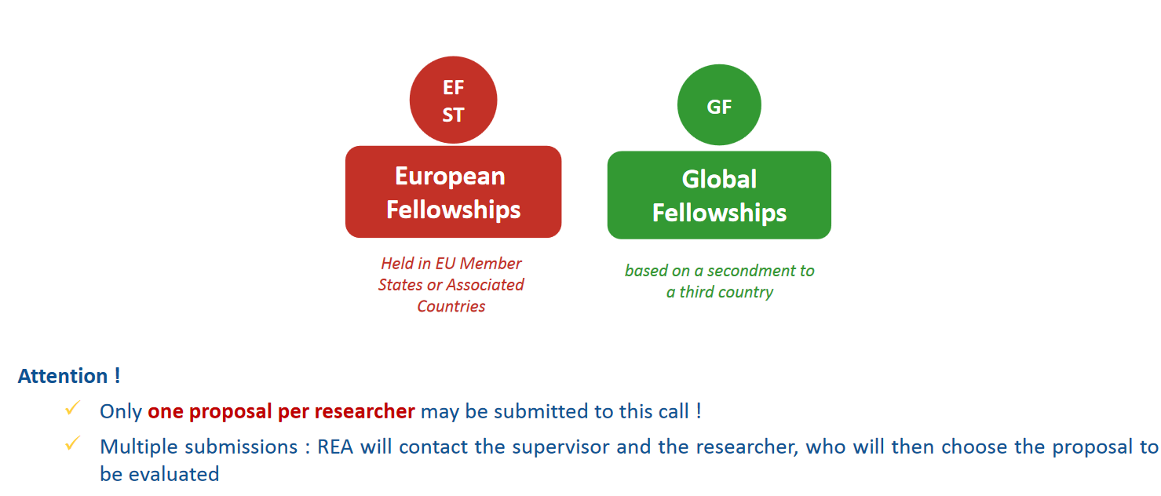
Individual Fellowships

Slide 13
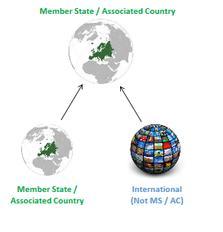
European Fellowships (EF)
Four types of mobility from 12 to 24 months (36 months for CAR panel)
1.Standard European Fellowship
2. Career Restart Panel :
after a career break (parental leave, working outside research, etc.) of at least 12 months within the 18 months immediately prior to the deadline
3.Reintegration Panel : to return and reintegrate
In a longer term research position in Europe
4. Society and Enterprise : to work on research and
innovation projects in an organisation from the non
-academic sector

Slide 14
European Fellowships (EF)
One experienced researcher applies jointly with one host institution located in a MS or AC for a research project that can last between 12 and 24 months (36 months for CAR panel)
Host institution (future beneficiary)
Location : MS or AC
Sector : Academic or non-academic
International European Interest Organisation (IEIO)
International Organisations (exceptional cases)
Appoints the Supervisor (who will legally act in the name of the organisation until the Grant Preparation phase)
Recruits the experienced researcher under the condition established in the Grant Agreement (contract of employment)

Slide 15
European Fellowships (EF)
Researcher (future fellow) :
Experienced researcher : PhD or at least 4 years of full-time equivalent research experience by the call deadline
  Full-Time Equivalent Research Experience is measured from the date when the researcher obtained the degree entitling him/her to embark on a doctorate, eigher in the country in which the degree was obtained or in the country in which the researcher is recruted, even if a doctorate was never started or envisaged
Must undertake transnational mobility
Nationality : any (exception for the Reintegration Panel)
Recruited by the beneficiary under the condition established in the Grant Agreement (contract of employment)

Slide 16
European Fellowships (EF)
The project is written by the experienced researcher, a concrete plan of training-through-research for 12-24 months (12-36 months for CAR panel) at the host organisation’s premises
Realistic and well-defined objective in terms of career advancement (e.g. by attaining a leading independant position) or resuming a research carrer after a break
Typical training activities may include :
Primarly training-through-research : individual personalised action
Hands-on training activities for developing scientific (new techniques, instruments,…) and transferable skills
Inter-sectoral or interdisciplinary transfer of knowkedge (e.g. through secondments)
Taking part in the research and financial management of the action
Organisation of scientific/training/dissemination events
Communication, outreach activities and horizontal skills
Training dedicated to gender issues

Slide 17
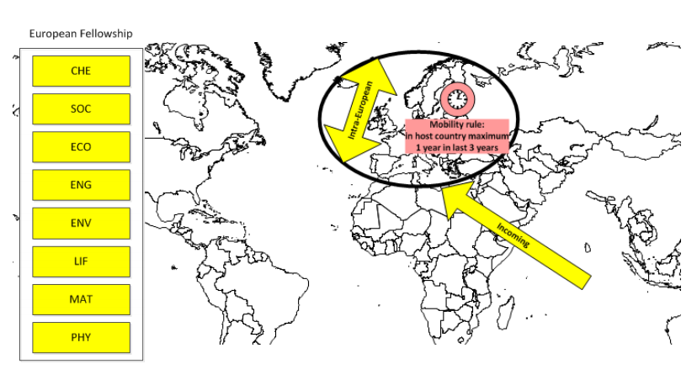
Standard
European fellowship

Slide 18
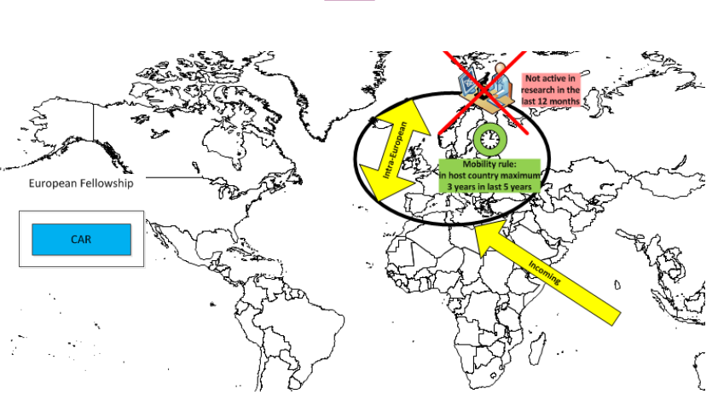
Career Restart Panel
Not active in research for a continuous period of at least 12 months within the 18 months prior to the deadline for submission

Slide 19
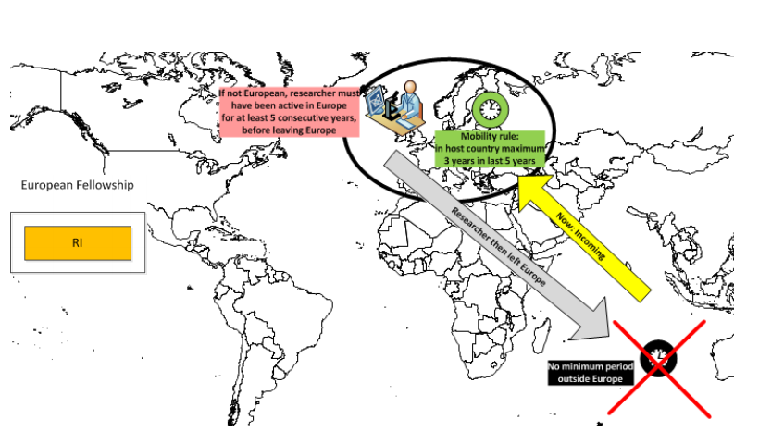
Reintegration Panel
If not European, researcher must have been a long term EU resident (at least 5 consecutive years)

Slide 20
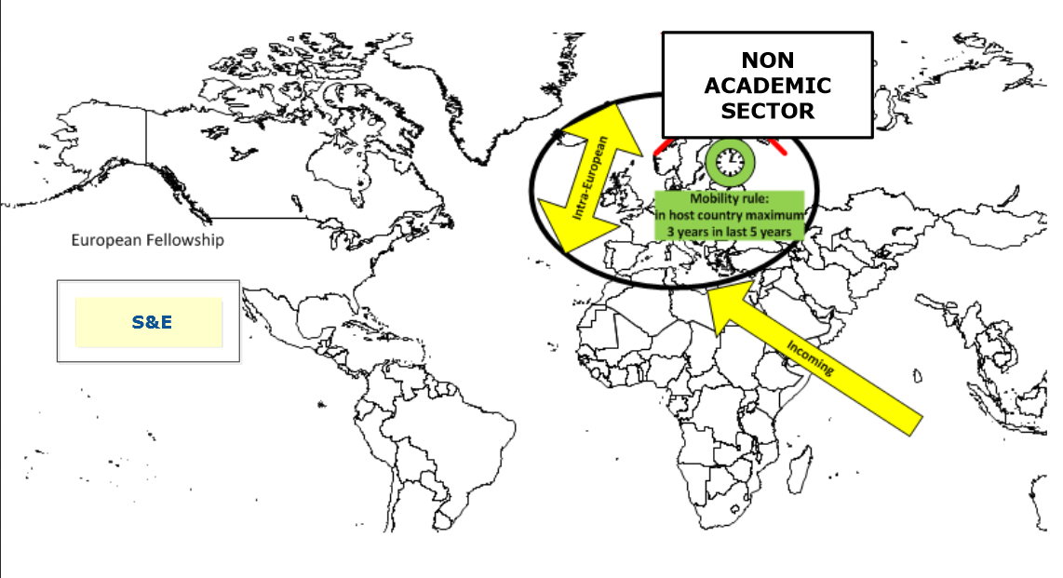
Society and Enterprise
Society and entreprise panel

Slide 21


Global Fellowships
Features
Outgoing phase in a Third Country (from 12 to 24 months)
Mandatory 12 month return phase to the beneficiary located in a MS or AC
Mandatory letter of commitment from the partner organisation
Outgoing phase
Return phase
International (Not MS / AC)
Member State / Associated Country

Slide 22
Global Fellowships
One experienced researcher applies jointly with one host institution located in a MS or AC for a research project that has an initial outgoing phase in Partner Organisation in a Third Country and the whole project can last between 24 and 36 months
Partner organisation
Location : Third Country (not MS or AC)
Sector : Academic or non-academic
International Organisations
Nominates a Supervisor for the researcher
Provides the Commitment Letter signed by the legal representative
Does not sign the Grant Agreement
Does not recruit the researcher
Does not directly claim costs from the action

Slide 23
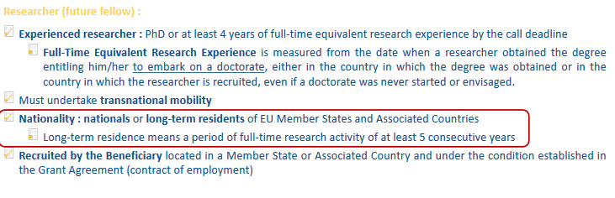
Global Fellowships
Long-term residence means a period of legal and continuous residence of at least 5 consecutive years

Slide 24
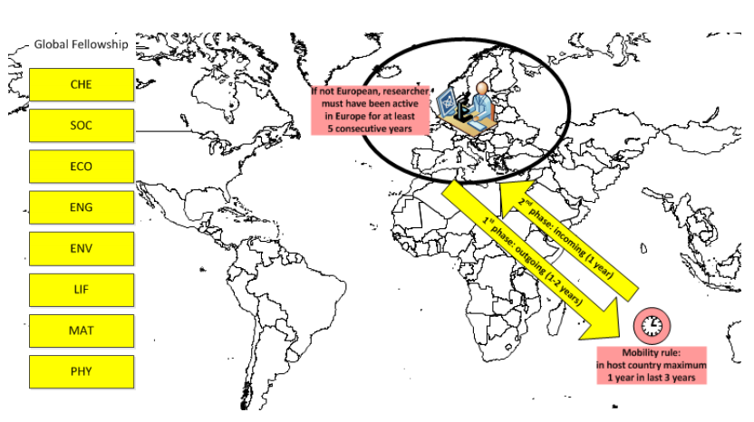
Global Fellowships
If not European, researcher must have been a long term EU resident (at least 5 consecutive years)

Slide 25

Secondments
When : During the implementation of the project
Who : the Experienced Researcher
Where : to partner organisation – another institution including IO located in Europe (MS/AC) or to an IEIO / to beneficiary at the start of a GF (new 2018-2020)
How long :
Clearly justified and described in Part B
Single period or divided into shorter mobility periods
Can be at more than one partner organisation
Can be to an institution in the same country as the beneficiary
Can be in the same sector (academic-academic)

Slide 26
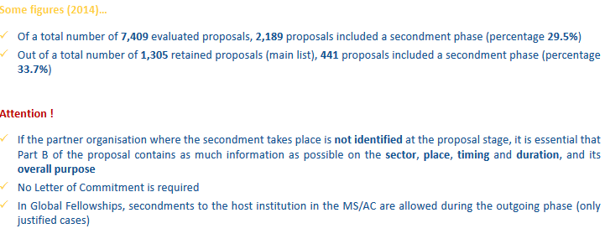
Secondments

Slide 27

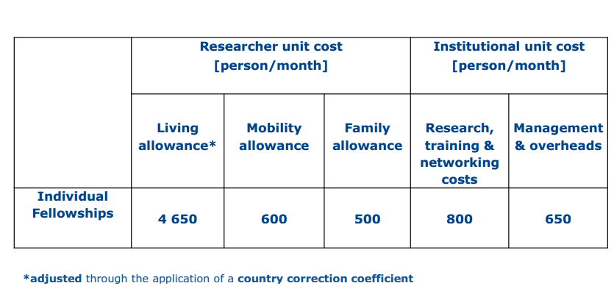
EU Contribution
4 880

Slide 28
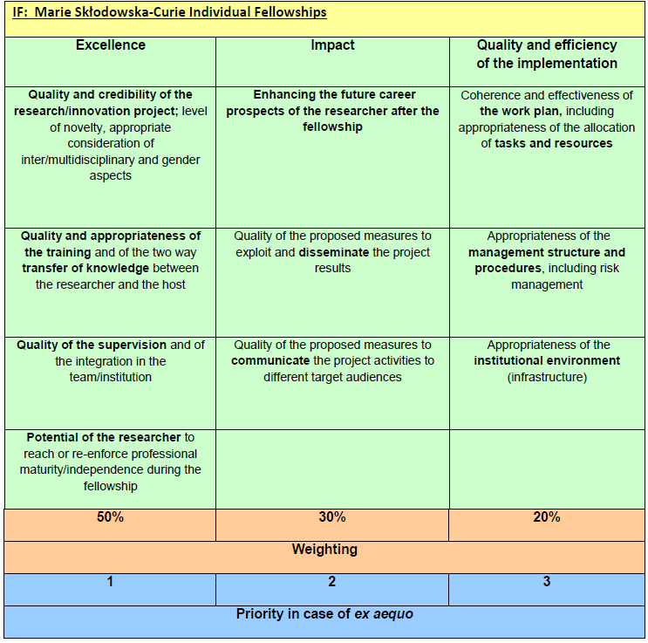

Slide 29
CALL
IF – 2018 Call
H2020-MSCA-IF-2019
- Opened 11 April 2019
- Deadline: 11 September 2019 (17.00 – Brussels time)
Results of the evaluation: 5 months after the call deadline
Signing of grant agreements: 8 months after the call deadline
Individual Fellowships | 2017 | 2018 | 2019
European Fellowships | EUR 205 million | EUR 220 million | EUR 236,49 million
Society & Entreprise panel | EUR 10 million | EUR 8 million | EUR 8 million
Global Fellowships | EUR 33,7 million | EUR 45 million | EUR 50 million

Slide 30
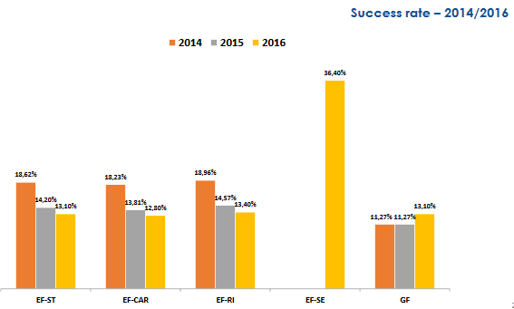
CALL
Results - Statistics

Slide 31
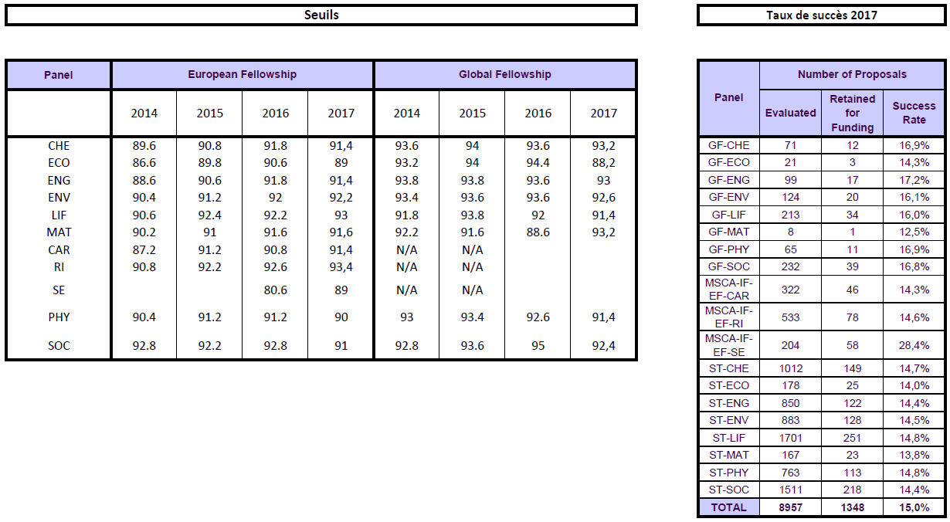
CALL
Results - Statistics

Slide 32
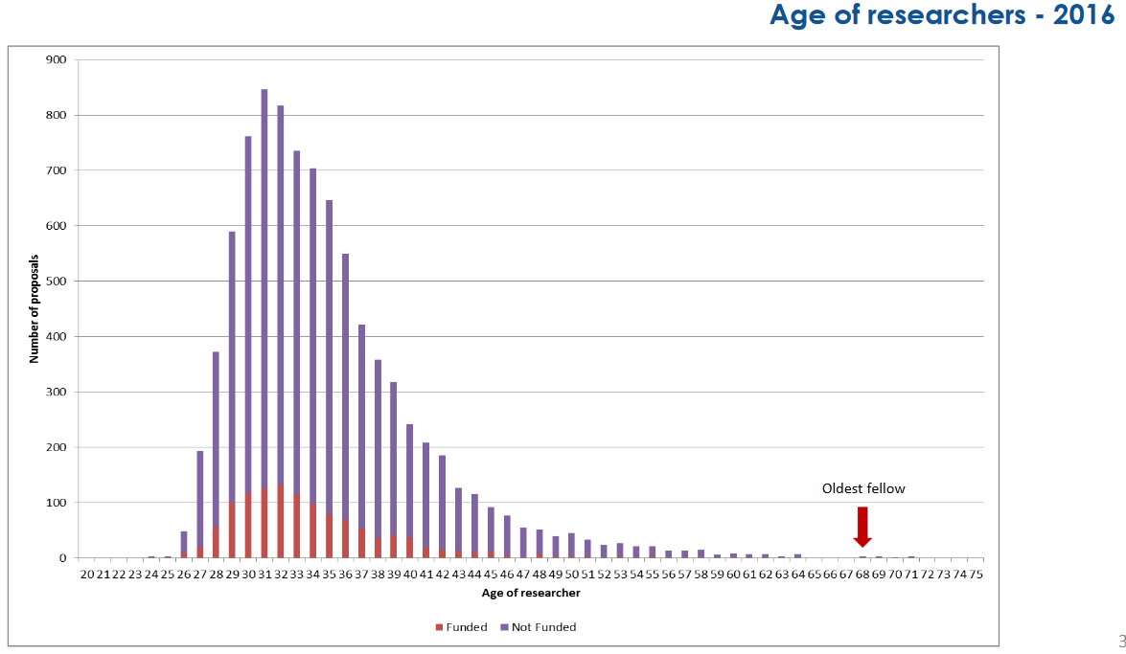
CALL
Results - Statistics

Slide 33

ITN
Innovative Training Networks

Slide 34
ITN
Objectives
Train innovative early-stage researchers
Excellence in doctoral/early-stage research training
Provide skills to match public and private sector needs
Scope
Excellence: International network of organisations applies and proposes a joint research training or doctoral programme
Bottom-up (no pre-defined topics)
All domains*: CHE, ECO, ENG, ENV, LIF, MAT, PHY, SOC
Multidisciplinary approach
Meaningful exposure to non-academic sector
Expected impact
Improved career perspectives of researchers
Structured high-quality research / doctoral training
Collaboration academia with non-academic sectors

Slide 35
ITN typical activities
ITN
Core activity: Training through individual research projects
Network-wide training activities
(e.g. seminars, workshops, summer schools).
Training in key transferable skills
(e.g. entrepreneurship, management, IPR, communication, ethics, grant writing).
Collaboration and exchange of knowledge within the network
Communication & Dissemination
Public engagement

Slide 36
ITN
Who can be recruited?
Researcher-months requested in proposal
Recruitment after the project starts.
Only Early-Stage Researchers (ESRs):
≤ 4 years of research experience
no PhD yet
Recruitment:
3 to 36 months (typical)
Mandatory trans-national mobility at the time of recruitment.

Slide 37
EU 28 Member States (MS)
Associated Countries (AC)
Other Third Countries (OTC)
ITN
ETN
European
Training Network
Participants implement a joint research programme
Min. 3 beneficiaries from any sector
from 3 different MS/AC
Doctoral programme with the non-academic sector
Min. 2 beneficiaries from 2 different MS/AC:
min. 1 from academic sector
+ min. 1 from non-academic sector
EID
European
Industrial Doctorates
EJD
European
Joint Doctorates
Doctoral programme to deliver joint degrees
Min. 3 beneficiaries
from academic sector awarding PhD
from 3 different MS/AC
Above this minimum: participants from any sector / country
Research fields chosen freely by applicants
(CHE, ECO, ENG, ENV, LIF, MAT, PHY, SOC)

Slide 38
ITN - ETN
ETN – European
Training Network
Participants implement a joint research training programme
Mandatory
Min. 3 beneficiaries from 3 different MS/AC
Each beneficiary recruits and hosts at least 1 ESR
Max 540 person-months (e.g. 15 ESRs x 36 months)
Other features
Non-academic participation essential
PhD enrolment typically expected (not mandatory)
Secondments to other countries/sector/disciplines (≤30% time)
Joint supervision recommended
Partner organisations (any country/sector)

Slide 39







ITN - ETN
Participants implement a joint research training programme
ETN
Beneficiaries
Partner organisations

Slide 40
ITN - EID
EID – European
Industrial Doctorates
Doctoral training with the non-academic sector
Min. 2 organisations from 2 different EU/ associated countries
1 academic awarding PhD + 1 non-academic
Max 180 person-months (if 2 organisations) - e.g. 5 x 36 months
Max 540 person-months (if ≥3 organisations) - e.g. 15 x 36 months
Individual research projects under the topic of the doctoral programme
Flexible recruitment rule
Each fellow enrolled in the doctoral programme
Each fellow must spend ≥50% of time in non-academic sector
Secondments possible
Partner organisations (any country/sector)

Slide 41





ITN - EID
EID
≥ 50% time for each ESR
Beneficiaries
Partner organisations
non-academic sector
2 beneficiaries : max 180 PM

Slide 42

ITN - EID
EID
≥ 50% time for each ESR
Beneficiaries
Partner organisations
non-academic sector
≥3 beneficiaries: max 540 PM

Slide 43
ITN - EJD
EJD – European
Joint Doctorates
Universities cooperating to deliver joint/multiple doctoral degrees
Mandatory
Min. 3 beneficiaries from academic sector awarding PhDs, from 3 different MS/AC
Each ESR enrolled in the joint (international) doctoral programme
Joint selection, training and supervision
Commitment to deliver joint/double/multiple degrees
At least 2/3 of ESR must be enrolled in joint, double or multi degree within Europe
Max 540 person-months
Other features
Meaningful stays at joint doctorate beneficiaries
Non-academic participation through secondments to other sector/disciplines possible
Flexible recruitment rule

Slide 44



ITN - EJD
EJD
Joint PhD
Joint PhD
Joint PhD
Beneficiaries
Letters of institutional commitment to deliver degrees are required in the proposal
Partner Organisations

Slide 45
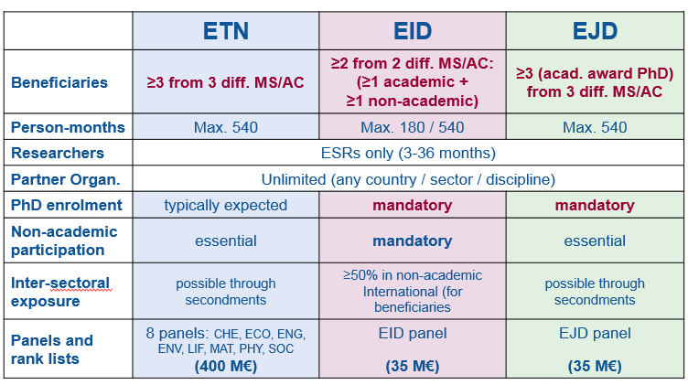
Summary

Slide 46
EU Contribution
Unit costs/1 researcher month:
Marie Skłodowska Curie Actions | Researcher unit cost [person/month] |  |  | Institutional unit cost [person/month]
 | Living allowance | Mobility allowance | Family Allowance | Research, training and networking costs | Management and indirect costs
Innovative Training Networks | 3 270 | 600 | 500 | 1 800 | 1 200
Country correction coefficient applies to the living allowance
Researcher allowances include employer contributions.
Researcher allowances are a minimum to be paid (top-up funds from other sources permitted).

Slide 47
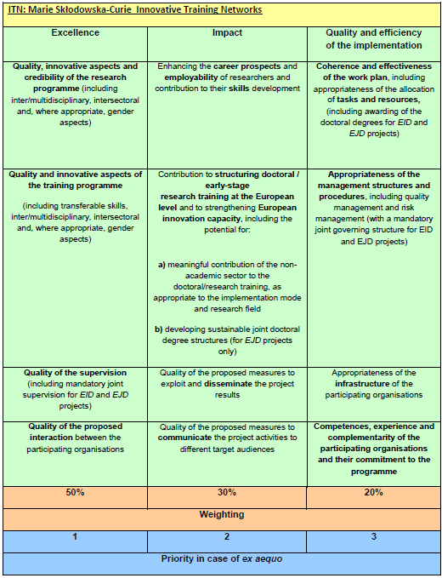

Slide 48
ITN 2019 Call
H2020-MSCA-ITN-2019
Opening 13 September 2018
Closure: 15 January 2019 (17:00:00 Brussels time)
Budget: € 470 Million (ETN: 400 M€, EID: 35 M€; EJD: 35 M€)
Results of the evaluation: 5 months after the call deadline
Signing of grant agreements: 8 months after the call deadline

Slide 49
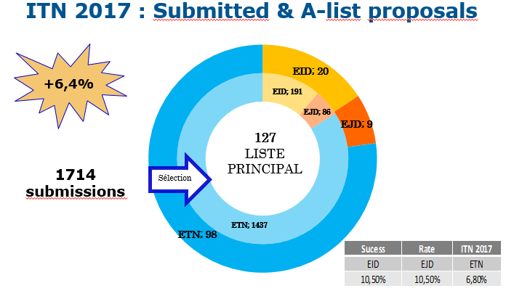

Slide 50
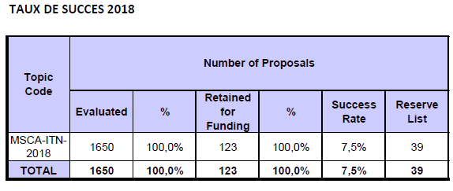
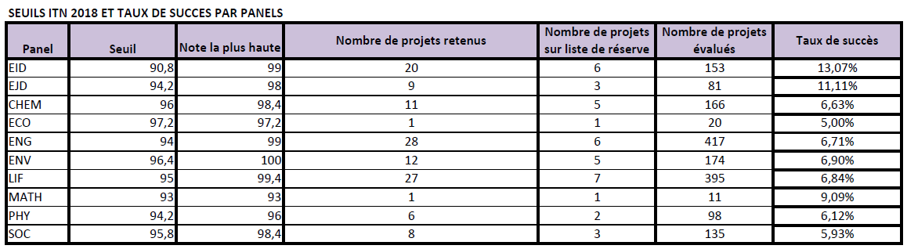
ITN 2018 Results

Slide 51
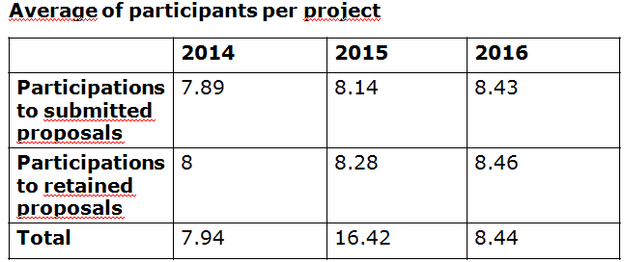
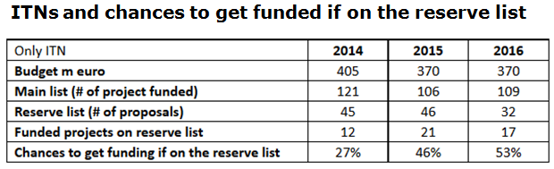

Slide 52
RISE
Research and Innovation Staff Exchange

Slide 53
RISE
New type of exchange of staff action to stimulate transfer of knowledge
Academic and non-academic participants
Flexible inter-sector and international exchange of highly skilled research and innovation staff members
Work with existing staff – no recruitment foreseen
Based on a common project
Bottom-up approach

Slide 54
RISE
2 dimensions of projects promoting staff exchanges :
MS/AC and TC => International
Academic and non-academic sectors => Inter-sectoral

Slide 55
RISE
Main features
Project built on joint research and innovation activities
Project implemented through the secondment of staff (no recruitments)
Each staff member seconded for a period of 1 to 12 months
The maximum size for a project is 540 person months
No minimum size explicitly defined for the project, but substantial impact is expected
Maximum project duration is 4 years

Slide 56
RISE
Who can participate?
All Countries can participate in RISE, but not all are eligible for funding
All institutions fulfilling the requirements of the Horizon 2020 Rules for Participation can participate in RISE
Beneficiaries : sign the Grant and claim the costs, established in a MS/AC
Partner organisations : Must include a letter of commitment, are established in a Third Country (i.e. neither MS or AC)

Slide 57
RISE
Eligibility of staff members for the mobilities
Actively engaged in or linked to research/innovation activities for at least 1 month prior to first secondment
Types of staff members:
ESR (no PhD and < 4 years experience)
ER (PhD or > 4 years experience)
Managerial staff
Administrative or Technical staff
In-built return mechanism

Slide 58
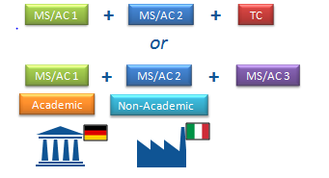
RISE
At least 3 independent participants in 3 different countries of which at least 2 participants from 2 different MS/AC
Add RISE condition for funding secondment :
Always between different countries and
- International (MS/AC Third Countries)
- Intersectoral (Academic Non-Academic)

Slide 59
Countries Eligible
For EU Funding
EU Member States
Overseas Countries and Territories linked to the MS
As defined on page 3 of General Annex A to the Horizon 2020 Work Programme 2014-2015)
Horizon 2020 Associated Countries
(In principle, the same as FP7, but subject to the adoption of the association agreements)
The Third Countries listed
(On page 3 of General Annex A to the Horizon 2020 Work Programme 2014-2015)
Countries not listed previously are not eligible for EU funding
In practice, those countries are mainly: Australia, Brazil, Canada, China, India, Japan, Mexico, New Zealand, Republic of Korea, Russia, United States.
In very exceptional cases, partners from those countries might be funded. But the following conditions have to be fulfilled:
a) This partner has competences/expertise that no organisation in MS/AC has
b) The relevant transfer of knowledge can only be done via a secondment in the direction TC->MS/AC
c) Points a) and b) must be endorsed by the expert evaluators
d) The experts' endorsement (point c) must be confirmed by the REA

Slide 60

EU Contribution
Unit costs per researcher per month
For secondments eligible for funding
Marie Skłodowska-Curie Action | Staff member unit cost * person/month Top-up allowance | Institutional unit cost * person/month
 |  | Research, training and networking costs | Management and indirect costs
Research and Innovation Staff Exchange | 2 100 | 1 800 | 700
*These unit costs are subject to a funding rate of 100% and no country coefficients apply.

Slide 61
EU Contribution
Staff member unit cost : support the travel, accommodation and subsistence costs linked to the respective secondments. Participants are expected to continue paying the salary of the seconded staff during the period of exchange. The EU contribution is fully used for the benefit of the seconded staff members
Paid directly to the seconded staff member
Managed centrally by the beneficiary according to the specific needs of the secondment
Combination of the two
Research, training and networking costs : costs related to the activities of the project (consumables, conferences, workshops, coordination…)
Management and indirect costs : organisation and implementation of the secondment (administrative and financial management, legal advice…)

Slide 62
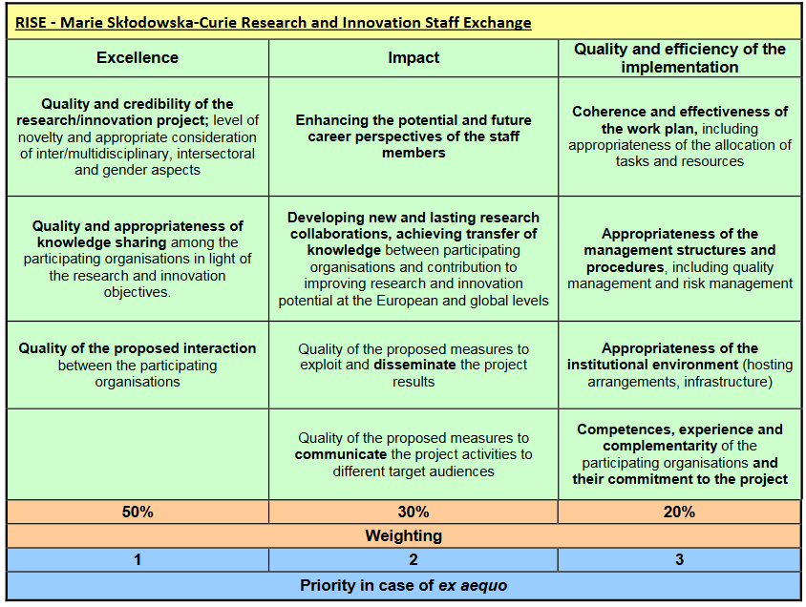

Slide 63
RISE 2019 Call
H2020-MSCA-RISE-2019
Opening 4 December 2018
Closure: 2 April 2019 (17:00:00 Brussels time)
Budget: € 80 Million
Results of the evaluation: 5 months after the call deadline
Signing of grant agreements: 8 months after the call deadline

Slide 64
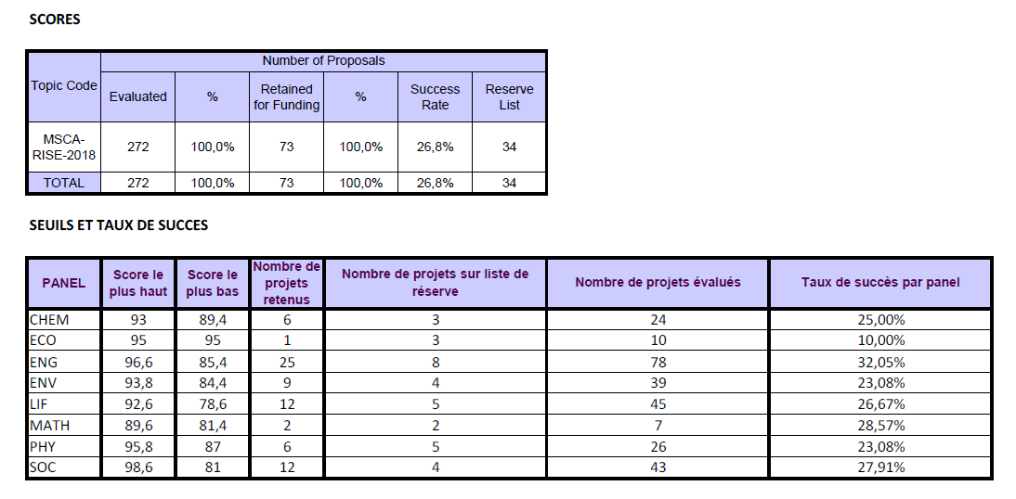
RISE 2018 Results

Slide 65
RISE 2016: A-list – Success rates
22,9% A list
Others | 25 | 14 | 85 | 43 | 33 | 8 | 27 | 47
A-list | 9 | 4 | 28 | 9 | 11 | 3 | 7 | 13

Slide 66
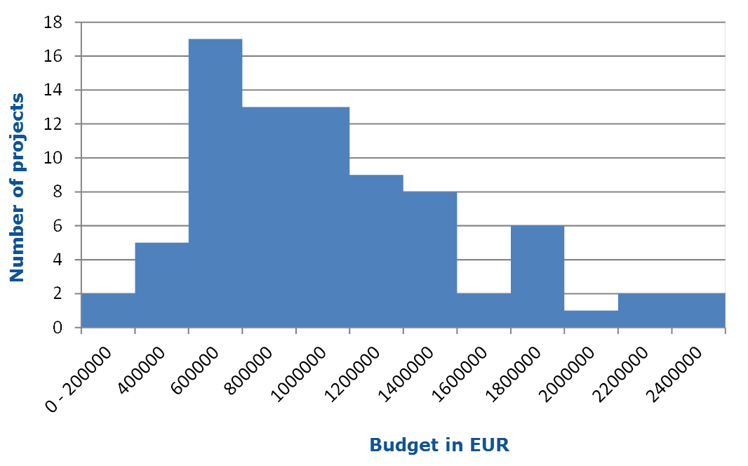
Size of projects - Budget

Slide 67
Secondment types in A-list proposals

Slide 68
COFUND

Slide 69
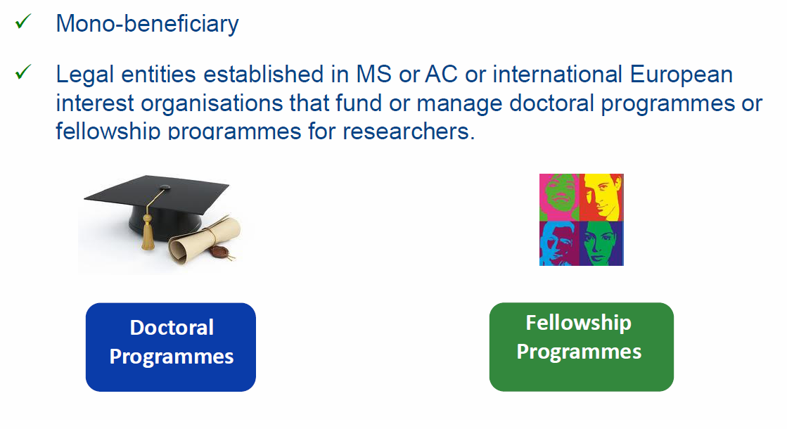
General aspects

Slide 70
Main features (1/4)
COFUND
Objectives
      to stimulate regional, national or international programmes to foster excellence in researchers' training, mobility and career development
    Scope
      Co-funding new or existing regional, national, and international programmes to open up to, and provide for, international, intersectoral and interdicisplinary research training, as well as transnational and cross-sector mobility of researchers at all stages of their career
      Possibilities of synergies with structural funds
      Doctoral Programmes (for ESR) and Fellowship Programmes (for ER)
      Researchers to comply with the mobility rules of the MSCA
      Minimum support for researchers: 3 months
      Implemented by a sole beneficiary
    Expected Impact
      to exploit synergies between European Union actions and those at regional, national, and international level, and leverage funding

Slide 71
Main features (2/4)
Budget
      € 80 Million in 2018 (€ 30 Million reserved for Doctoral Programmes)
      Maximum € 10 Million per single applicant per call
      EU contribution to cover living allowances for researchers and management costs
      50% co-funding for established unit costs
      Minimum living allowance established in the WP
Duration
      Minimum 3 years, maximum 5 years (including the time taken to publish call and recruit researchers)
      Fellowships: minimum 3 months

Slide 72
Main features (3/4)
Doctoral Programmes
      Training follows the EU Principles on Innovative Doctoral Training
      Collaboration with a wider set of partners, including from the non-academic sector, which may provide hosting or secondment opportunities or training
Fellowship Programmes
      Regular selection rounds following fixed deadlines or regular cut-off dates allowing a fair competition between applying researchers
      The selections should be based on open, widely advertised competition, with transparent international peer review and selection of candidates on merits.
      Mobility types may be similar to the ones supported under Marie Skłodowska-Curie.
      Limitations regarding the researchers' origin and destination should be avoided
      Proposed programmes are encouraged to cover all research disciplines

Slide 73
Main features (4/4)
      Each single application must only address the doctoral or fellowship programme, but
      More than one application can be submitted
      Recruited researcher must respect the same mobility rule as MSCA actions. Existing programmes can continue with own mobility rule if well-justified.
      Unless prohibited by national legislation, all fellows, including doctoral fellows, must be recruited on a work contract.
      In the doctoral programme, all fellows must be registered for a PhD

Slide 74
Budget : Unit Costs
Marie Skłodowska Curie Actions | Research unit cost [person/month]*** |  | Institutional unit cost [person/month]
COFUND | Early-stage researchers | 3 870 | 650
 | Experienced researchers | 5 480
*** These unit costs will be subject to a co-funding rate of 50%
The living and mobility allowances provided by the programmes for the benefit of the researchers
      Recruited under an employment contract shall in no case be lower than € 2 709 (ESR) and € 3 836 (ER)
      Recruited under a status equivalent to a fixed-amount fellowship shall in no case be lower than € 1 354,50 (ESR) and € 1 918 (ER)

Slide 75
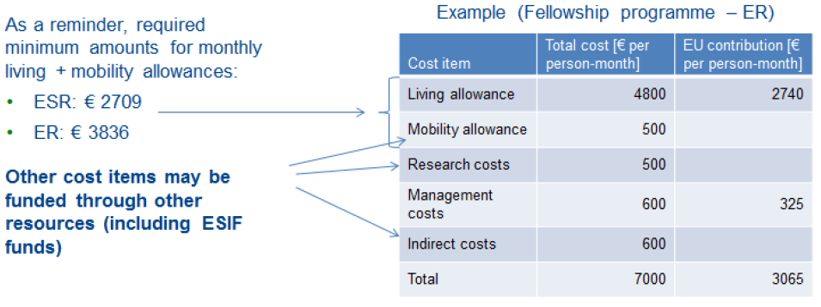
Budget : in practice
      EU contribution to living allowance for contracts with full social security:
        Early stage researcher (ESR): € 1 935 per person-month
        Experienced researchers (ER): € 2 740 per person-month
      EU contribution to management costs: € 325 per person-month

Slide 76
Call 2019
      Publication date: 04 April 2019
      Deadline: 26 September 2019 at 17.00.00 Brussels time
      35 M€ are allocated to Doctoral Programmes and 55 M€ to Fellowship Programmes
      Contribution has maximum overall of 10 M€ to a single applicant
      Duration: 36 to 60 months. This duration includes also the time that is needed to select or recruit the researchers
      Participants having benefited from COFUND under previous calls will explain how the latest proposal relates to and goes beyond the earlier grant and provide evidence for its quality

Slide 77
Submission of the proposal and
Evaluation

Slide 78
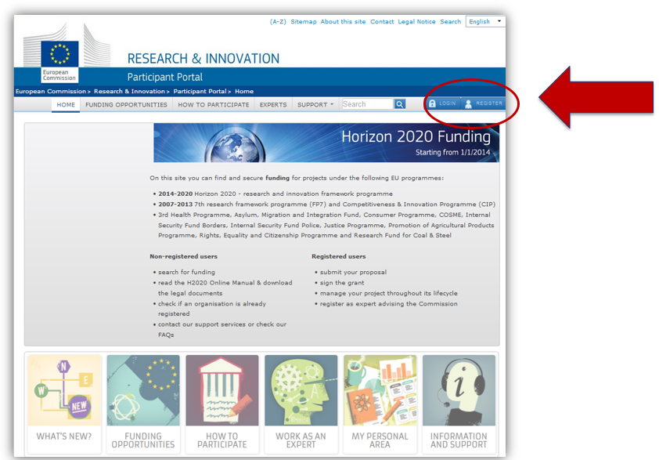
Participant portal

Slide 79
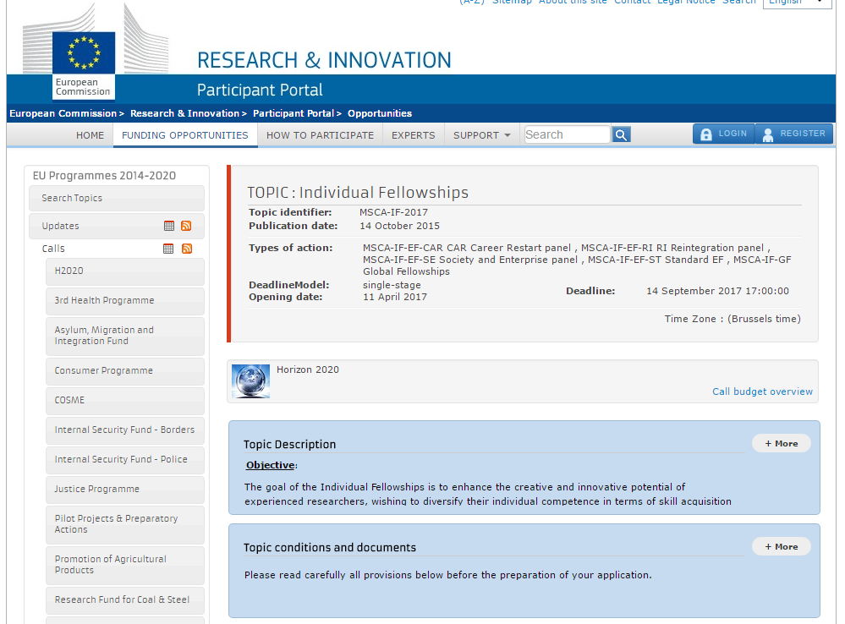
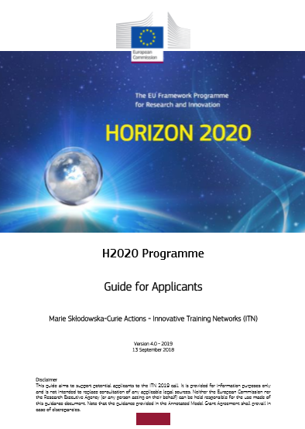
Where to find information ?
Participant Portal
Call pages
Guide for Applicants
Work Programme (2018-20)
FAQ
Descriptors

Slide 80
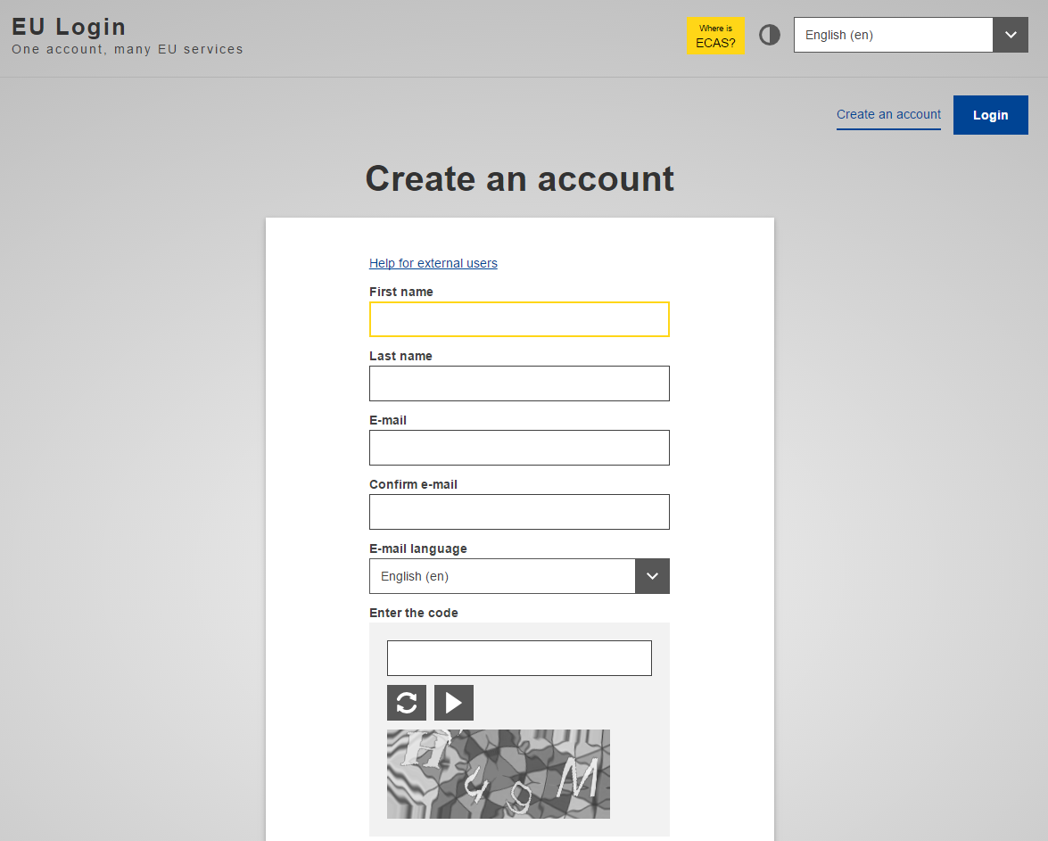
Authentication service
Ensure you have your EU Login account and the PIC number of the host institution (beneficiary)

Slide 81
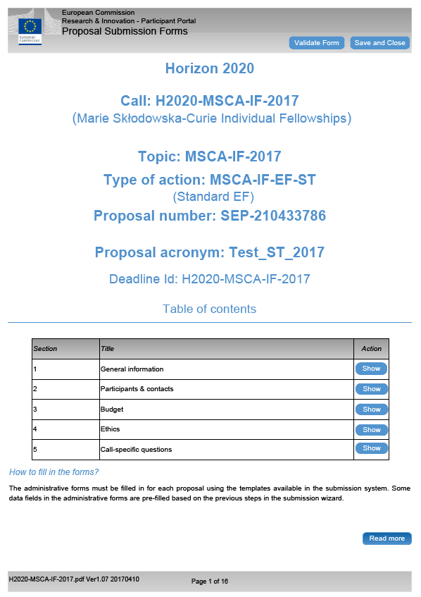
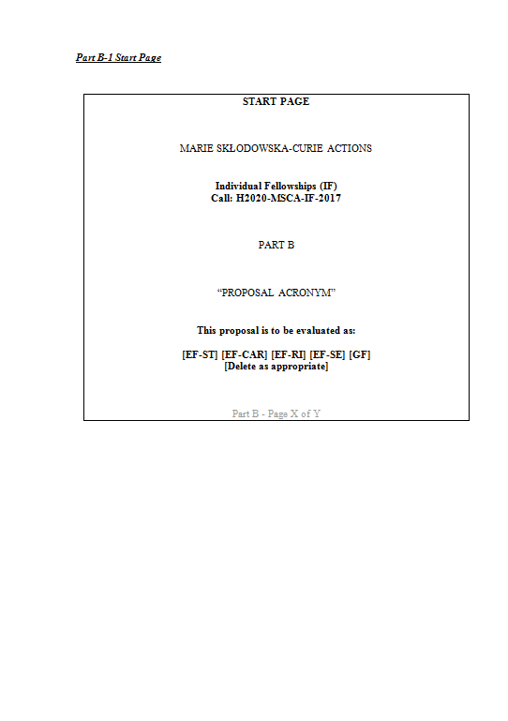
Structure of the proposal
Part A
- structured data -
Part B
- description of action -

Slide 82
Contact and useful information
The Europe grant office of the host institution
The National Contact Point : Advice; meetings, trainings but not proof-reading
      pcn-mariescurie@recherche.gouv.fr
Work programme 2018/2020
Guide for applicants and templates of the year of the call
European policies
EU principles
  (ex. EU principles for innovative training networks :
  http://ec.europa.eu/euraxess/pdf/research_policies/Principles_for_Innovative_Doctoral_Training.pdf)

Slide 83
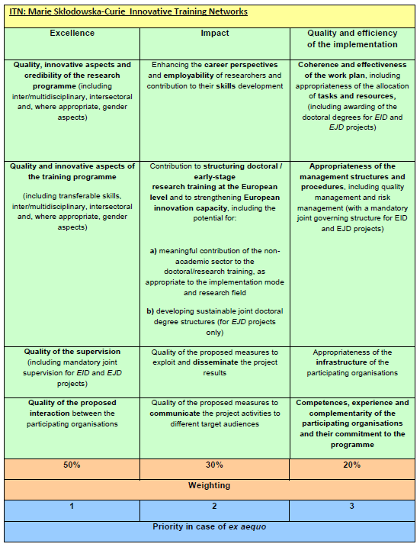
Evaluation criteria

Slide 84
Evaluation process
3 Individual Assessments
Consensus
Proposal A
Ranked list
Proposal B
B > A > C
Proposal C
Remote
Central
NEW : REMOTE CONSENSUS REPORT
➔ to reduce workload during Central week

Slide 85
Panels
      Proposals are allocated to one of the eight main evaluation panels:
        Chemistry (CHE)
        Social Sciences and Humanities (SOC)
        Economic Sciences (ECO)
        Information Science and Engineering (ENG)
        Environment and Geosciences (ENV)
        Life Sciences (LIF)
        Mathematics (MAT)
        Physics (PHY)
      In ITN, separate multidisciplinary panels will be created for EID and the EJD
      In IF, separate multidisciplinary panels will be created for the Career Restart Panel (CAR), the Reintegration Panel (RI), and the Society and Enterprise Panel (SE).
      COFUND evaluation will be organised in two different panels: Doctoral programmes and Fellowship programmes

Slide 86
Procedure
      For each panel a ranked list is established
      The distribution of the budget of the call will be proportional to the number of eligible proposals received in each panel, except where a specific budget for a multidisciplinary panel has been fixed in the call.
      Excess budget will be reallocated to the other panels
      Proposals will not be evaluated anonymously.
      A panel review will recommend one or more ranked lists for the proposals
      Priority order for proposals which have been awarded the same score
      If necessary, any further prioritisation will be based on other appropriate characteristics, to be decided by the panel

Slide 87
Award criteria : key features
Evaluation scores will be awarded for each of the criteria, not for their individual elements
Each criterion scored from 0 to 5 - decimal points will be given:
0 - The proposal fails to address the criterion under examination or cannot be judged due to missing or incomplete information
1 - Poor. The criterion is addressed in an inadequate manner, or there are serious inherent weaknesses.
2 - Fair. While the proposal broadly addresses the criterion, there are significant weaknesses.
3 - Good. The proposal addresses the criterion well, although improvements would be necessary.
4 - Very good. The proposal addresses the criterion very well, although certain improvements are still possible.
5 - Excellent. The proposal successfully addresses all relevant aspects of the criterion in question. Any shortcomings are minor.
Total score subject to a threshold of 70%

Slide 88
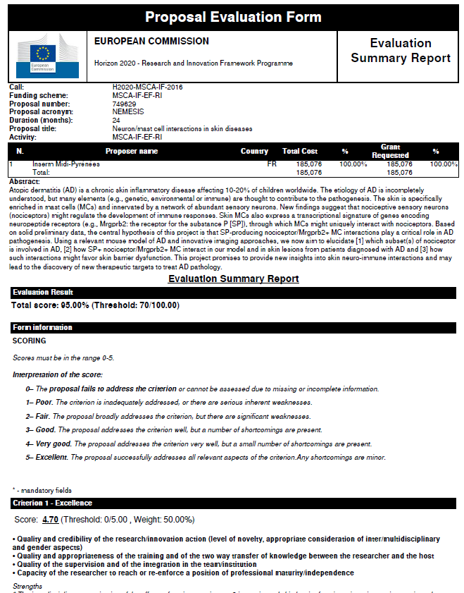
Evaluation summary report

Slide 89
Reminders
  Experts will evaluate proposals as submitted (not on its potential if certain changes were to be made)
  Proposals selected for funding are converted into description of work of the grant agreement.
  Commitment Letters and recommendation letters
  No reference to the outcome of previous evaluations in part B
  Ethics (part A and part B)

Slide 90
Recommendations

Slide 91
Recommendations : project
1 - Choose the right call, the right area, consult NCP (eligibility)
2 - Respect conditions (participants, full time, budget, etc.)
3 - Show European dimension (scale, populations, cooperation)
4 - Develop perspectives (synergies, future…)
5 - Choose the right duration of your project in line with the objectives
6 - Have a strong partnership (host/you), complementarity, time
7 - Plan research and Training
8 - Have a work programme : use Gantt chart
9 - Mention interdisciplinarity, intersectorality, gender
10 - Describe carefully the methodology (advantages/difficulties)
11 - State of the art should be accurate
12 - Choose a problem-solving approach
13 - Choose clear and measurable objectives
14 - Insist on the innovative part of your project

Slide 92
Recommendations : training
Integrate training about equipment, new tools, new software
Take part in internal seminars, workshops, summer schools, …
Participate to dissemination of scientific culture
How to answer research calls
Financial training + management
Complementarity skills
(communication, Intellectual property, management…)
Inter-sectoral (public/private) relation, employability
Launch new collaborations

Slide 93
Recommendations : host institutions
Choose a well known laboratories, with a good reputation, and their complementarity
Choose a well known supervisors
Choose institutions with a high level of quality
Underline the main achievement of the institutions : patents, publications, number of PhD, contracts, international projects…
Describe carefully the infrastructure/equipment…

Slide 94
Recommendations : implementation
Describe responsibilities (who do what)
Anticipate resolution of conflicts, organise communication (meetings)
Describe the risks
Resources : environment, infrastructures
Describe host institution (library, equipment…)
Describe type of contract (justify stipend)

Slide 95
Recommendations : impact
Interest of your mobility (IF projects) for you, for the lab, etc.
Describe synergies (societal challenges)
Describe the European “added value”
Link your research with European policies : (ex: green papers, recommendations…)
Propose outreach activities with details
Propose links with students, with medias

Slide 96
Recommendations : writing
Respect the number of pages
Write in English and in good English (concision, accuracy)
Take care of the format : separations, tables, bold…)
Avoid redundancies
Give easy access to the information (numbers, tables, references…)
Read all documents : guides, guidelines for evaluators…
Write with the help of the supervisor and host institution (IF projects)
Take time for Abstract and keywords
Think as if you were the evaluator
Evaluators are from all over Europe and beyond
Forget national codes)
Take care of the criteria, weighting, threshold, success rates…
Give your proposal to read
Find an accepted project

Slide 97
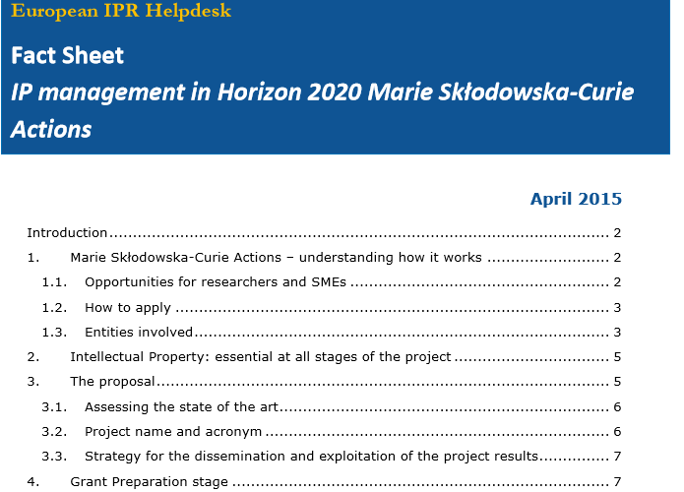
IP Issues
  Présentation des services de l’IPR Helpdesk
  La propriété intellectuelle dans Horizon 2020
  Conseiller les porteurs de projet sur la propriété intellectuelle
IPR Helpdesk
Fact sheet

Slide 98


Human resources strategy for researcher
HRS4R

Slide 99
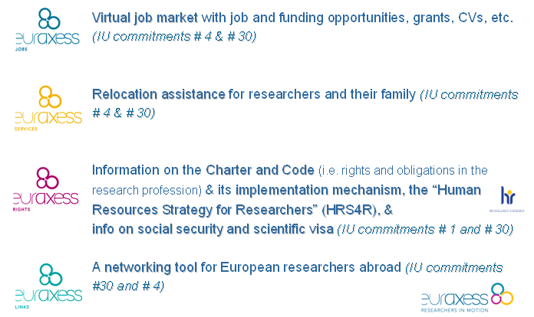
EURAXESS
Website

Slide 100
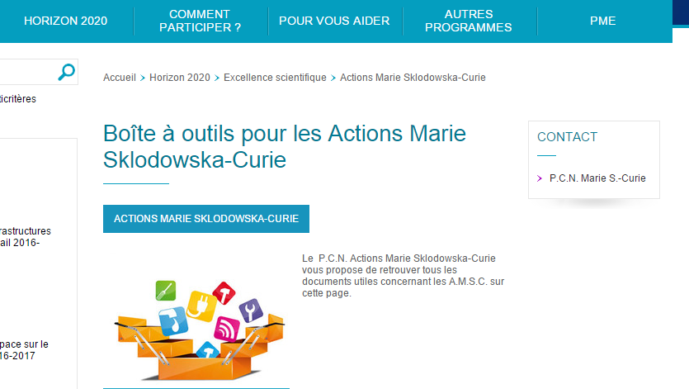
http://www.horizon2020.gouv.fr/cid79134/boite-outils-pour-les-actions-marie-sklodowska-curie.html

Slide 101
National Contact Point : pcn.mariescurie@recherche.gouv.fr
Sandrine Schott-Carrière – Université de Strasbourg
Martine Roussel – RCP – MESRI
Sophie Beaubron – Université Grenoble Alpes
Jean Jacques Bernadini – Grand E-nov
Morgane Bureau – INSERM
Meryl Airault – CNRS
Jean Marie Pincemin – Université de Poitiers
Cyrielle Tirman – Université d’Artois

Slide 102

pcn-mariescurie@recherche.gouv.fr

