Slide 1
Horizon 2020
Marie Skłodowska-Curie Actions

Slide 2
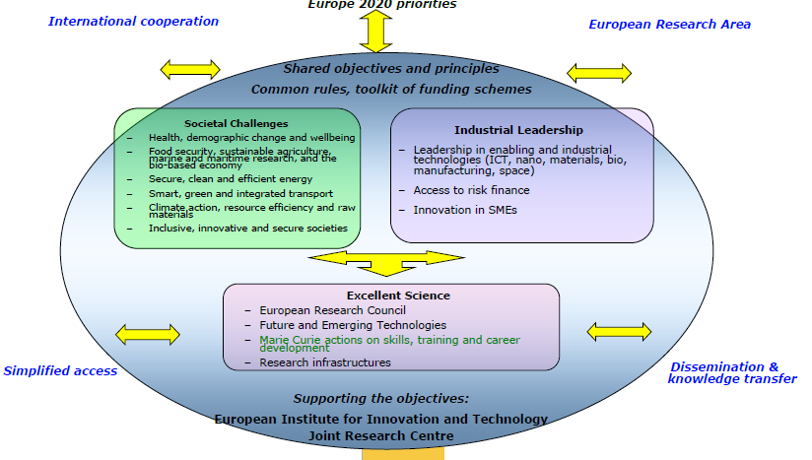
Horizon 2020

Slide 3

Objectives
  new skills, knowledge and innovation
  Fostering new skills through excellence in initial training of researchers
  Nurturing excellence through cross-border and cross-sector mobility
  Stimulating innovation through cross-fertilisation of knowledge
  Increasing structural impact by co-funding activities
  Specific support and policy action

Slide 4
Strategic programming approach
    Attract and retain research talent
    Develop state-of-the-art, innovative training schemes, consistent with the highly competitive and increasingly inter-disciplinary requirements of research and innovation
    Promote sustainable career development in research and innovation
    Focus on delivering new knowledge and skills, in line with the key driver identified in the strategic programming approach
    Contribute to a strong partnership with MS via the co-funding mechanism

Slide 5
Key features of the MSCA part
    Open to all domains of research and innovation from basic research up to market take-up and innovation services
    Entirely bottom-up
    Participation of non-academic sector strongly encouraged, especially industry and SMEs
    Mobility as the key requirement - funding on condition participants move from one country to another
    Promotion of attractive working and employment conditions
    Particular attention to gender balance
    Budget 2014/2020 : 6 162 million €

Slide 6
FP7 MCA Achievements
    ~ 80 000 researchers financed since creation of MCA
    > 10 000 PhD supported in FP7
    ~ 9 200 projects funded so far in FP7 (€4.2 billion)
    ~ 17 800 participations of host organisations in 83 countries (46 TC)
    ~ 18 500 participations of MCA researchers coming from all over the world: 130 nationalities (90 TC)
    66 000 researcher-months exchanged (~22 000 individuals) in IRSES
    SMEs play a major role (IAPP & ITN)
    38% women participation in FP7 MCA (target: 40%)

Slide 7
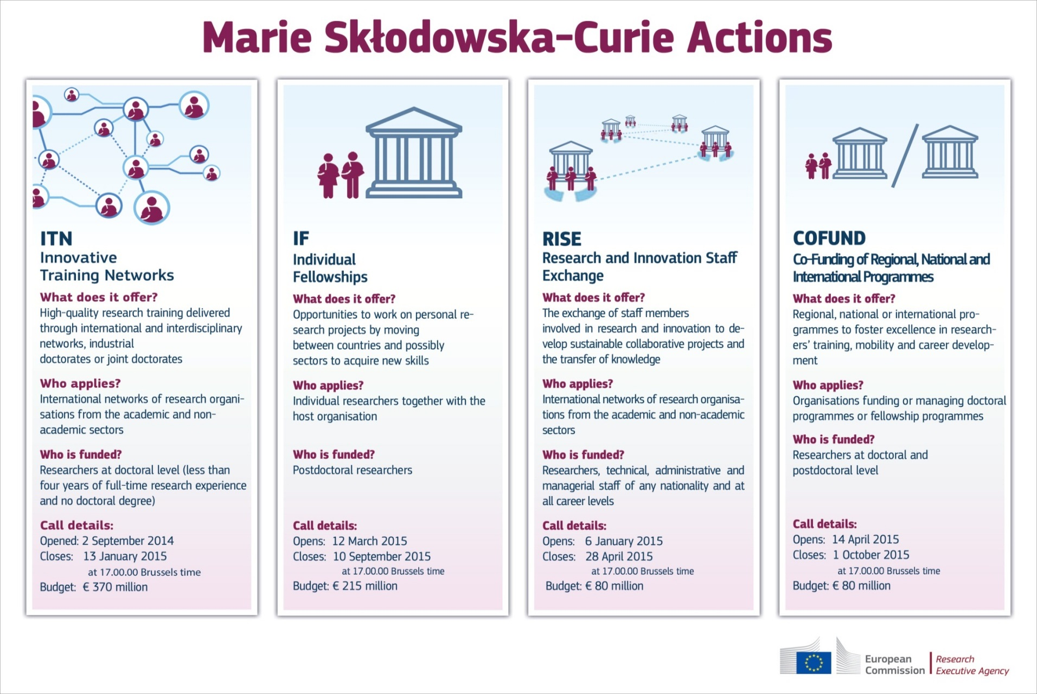

Slide 8
Mobility Rules
    At the time of the relevant deadline for submission of proposals (IF), or recruitment by the host organisation (ITN), researchers shall not have resided or carried out their main activity in the country of their host organisation for more than 12 months in the 3 years immediately prior to the reference date
    Compulsory national service and/or short stays such as holidays are not taken into account
    Career Restart Panel and the Reintegration Panel in IF: researchers shall not have resided or carried out their main activity in the country of their host organisation for more than 3 years in the 5 years immediately prior to the relevant deadline for submission of proposals

Slide 9
Researchers
Early Stage Researchers
    Shall at the time of recruitment (ITN, COFUND) or secondment (RISE), be in the first four years (full-time equivalent) of their research careers and have not yet been awarded a doctoral degree
Experienced Researchers
    Shall, at the time of the relevant deadline for submission of proposals (IF), recruitment (COFUND) or secondment (RISE), be in possession of a doctoral degree or have at least four years of full-time equivalent research experience
Nationality, residence
    Global fellowships and Reintegration panel in IF are open to nationals or long-term residents of EU Member States and Associated Countries.
    Long-term residence means a period of full-time research activity of at least 5 consecutive years

Slide 10

ITN : Innovative Training Networks

Slide 11

Innovative Training Networks
Support for early-stage/doctoral
research training through:
  European Training Networks (ETN)
  European Industrial Doctorates (EID)
  European Joint Doctorates (EJD)

Slide 12


ITN Objectives
Train innovative early-stage researchers
Excellence in doctoral/early-stage research training
Provide skills to match public and private sector needs
ITN Expected impact
Improved career perspectives of researchers
Structured high-quality research / doctoral training
Collaboration academia with non-academic sectors

Slide 13

  ITN Features (1)
Excellence: International network of organisations applies and proposes a joint research training or doctoral programme
Bottom-up (no pre-defined topics)
All domains*: CHE, ECO, ENG, ENV, LIF, MAT, PHY, SOC
Multidisciplinary approach
Meaningful exposure to non-academic sector
*: except areas of research covered by the EURATOM Treaty

Slide 14

  ITN Features (2)
Strong networking within the consortium
Mobility across countries /disciplines
Career guidance arrangements
Supervisory Board
Project duration typically 48 months
  only for Early Stage Researchers

Slide 15



ITN typical activities
Core activity: Training through individual research projects
Network-wide training activities
(e.g. seminars, workshops, summer schools).
Training in key transferable skills
(e.g. entrepreneurship, management, IPR, communication, ethics, grant writing).
Collaboration and exchange of knowledge within the network
Communication & Dissemination
Public engagement

Slide 16
Who applies?
International networks of organisations
actively involved in research/doctoral training
Two categories of organisations
Academic sector
public /private higher education establishments
awarding academic degrees
public /private non-profit research organisations
whose primary mission is to pursue research
international European interest organisations (e.g. CERN, EMBL)
Non-academic sector
any entity not included in the academic sector:
e.g. large companies, SMEs, NGOs, museums, hospitals
international organisations (e.g. UN, WHO)
Standardised legal validation of entities is applied
to determine the domain of each participant

Slide 17



Which roles?
Partner Organisation
Beneficiary vs.
Signs Grant Agreement
Recruits and Hosts Researchers
Trains/Hosts Researchers on secondment
Participates in Supervisory Board
Directly Claims Costs
EU funding

Slide 18

Who can be recruited?
Researcher-months requested in proposal
Recruitment after the project starts.
Only Early-Stage Researchers (ESRs):
≤ 4 years of research experience
no PhD yet
Recruitment:
3 to 36 months (typical)
Mandatory trans-national mobility at the time of recruitment.

Slide 19
ITN three implementation modes
ETN
EID
EJD
European
Training
Networks
European
Industrial
Doctorates
European
Joint
Doctorates
Participants implement
a joint research programme
Doctoral programme with the non-academic sector
Doctoral programme to deliver joint degrees
317 M€
25 M€
28 M€
Research fields chosen freely by applicants
(CHE, ECO, ENG, ENV, LIF, MAT, PHY, SOC)

Slide 20
Eligibility rules?
EU 28 Member States (MS)
Associated Countries (AC)
Other Third Countries (OTC)
ETN
Min. 3 beneficiaries from any sector
from 3 different MS/AC
EID
Min. 2 beneficiaries from 2 different MS/AC:
min. 1 from academic sector awarding PhD
+ min. 1 from non-academic sector
EJD
Min. 3 beneficiaries
from academic sector awarding PhD
from 3 different MS/AC
Above this minimum: participants from any sector / country

Slide 21



Funding for IO/TC beneficiaries?
International organisations (e.g. United Nations) and organisations in those Third Countries not listed in the general annex to the MSCA Work Programme 2014-2015 may receive funding only in exceptional cases:
essential to the action
endorsed by evaluators
Example of countries: Australia, Brazil, Canada, China, India, Japan, Mexico, New Zealand, Republic of Korea, Russia, United States…
The case of Switzerland
In such a case
the evaluators
state whether
funding by EU is
recommended
or not

Slide 22
European Training Networks (ETN)

Slide 23
ETN
Participants implement a joint research training programme
Mandatory
Min. 3 beneficiaries from 3 different MS/AC
Each beneficiary recruits and hosts at least 1 ESR
Max 540 person-months (e.g. 15 ESRs x 36 months)
Other features
Non-academic participation essential
PhD enrolment typically expected (not mandatory)
Secondments to other countries/sector/disciplines (≤30% time)
Joint supervision recommended
Partner organisations (any country/sector)

Slide 24







ETN
Participants implement a joint research training programme
Beneficiaries
Partner organisations

Slide 25
European Industrial Doctorates (EID)

Slide 26
EID
Doctoral training with the
non-academic sector
Min. 2 organisations from 2 different EU/ associated countries
1 academic awarding PhD + 1 non-academic
Max 180 person-months (if 2 organisations) - e.g. 5 x 36 months
Max 540 person-months (if ≥3 organisations) - e.g. 15 x 36 months
Individual research projects under the topic of the doctoral programme
Flexible recruitment rule
Each fellow enrolled in the doctoral programme
Each fellow must spend ≥50% of time in non-academic sector
Secondments above 50% rule (up to 30% of time)
Partner organisations (any country/sector)

Slide 27





EID
Doctoral training with the
non-academic sector
≥ 50% time for each ESR
Beneficiaries
Partner organisations
non-academic sector
2 beneficiaries : max 180 PM

Slide 28

EID
Doctoral training with the
non-academic sector
≥ 50% time for each ESR
Beneficiaries
Partner organisations
non-academic sector
≥3 beneficiaries: max 540 PM

Slide 29
European Joint Doctorates (EJD)

Slide 30
EJD
Universities cooperating to deliver joint/multiple doctoral degrees
Mandatory
Min. 3 beneficiaries from academic sector awarding PhDs, from 3 different MS/AC
Each ESR enrolled in the joint (international) doctoral programme
Joint selection, training and supervision
Commitment to deliver joint/double/multi degrees
Max 540 person-months
Other features
Meaningful stays at joint doctorate beneficiaries
Non-academic participation through secondments to other sector/disciplines (≤ 30%)
Flexible recruitment rule

Slide 31


EJD
Joint degree: single diploma issued by at least 2 academic institutions, and recognised officially
Joint PhD
Double/multiple degree: 2 or more separate national diplomas issued by two or more higher education institutions and recognised officially
+
Letters of institutional commitment to deliver degrees are required in the proposal

Slide 32


EJD
Joint PhD
Joint PhD
Joint PhD
Beneficiaries
Partner Organisations

Slide 33
 | ETN | EID | EJD
Beneficiaries | ≥3 from 3 diff. MS/AC Any type | ≥2 from 2 diff. MS/AC: (≥1 acad. award. PhD + ≥1 non-academic) | ≥3 (acad. award PhD) from 3 diff. MS/AC
Person-months | Max. 540 | Max. 180 / 540 | Max. 540
Researchers | ESRs only (3-36 months)
Partner Organ. | Not pre-defined (any country / sector / discipline)
PhD enrolment | typically expected | mandatory | mandatory
Non-academic participation | essential | mandatory | essential
Inter-sectoral exposure | possible through secondments | ≥50% in non-academic | possible through secondments
Panels and rank lists | 8 panels: CHE, ECO, ENG, ENV, LIF, MAT, PHY, SOC (317 M€) | EID panel (25 M€) | EJD panel (28 M€)

Slide 34
Innovative Training Networks (ITN)
Unit costs/1 researcher month:
Marie Skłodowska Curie Actions | Researcher unit cost [person/month] |  |  | Institutional unit cost [person/month]
 | Living allowance | Mobility allowance | Family Allowance | Research, training and networking costs | Management and indirect costs
Innovative Training Networks | 3 110 | 600 | 500 | 1 800 | 1 200
Country correction coefficient applies to the living allowance
Researcher allowances include employer contributions.
Researcher allowances are a minimum to be paid (top-up funds from other sources permitted).

Slide 35
ITN 2015: Open call
H2020-MSCA-ITN-2015
Opened 02 September 2015
Closure: 13 January 2015 (17:00:00 Brussels time)
Budget: € 370 Million (ETN: 317 M€, EID: 25 M€; EJD: 28 M€)
Results of the evaluation: 5 months after the call deadline
Signing of grant agreements: 8 months after the call deadline

Slide 36

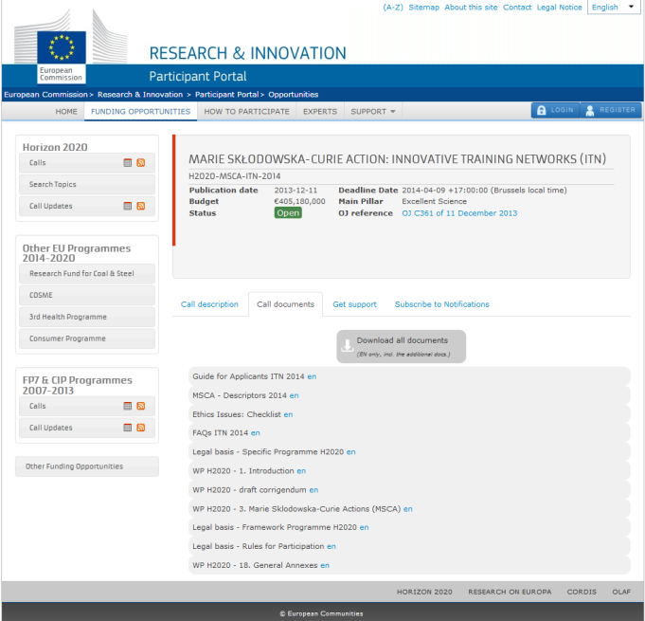
Where to find information?
Participant Portal
ITN 2015 Call page
Guide for Applicants 2015
Work Programme (2014-15)
Call updates (e.g. Switzerland)
http://ec.europa.eu/research/participants/portal/desktop/en/opportunities/h2020/calls/h2020-msca-itn-2015.html

Slide 37
French Participation

Slide 38
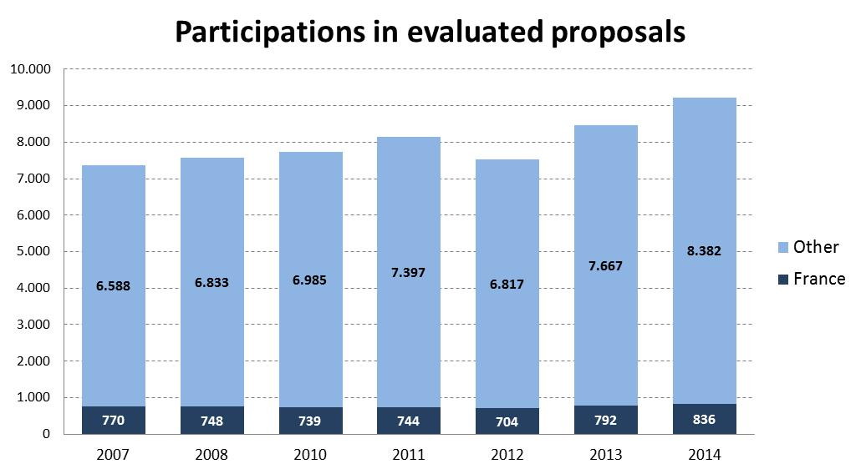

Slide 39
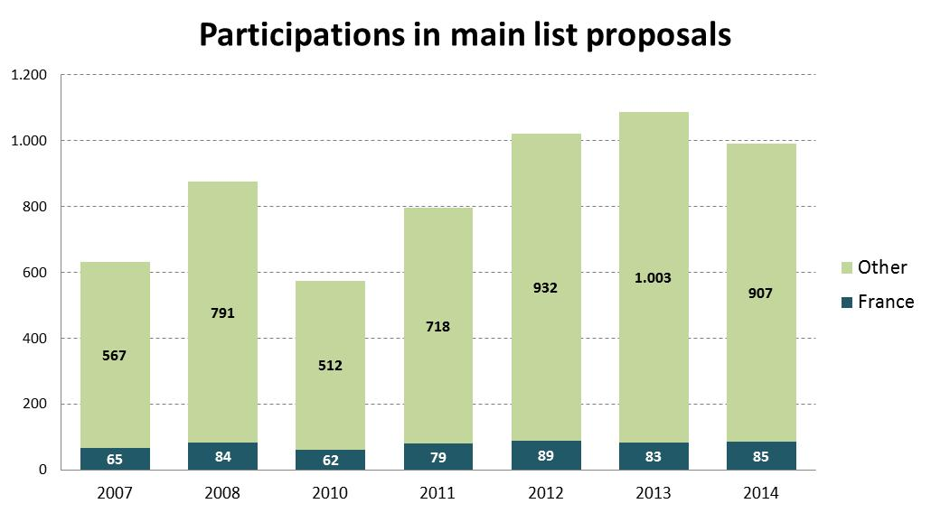

Slide 40
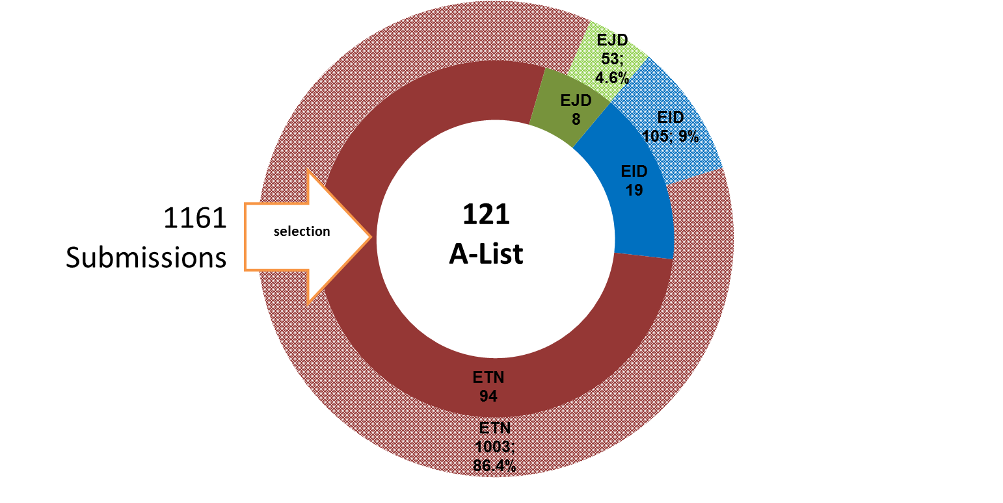
ITN 2014: submitted and A-list proposals
selection

Slide 41
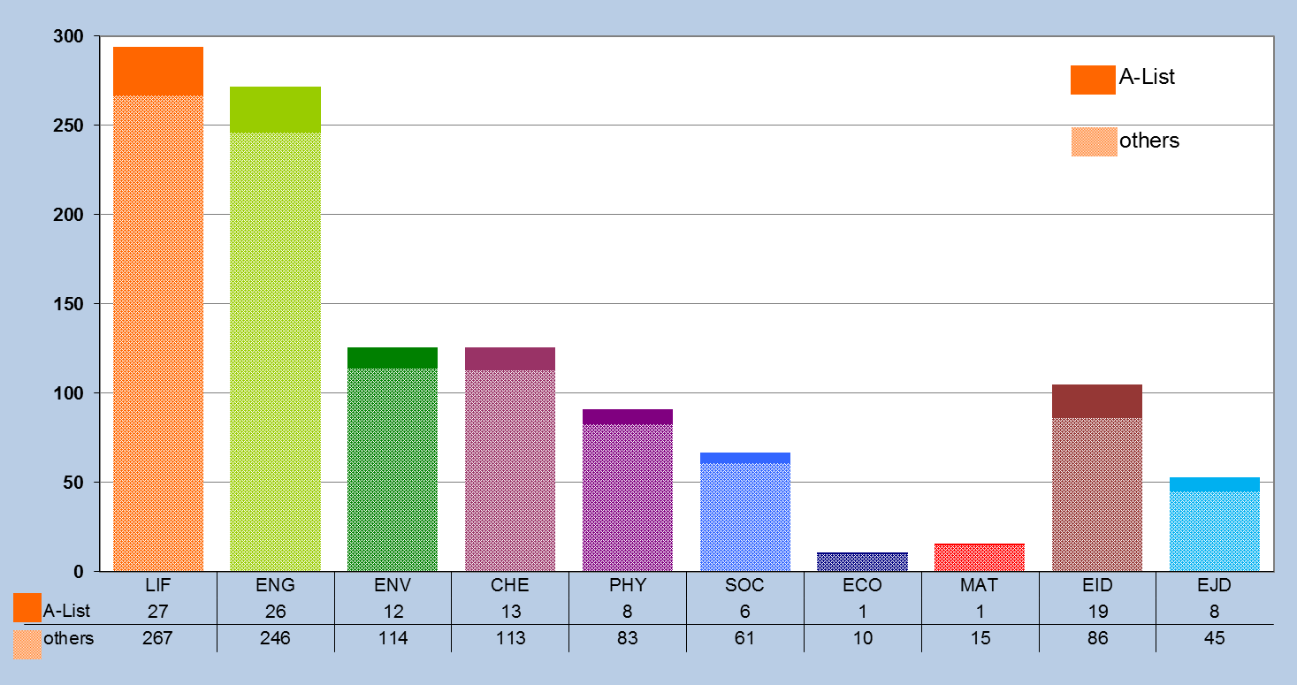
ITN 2014: eligible and A-list proposals by panel

Slide 42
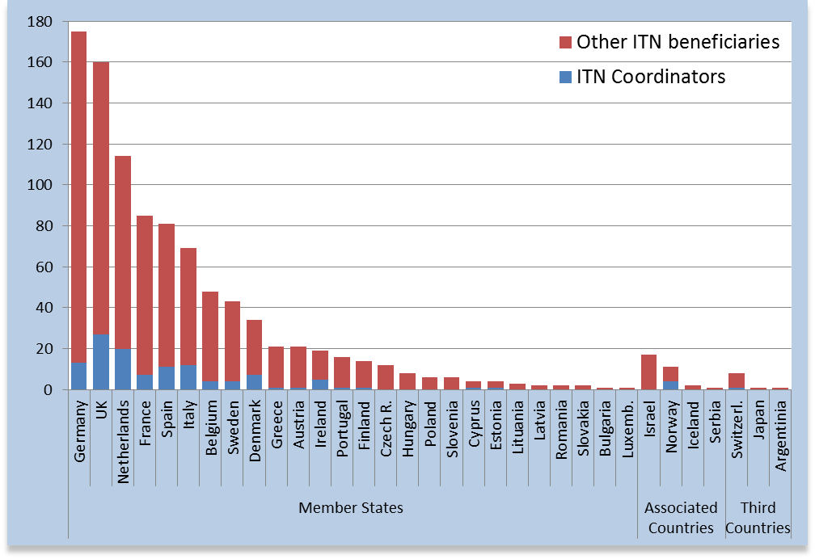
ITN 2014: Number of beneficiaries in A-list & Role

Slide 43
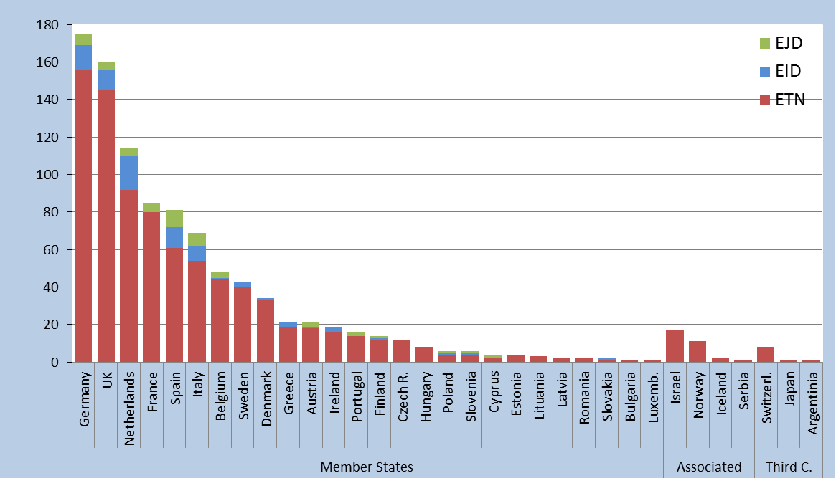
ITN 2014: Number of beneficiaries in A-list & Mode

Slide 44
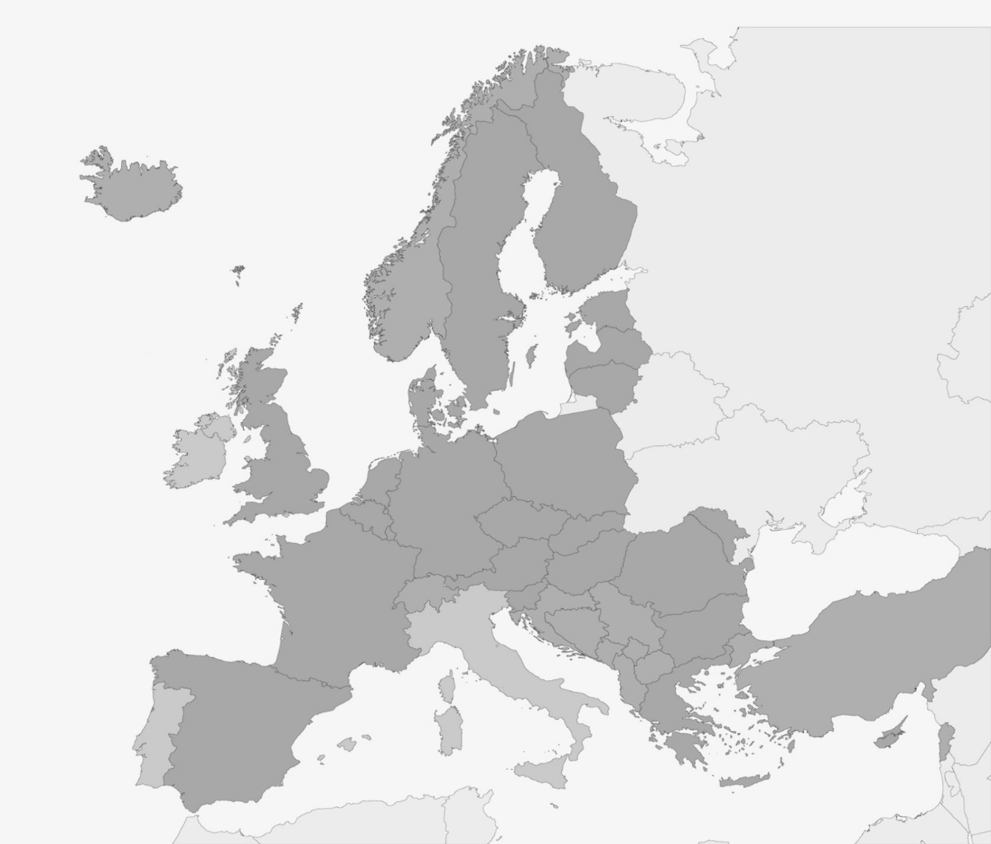
ITN 2014: European Joint Doctorate
Programmes in Europe
Environment
Life
Physics
Engineering
Chemistry
Chemistry
Physics
Engineering

Slide 45
RISE
Research and Innovation Staff Exchange

Slide 46
Scope: RISE
- Promote international and inter-sector collaboration through research and innovation staff exchanges
- Sharing of knowledge and ideas for the advancement of science and the development of innovation.
- Support is provided for the development of partnerships (e.g. joint research and innovation activities)
- Bottom-up approach: set of clear research and innovation objectives and deliverables.

Slide 47
General Aspects
- All Countries can participate in RISE
- All nationalities can participate in RISE
- All institutions fulfilling the requirements of the Horizon 2020 Rules for Participation can participate in RISE
- No mobility rules* for RISE

Slide 48
Project Main Aspects
- Project built on joint research and innovation activities
- Project implemented through the secondment of staff (no recruitments)
- Each staff member seconded for a period of 1 to 12 months
- The maximum size for a project is 540 person months
- No minimum size explicitly defined for the
project, but substantial impact is expected
- Maximum project duration is 4 years

Slide 49
Participants in RISE
- Beneficiaries
  Sign the Grant Agreement and claim costs
  Are responsible for the execution of the programme
  Are established in a MS/AC
- Partner Organisations
  Do not sign the Grant Agreement and do not claim costs
  Must include a letter of commitment in the proposal
  Are established in a TC

Slide 50
Sectors
The sector of an organisation is defined automatically
- Academic Sector
  Higher education establishments (public or private)
  Non-profit research organisations (public or private)
  International European interest organisations
- Non-Academic Sector
  Any socio-economic actor not included in the academic
  sector and fulfilling the requirements of the Horizon 2020
  Rules for Participation (SMEs, multinationals, NGOs, ...)

Slide 51
Staff Members
- Actively engaged in or linked to research/innovation activities for at least 6 months prior to first secondment
- Types of staff members:
ESR (no PhD and < 4 years experience)
ER (PhD or > 4 years experience)
Managerial staff
Administrative or Technical staff
- In-built return mechanism

Slide 52
Minimum
Eligibility Conditions
- At least 3 independent participants in 3 different countries
- At least 2 participants from 2 different MS/AC
- If all in MS/AC: at least 1 academic and 1 non-academic
In practice, 2 possible minimum settings:
MS/AC 1
+
MS/AC 2
+
TC
or
MS/AC 1
+
MS/AC 2
+
MS/AC 3
Academic
Non-Academic

Slide 53
Eligible Secondments 1
Intra-European Exchanges
Country
MS/AC 1
MS/AC 2
MS/AC 3
Sector
Academic
A
Same sector
C
X
X
Same
Country
Non-Academic
B
X
D
Same sector

Slide 54



Eligible Secondments 2
Europe-Third Countries Exchanges
Country
MS/AC 1
MS/AC 2
TC
!
Sector
is not
relevant
A
C
Secondments from a TC to a MS/AC are not always eligible for EU funding but all of them must be described in the proposal.
X
Same or
Different
Third
Country
B
D

Slide 55
Secondments
Secondments that must be described in the proposal:
MS/AC 1
Academic
MS/AC 2
Non-Academic
Eligible for EU Funding
MS/AC
TC
Eligible for EU Funding
TC
MS/AC
Eligibility for EU funding depends on the TC
Secondments that must not be described in the proposal:
All other possibilities, such as:
MS/AC 1
Academic
MS/AC 2
Academic
MS/AC 1
Non-Academic
MS/AC 2
Non-Academic
MS/AC 1
MS/AC 1
TC
TC

Slide 56
Countries Eligible
For EU Funding
- EU Member States
- Overseas Countries and Territories linked to the MS
(As defined on page 3 of General Annex A to the Horizon 2020 Work Programme 2014-2015)
- Horizon 2020 Associated Countries
(In principle, the same as FP7, but subject to the adoption of the association agreements)
- The Third Countries listed
(On page 3 of General Annex A to the Horizon 2020 Work Programme 2014-2015)

Slide 57
Countries Not Eligible
For EU Funding
Countries not listed previously are not eligible for EU funding
In practice, those countries are mainly: Australia, Brazil, Canada, China, India, Japan, Mexico, New Zealand, Republic of Korea, Russia, United States.
In very exceptional cases, partners from those countries might be funded. But the following conditions have to be fulfilled:
  a) This partner has competences/expertise that no organisation in MS/AC has
  b) The relevant transfer of knowledge can only be done via a secondment in the direction TC MS/AC
  c) Points a) and b) must be endorsed by the expert evaluators

Slide 58
EU Contribution
Unit costs per researcher per month
For secondments eligible for funding
Marie Skłodowska-Curie Action | Staff member unit cost * person/month Top-up allowance | Institutional unit cost * person/month
 |  | Research, training and networking costs | Management and indirect costs
Research and Innovation Staff Exchange | 2 000 | 1 800 | 700
*These unit costs are subject to a funding rate of 100% and no country coefficients apply.

Slide 59

Evaluation
Evaluation Panels:
- Chemistry (CHE)
- Social Sciences and Humanities (SOC)
- Economic Sciences (ECO)
- Information Science and Engineering (ENG)
- Environment and Geosciences (ENV)
- Life Sciences (LIF)
- Mathematics (MAT)
- Physics (PHY)
Evaluation Criteria:
- Award Criteria
- Selection Criteria

Slide 60
Selection Criteria
- Operational capacity has to be checked
- Proposals must include a description of:
The profile of the people who will be primarily responsible for carrying out the proposed work
Any significant infrastructure or major items of technical equipment, relevant to the proposed work
Any partner organisations (not beneficiaries) contributing towards the proposed work

Slide 61
Proposal Part A
- Section 1: General information (including abstract)
- Section 2: Information on participants
- Section 3: Budget and Secondments tables
- Section 4: Ethics table

Slide 62
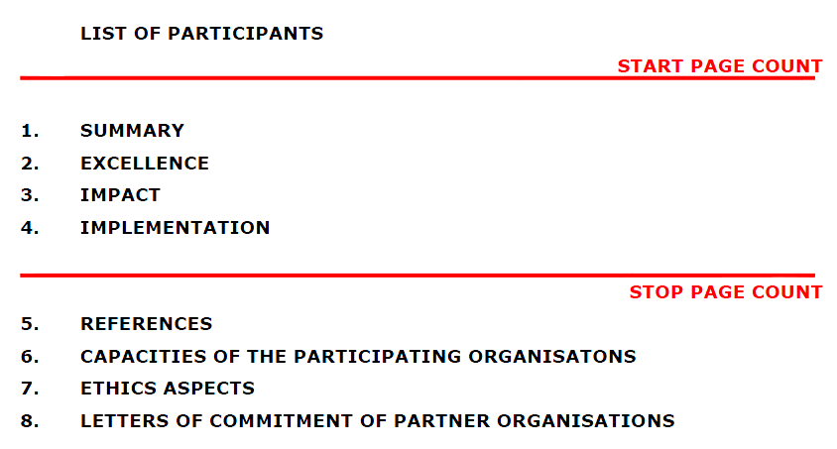
Proposal Part B
(including data for non-academic beneficiaries)
30 pages limit

Slide 63
Next RISE Call
Next call: - H2020-MSCA-RISE-2015
- Opens 06 January 2015
- Deadline: 28 April 2015
- Budget: € 80 Million
Results of the evaluation: 5 months after the call deadline
Signing of grant agreements: 8 months after the call deadline

Slide 64
RISE 2014
RISE 2014: Submitted & A-list proposals
The success rate of Academic and non-Academic is equal !

Slide 65
RISE 2014
RISE 2014: Submitted and A-list proposals by panel
Notes:
CHE ECO ENG ENV LIF MAT PHY SOC Total
others 22 12 59 24 33 4 25 21 200
A-List 11 4 24 11 15 1 8 10 84
Success rate 50,0% 33,3% 40,7% 45,8% 45,5% 25,0% 32,0% 47,6% 42,0%

Slide 66
IF : Individual Fellowships

Slide 67
Individual Fellowships (IF)
Objective
      to enhance the creative and innovative potential of experienced researchers
      to provide opportunities to acquire new knowledge, resume a career or return to Europe
      the beneficiary shall be a participant established in EU (MS/AC) and employing the researcher during the project
    Scope
      Trans-national fellowships awarded to the best or most promising researchers
      European Fellowships (12-24 months) or Global Fellowships (12-24 months + mandatory return phase of 12 months)
      Career Restart Panel and Reintegration Panel
      Secondments, notably in the non-academic sector
    Expected Impact
      to release the full potential of researchers and development of their careers in both the academic and non-academic sectors

Slide 68
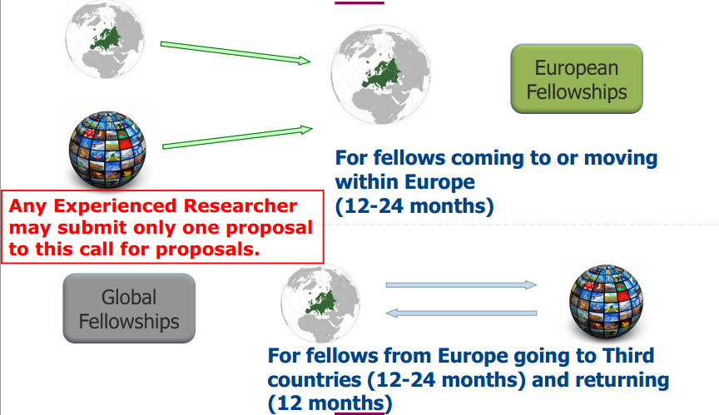

Slide 69
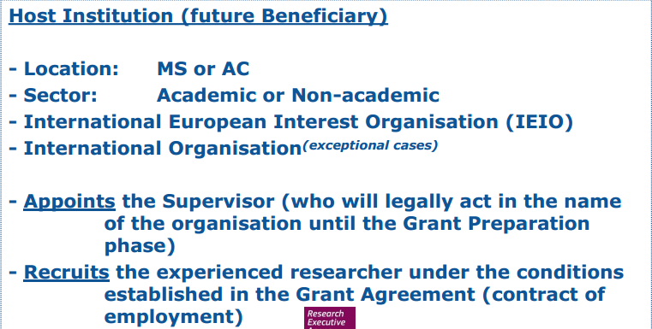
One (experienced researcher) applies jointly with one host institution located in a MS or AC for a reserach project that can last between 12 and 24 months
European Fellowships (EF)

Slide 70
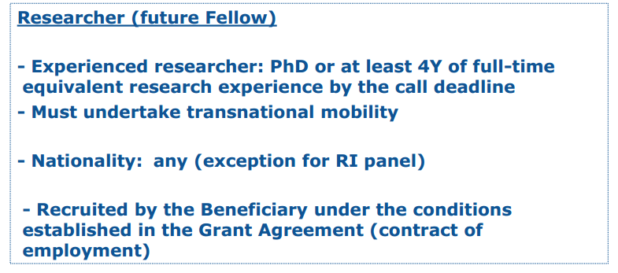
European Fellowships (EF)

Slide 71
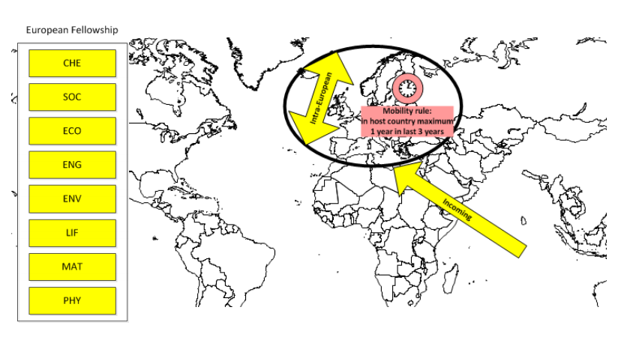
Standard
European fellowship

Slide 72
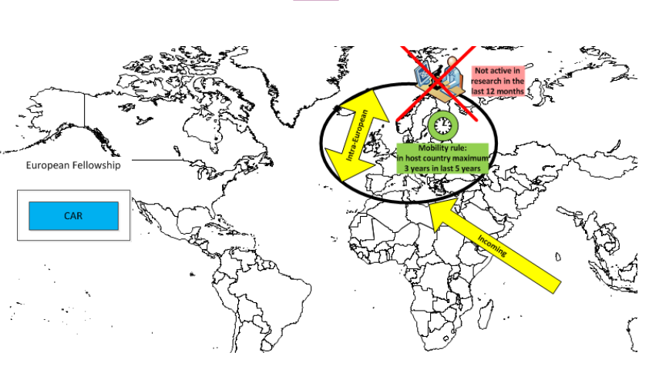
Career

Slide 73
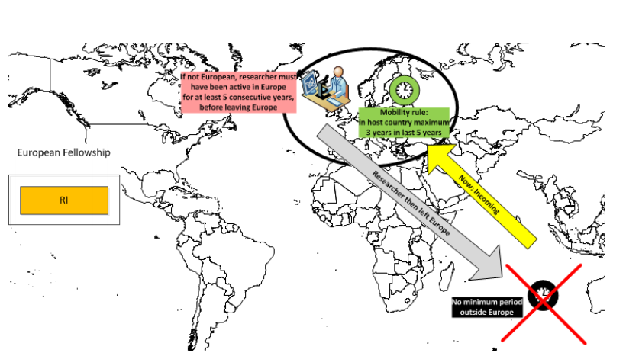
Reintegration

Slide 74
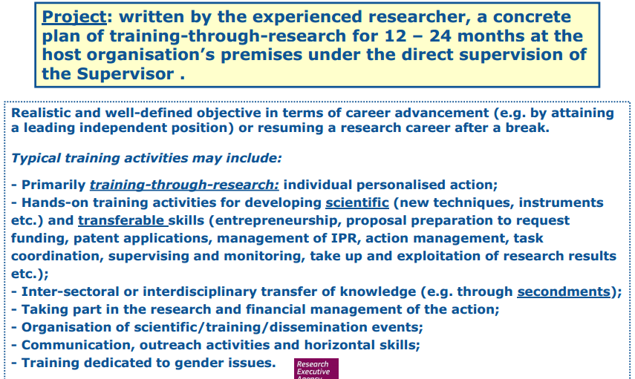
Project

Slide 75
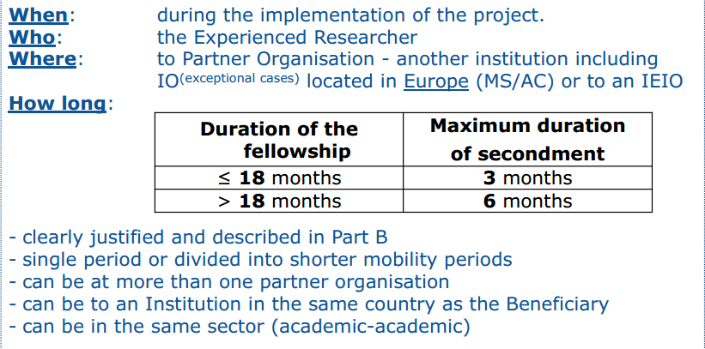
Secondments

Slide 76
Global Fellowships

Slide 77
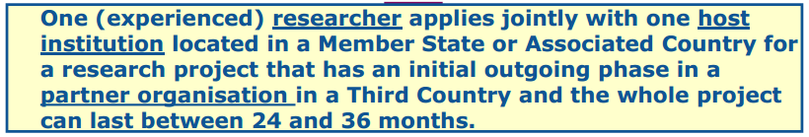
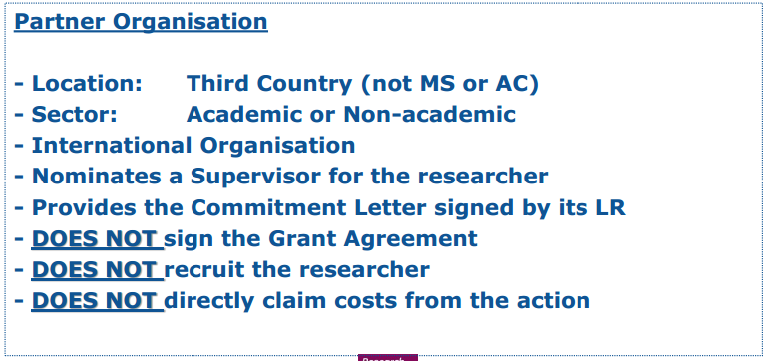
Global Fellowships

Slide 78
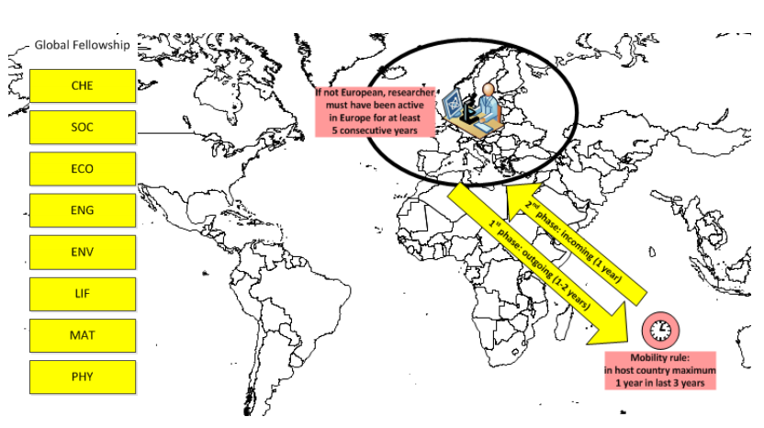
Global Fellowships

Slide 79
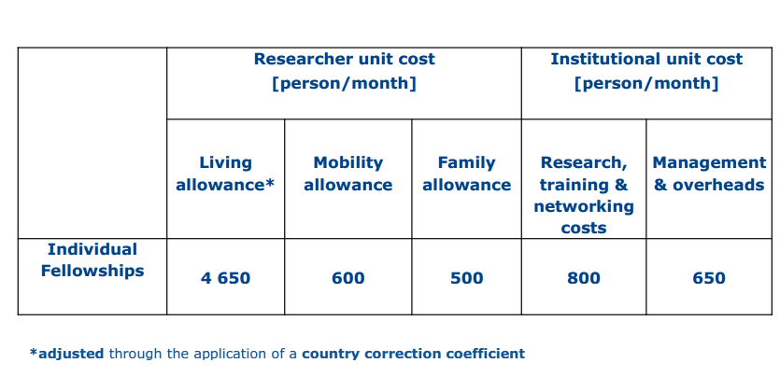
IF
Budget

Slide 80
CALL
Call 2015
  Publication date: 12 March 2015
  Deadline(s): 10 September 2015 at 17.00.00 Brussels time
  Indicative budget: 215 M€
  27 M€ are allocated to Global Fellowships

Slide 81
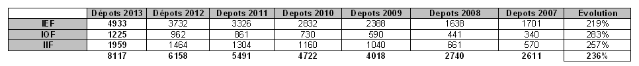
Evolution FP7

Slide 82
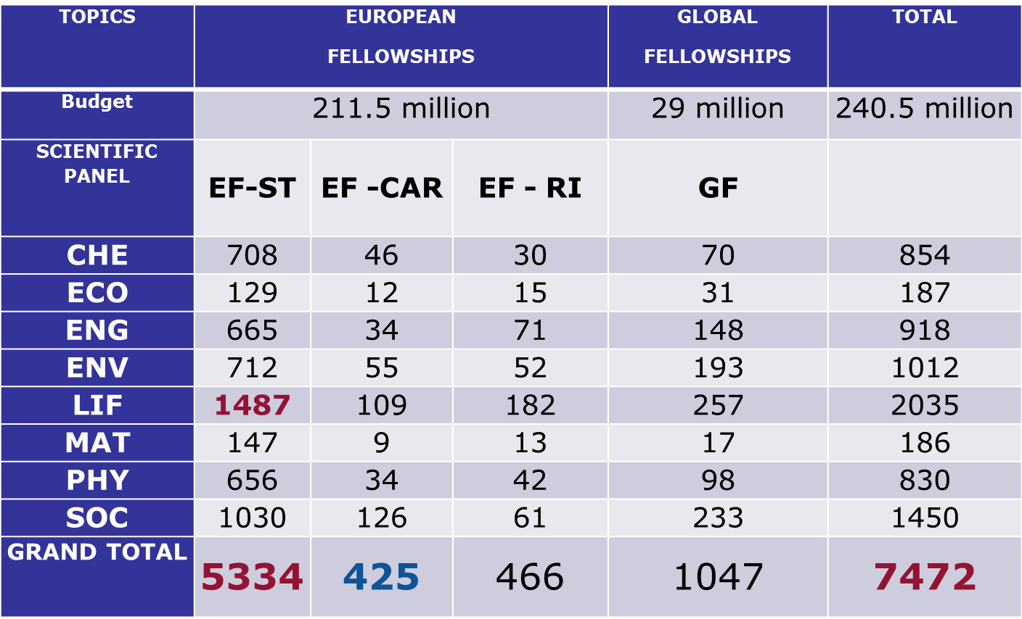
IF 2014
0verview

Slide 83
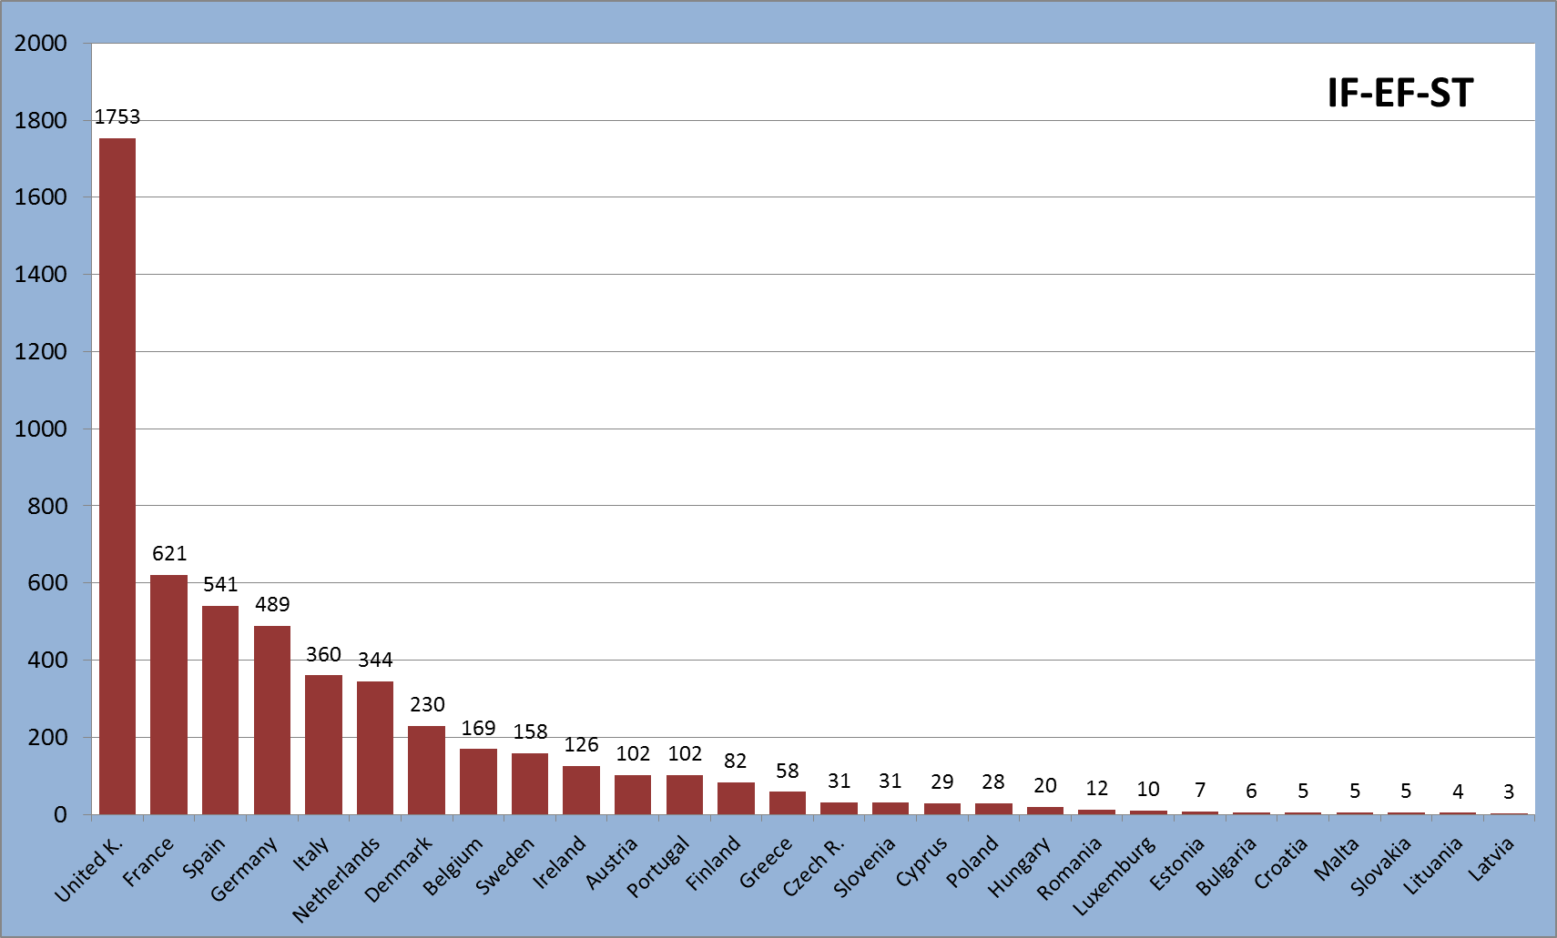
Country participation in 2014
EU – 28 MS

Slide 84
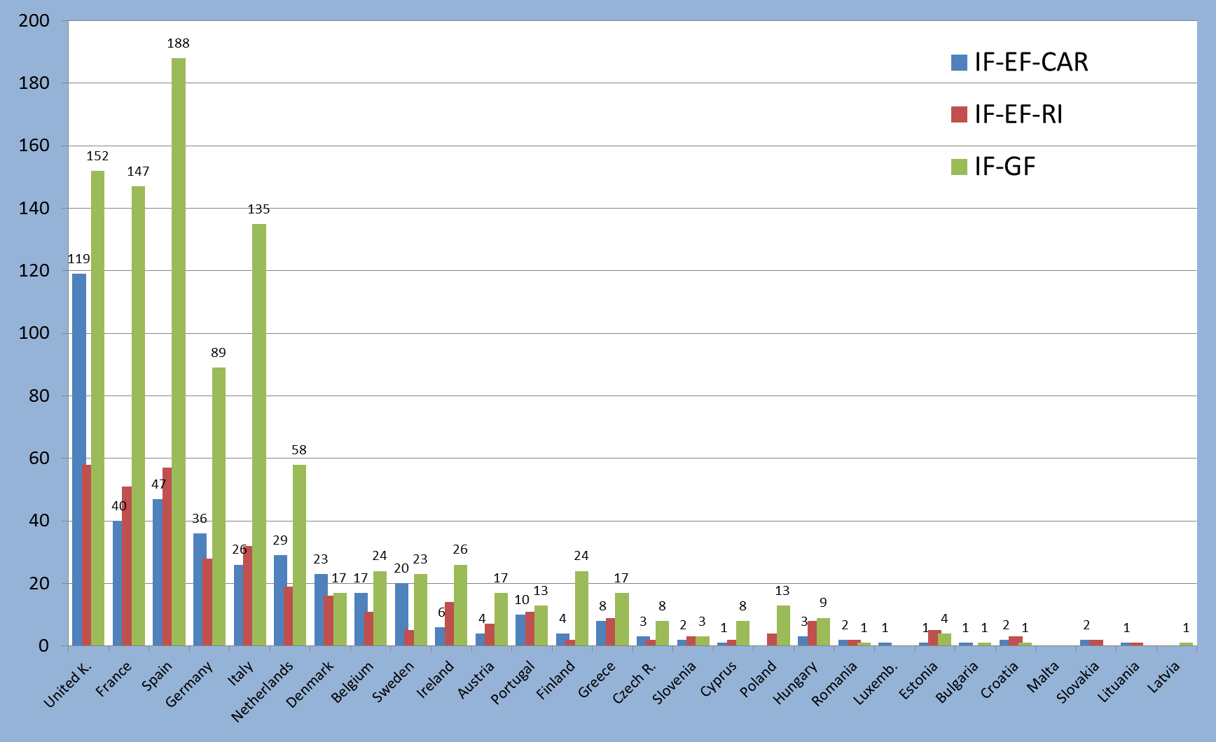
Country participation in 2014
EU – 28 MS

Slide 85
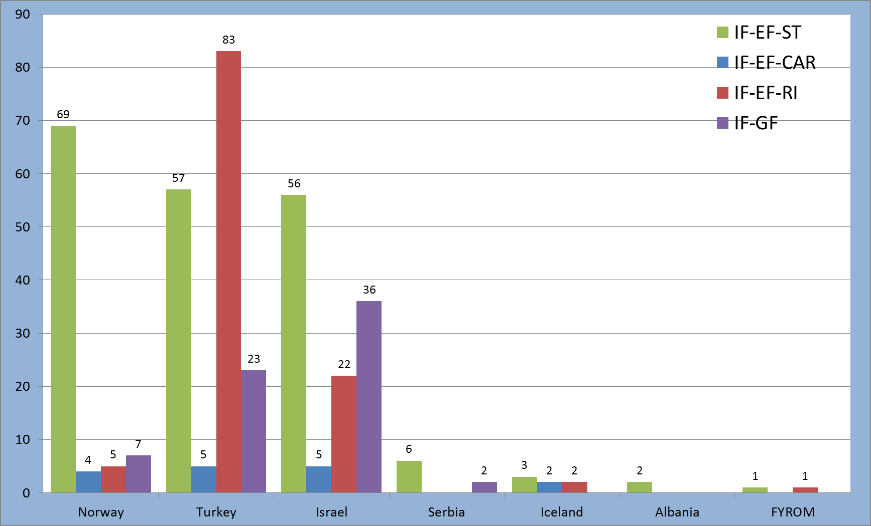
Country participation in 2014
EU – AC

Slide 86
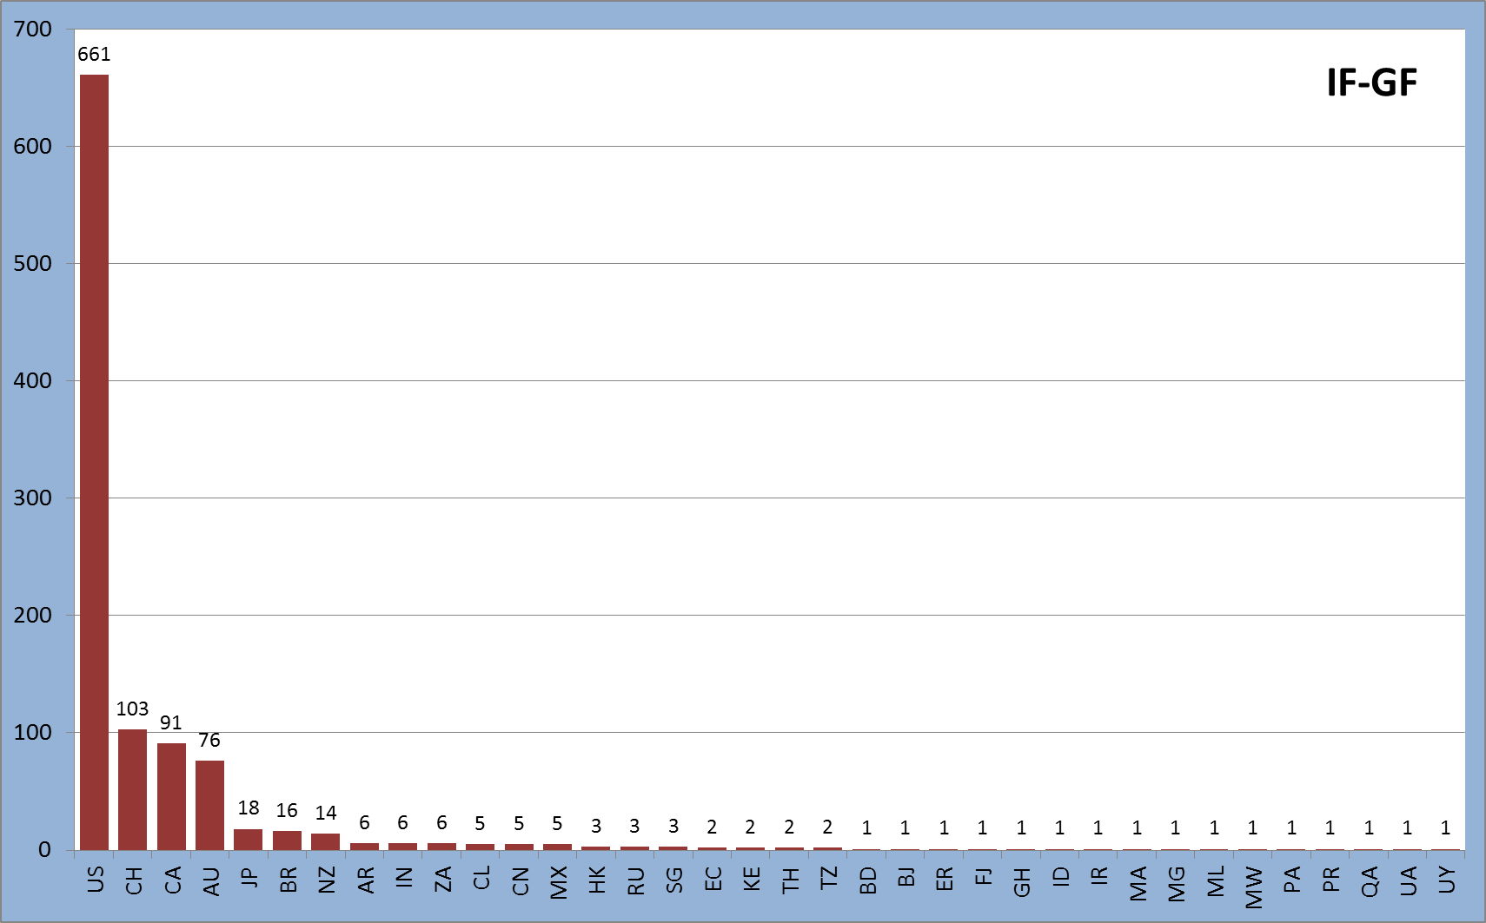
Country participation Third countries
As partner organisation for GF

Slide 87
COFUND

Slide 88
COFUND
Objective
  to stimulate regional, national or international programmes to foster excellence in researchers' training, mobility and career development
  Scope
  Co-funding new or existing regional, national, and international programmes to open up to, and provide for, international, intersectoral and interdicisplinary research training, as well as transnational and cross-sector mobility of researchers at all stages of their career
  Possibilities of synergies with structural funds
  Doctoral Programmes (for ESR) and Fellowship Programmes (for ER)
  Researchers to comply with the mobility rules of the MSCA
  Minimum support for researchers: 3 months
  Implemented by a sole beneficiary
  Expected Impact
  to exploit synergies between European Union actions and those at regional, national, and international level, and leverage funding

Slide 89
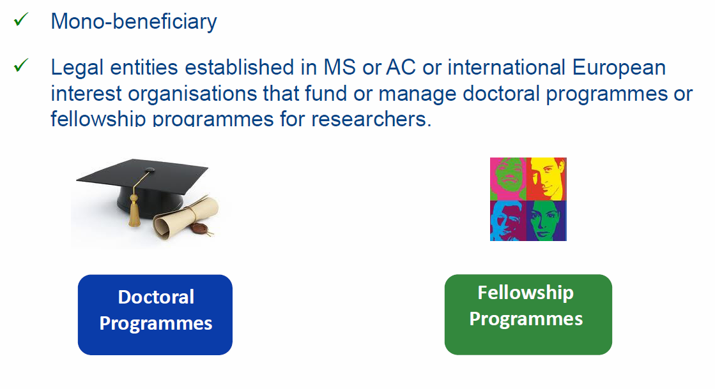
COFUND

Slide 90
COFUND
Doctoral Programmes
  Training follows the EU Principles on Innovative Doctoral Training.
  Collaboration with a wider set of partners, including from the non-academic sector, which may provide hosting or secondment opportunities or training
Fellowships Programmes
  Regular selection rounds following fixed deadlines or regular cut-off dates allowing a fair competition between applying researchers.
  The selections should be based on open, widely advertised competition, with transparent international peer review and selection of candidates on merits.
  Mobility types may be similar to the ones supported under Marie Skłodowska-Curie.
  Limitations regarding the researchers' origin and destination should be avoided
  Proposed programmes are encouraged to cover all research disciplines

Slide 91
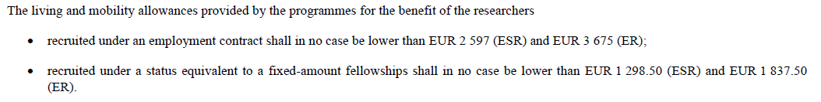
COFUND
Marie Skłodowska Curie Actions | Research unit cost [person/month]*** |  | Institutional unit cost [person/month]
COFUND | Early-stage researchers | 3 710 | 650
 | Experienced researchers | 5 250
*** These unit costs will be subject to a co-funding rate of 50%

Slide 92
COFUND
Call 2015
  Publication date: 14 April 2015
  Deadline(s): 01 October 2015 at 17.00.00 Brussels time
  Indicative budget: 80 M€:
  30 M€ are allocated to Doctoral Programmes.
  Contribution has maximum overall of 10 M€ to a single applicant
  Duration: 36 to 60 months. This duration includes also the time that is needed to select or recruit the researchers
  Participants having benefited from COFUND under previous calls will explain how the latest proposal relates to and goes beyond the earlier grant and provide evidence for its quality

Slide 93
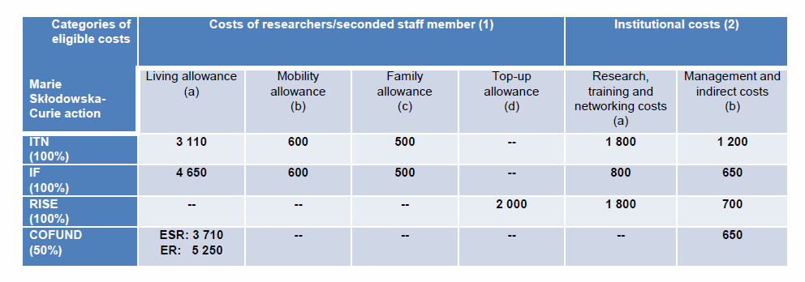
EU Contributions / Amounts

Slide 94
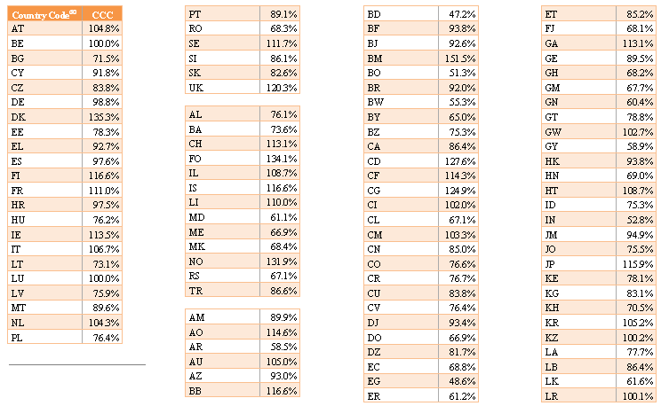
Country Correction Coefficients

Slide 95
Submission of the proposal

Slide 96
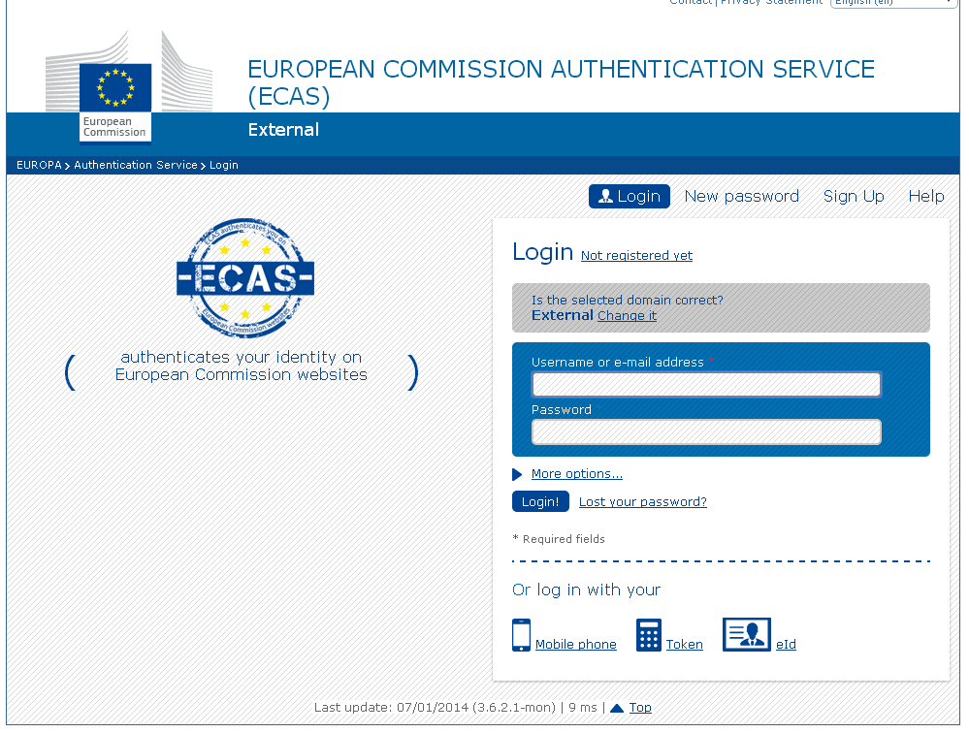
Participant portal

Slide 97
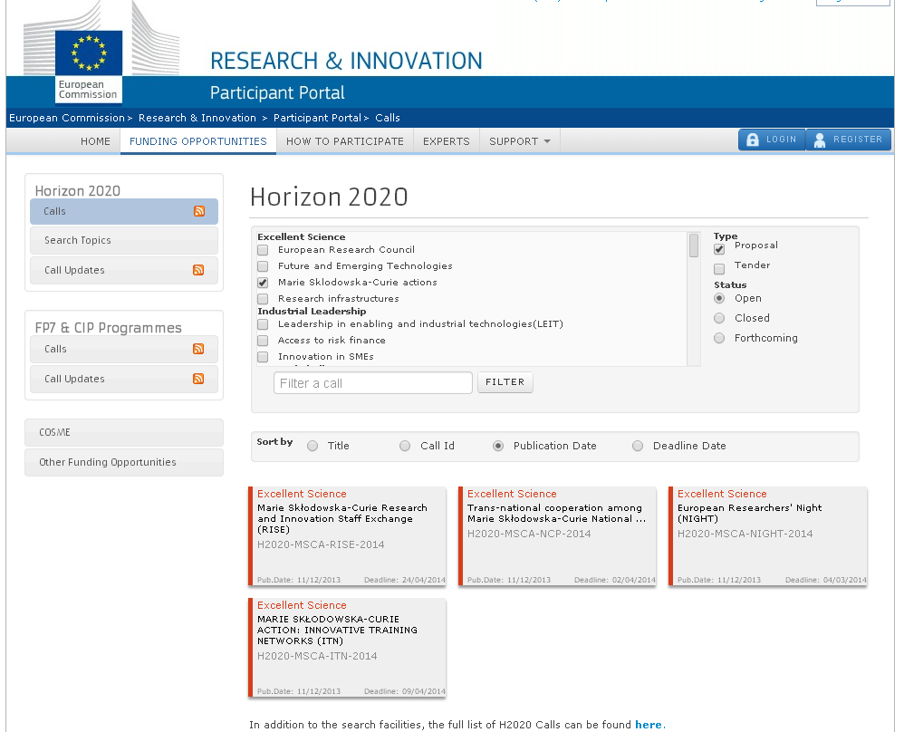
Participant portal

Slide 98

RECOMMANDATIONS

Slide 99
From policy objectives to a concrete proposal
Relevant documents available on the call page and under "Reference documents" (Participant Portal)
  MSCA Work Programme (version 2014-2015)
  Specific Guide for Applicants for related instrument (ITN, IF, RISE, COFUND,….
  E.g. for ITN
http://ec.europa.eu/research/participants/portal/desktop/en/opportunities/h2020/calls/h2020-msca-itn-2015.html

Slide 100

From policy objectives to a concrete proposal
  Type of Instrument
  Topic/Objectives
  Consortium

Slide 101
EVALUATION CRITERIA
Example ITN

Slide 102
Overview of evaluation criteria
Award Criterion | Threshold | Weight | Priority if ex-aequo
Excellence | n/a | 50% | 1
Impact | n/a | 30% | 2
Implementation | n/a | 20% | 3
Total | 70%

Slide 103
EXCELLENCE
  Quality, innovative aspects and credibility of the research programme (including inter/multidisciplinary and intersectoral aspects)
  Quality and innovative aspects of the training programme (including transferable skills, inter/multidisciplinary and intersectoral aspects)
  Quality of the supervision (including mandatory joint supervision for EID and EJD projects)
  Quality of the proposed interaction between the participating organisations

Slide 104
IMPACT
  Enhancing research- and innovation-related human resources, skills, and working conditions to realise the potential of individuals and to provide new career perspectives
  Contribution to structuring doctoral/early-stage research training at the European level and to strengthening European innovation capacity, including the potential for:
  a) meaningful contribution of the non-academic sector to the doctoral/research training, as appropriate to the implementation mode and research field
  b) developing sustainable joint doctoral degree structures (for EJD projects only)
  Effectiveness of the proposed measures for communication and dissemination of results

Slide 105
IMPLEMENTATION
  Overall coherence and effectiveness of the work plan, including appropriateness of the allocation of tasks and resources (including awarding of the doctoral degrees for EID and EJD projects)
  Appropriateness of the management structures and procedures, including quality management and risk management (with a mandatory joint governing structure for EID and EJD projects)
  Appropriateness of the infrastructure of the participating organisations
  Competences, experience and complementarity of the participating organisations and their commitment to the programme

Slide 106
Interpretation of scores
5
Excellent. The proposal successfully addresses all relevant aspects of the criterion. Any shortcomings are minor.
Very Good. The proposal addresses the criterion very well, but a small number of shortcomings are present.
Good. The proposal addresses the criterion well, but a number of shortcomings are present.
Fair. The proposal broadly addresses the criterion, but there are significant weaknesses.
Poor. The criterion is inadequately addressed, or there are serious inherent weaknesses.
The proposal fails to address the criterion or cannot be assessed due to missing or incomplete information.
4
ITN
decimal scores are used
3
2
1
0

Slide 107

Pay attention to differences
between ETN/EID/EJD
The proposal must be consistent with the requirements and objectives of the different modes (ETN/EID/EJD)
Some of the evaluation criteria are specific to EID and/or EJD

Slide 108
Operational Capacity
Evaluators will assess whether participants have the operational capacity to carry out the tasks described in the proposal.
How?
Based on information in the proposal
Ask yourself:
Does each beneficiary have appropriate premises to host researchers?
Does each beneficiary have appropriate staff resources to supervise/train researchers?
'No' operational capacity: participant excluded from evaluation!

Slide 109
PROPOSITION TEMPLATE

Slide 110
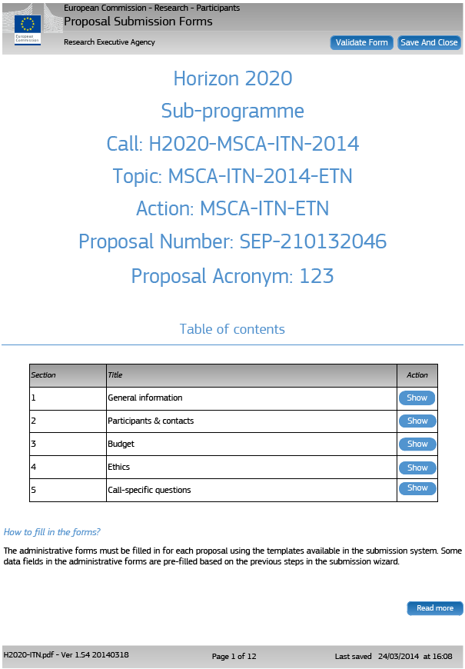
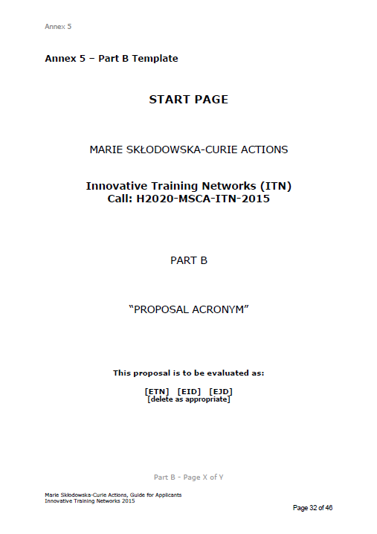
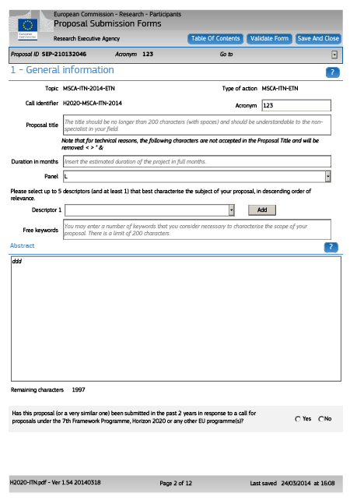


Structure of proposals
Part A
- structured data -
Part B
- description of action -
(Beneficiaries)
(Partner organisations)

Slide 111
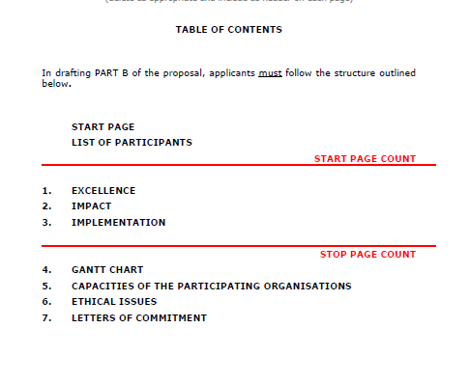
Page Limits
Clearly indicated in Guide for Applicants
Excess pages to be disregarded in evaluation
30 pages max

Slide 112
EVALUATION PROCESS

Slide 113
3 Individual Assessments
Consensus
Proposal A
Ranked list
Proposal B
B > A > C
Proposal C
Remote
Central

Slide 114

  Rank lists
  ETN: 1 rank list (RL) per scientific panel
  EID / EJD: dedicated, multi-disciplinary rank lists
 | ETN | EID | EJD
CHE | RL | EID rank list | EJD rank list
ECO | RL
ENG | RL
ENV | RL
LIF | RL
MAT | RL
PHY | RL
SOC | RL

Slide 115
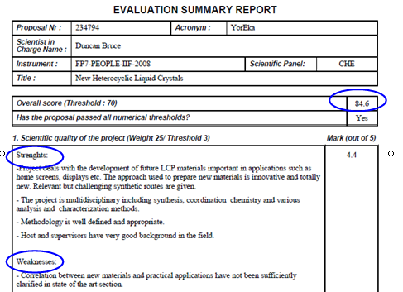
Evaluation
Summary
Report
Education
and Culture

Slide 116
The DO’s of proposal submission
  Check for eligibility
  Follow template guidance
  Respect the page limits
  Be precise, less can be more
  Excellent science is not enough: address all criteria
  Get impartial colleagues to read it before
  Start filling in with the submission tool asap
  Check for consistency between Part A (admin data) and Part B (substance)

Slide 117
Reminders
  Experts will evaluate proposals as submitted (not on its potential if certain changes were to be made)
  Proposals selected for funding are converted into description of work of the grant agreement.
  Commitment Letters
  Ethics (part A and part B)

Slide 118
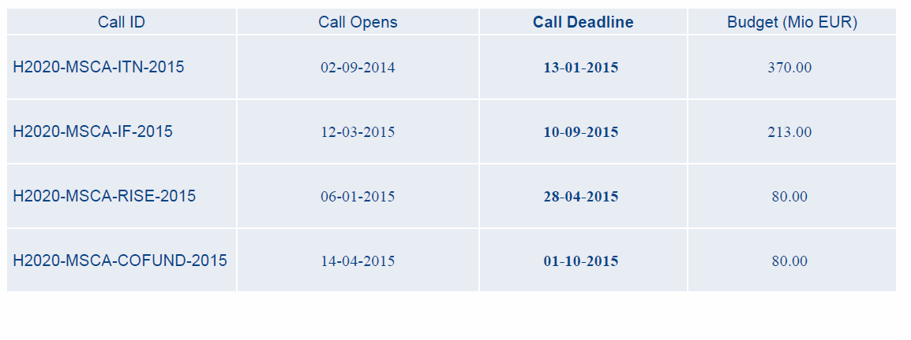
Calls 2015

Slide 119
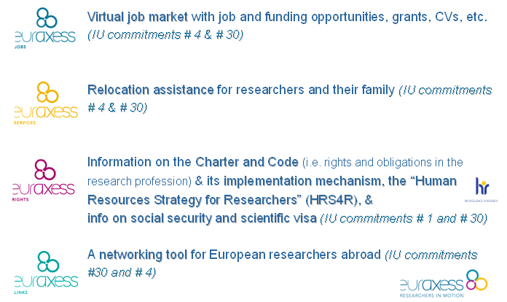
Other initiatives : Euraxess

Slide 120

pcn-mariescurie@recherche.gouv.fr

