Slide 1
Horizon 2020 Marie Skłodowska-Curie Actions
Journée d’information régionale
2017

Slide 2
MSCA - strategic programming approach
Attract and retain research talent
Develop state-of-the-art, innovative training schemes, consistent with the highly competitive and increasingly inter-disciplinary requirements of research and innovation
Promote sustainable career development in research and innovation
Focus on delivering new knowledge and skills, in line with the key driver identified in the strategic programming approach
Contribute to a strong partnership with MS via the co-funding mechanism

Slide 3
Key features of the MSCA part
Open to all domains of research and innovation from basic research up to market take-up and innovation services
Entirely bottom-up
Participation of non-academic sector strongly encouraged, especially industry and SMEs
Mobility as the key requirement - funding on condition participants move from one country to another
Promotion of attractive working and employment conditions
Particular attention to gender balance
Budget 2014/2020 : 6 162 billion €

Slide 5
Researchers
Definitions
Early Stage Researchers
Shall at the time of recruitment (ITN, COFUND) or secondment (RISE), be in the first four years (full-time equivalent) of their research careers and have not yet been awarded a doctoral degree
Experienced Researchers
Shall, at the time of the relevant deadline for submission of proposals (IF), recruitment (COFUND) or secondment (RISE), be in possession of a doctoral degree or have at least four years of full-time equivalent research experience
Nationality, residence
Global fellowships and Reintegration panel in IF are open to nationals or long-term residents of EU Member States and Associated Countries.
Long-term residence means a period of full-time research activity of at least 5 consecutive years

Slide 6
Definitions
Who applies?
International networks of organisations actively involved in research/doctoral training
Academic sector
public /private higher education establishments awarding academic degrees
public /private non-profit research organisations whose primary mission is to pursue research
international European interest organisations (e.g. CERN, EMBL)
Non-academic sector
any entity not included in the academic sector:
e.g. large companies, SMEs, NGOs, museums, hospitals
international organisations (e.g. UN, WHO)
Standardised legal validation of entities is applied to determine the domain of each participant

Slide 7
Definitions
Beneficiary vs.
Partner Organisation
Signs Grant Agreement
Recruits and Hosts Researchers
Trains/Hosts Researchers on secondment
Participates in Supervisory Board
Directly Claims Costs
EU funding

Slide 8
IF : Individual Fellowships

Slide 9
Objectives
to enhance the creative and innovative potential of experienced researchers
to provide opportunities to acquire new knowledge, resume a career or return to Europe
the beneficiary shall be a participant established in EU (MS/AC) and employing the researcher during the project
Scope
Trans-national fellowships awarded to the best or most promising researchers
European Fellowships (12-24 months) or Global Fellowships (12-24 months + mandatory return phase of 12 months)
Career Restart Panel, Reintegration Panel and Society and Enterprise Panel
Secondments, notably in the non-academic sector
Expected Impact
to release the full potential of researchers and development of their careers in both the academic and non-academic sectors

Slide 10
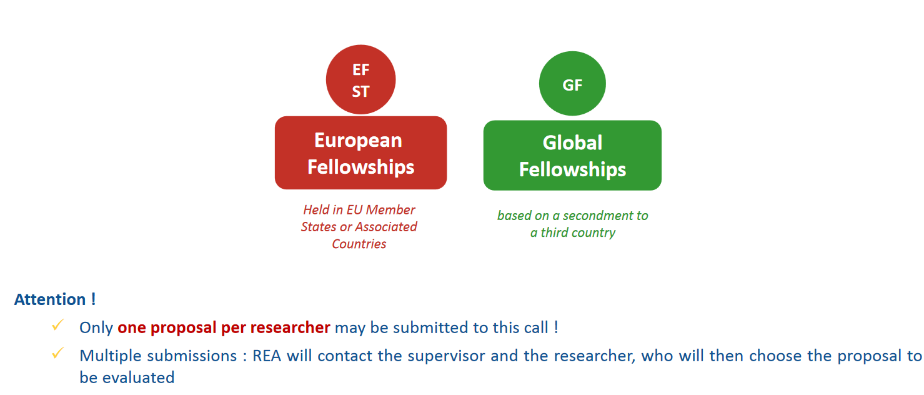
Individual Fellowships

Slide 11
European Fellowships (EF)
Four types of mobility from 12 to 24 months
1.Standard European Fellowship
2. Career Restart Panel :
after a career break (parental leave, working outside research, etc.) of at least 12 months
3.Reintegration Panel : to return and reintegrate
In a longer term research position in Europe
4. Society and Enterprise : to work on research and
innovation projects in an organisation from the non
-academic sector

Slide 12
European Fellowships (EF)
One experienced researcher applies jointly with one host institution located in a MS or AC for a research project that can last between 12 and 24 months
Host institution (future beneficiary)
Location : MS or AC
Sector : Academic or non-academic
International European Interest Organisation (IEIO)
International Organisations (exceptional cases)
Appoints the Supervisor (who will legally act in the name of the organisation until the Grant Preparation phase)
Recruits the experienced researcher under the condition established in the Grant Agreement (contract of employment)

Slide 13
European Fellowships (EF)
Researcher (future fellow) :
Experienced researcher : PhD or at least 4 years of full-time equivalent research experience by the call deadline
Full-Time Equivalent Research Experience is measured from the date when the researcher obtained the degree entitling him/her to embark on a doctorate, eigher in the country in which the degree was obtained or in the country in which the researcher is recruted, even if a doctorate was never started or envisaged
Must undertake transnational mobility
Nationality : any (exception for the Reintegration Panel)
Recruited by the beneficiary under the condition established in the Grant Agreement (contract of employment)

Slide 14
European Fellowships (EF)
The project is written by the experienced researcher, a concrete plan of training-through-research for 12-24 months at the host organisation’s premises
Realistic and well-defined objective in terms of career advancement (e.g. by attaining a leading independant position) or resuming a research carrer after a break
Typical training activities may include :
Primarly training-through-research : individual personalised action
Hands-on training activities for developing scientific (new techniques, instruments,…) and transferable skills
Inter-sectoral or interdisciplinary transfer of knowkedge (e.g. through secondments)
Taking part in the research and financial mangement of the action
Organisation of scientific/training/dissemination events
Communication, outreach activities and horizontal skills
Training dedicated to gender issues

Slide 15
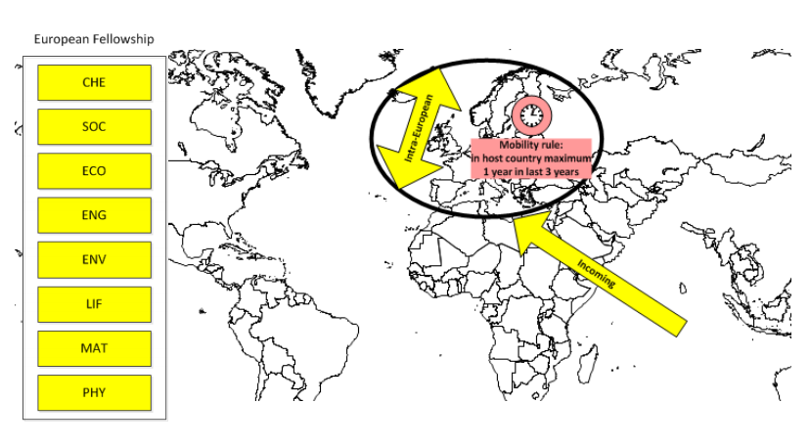
Standard
European fellowship

Slide 16
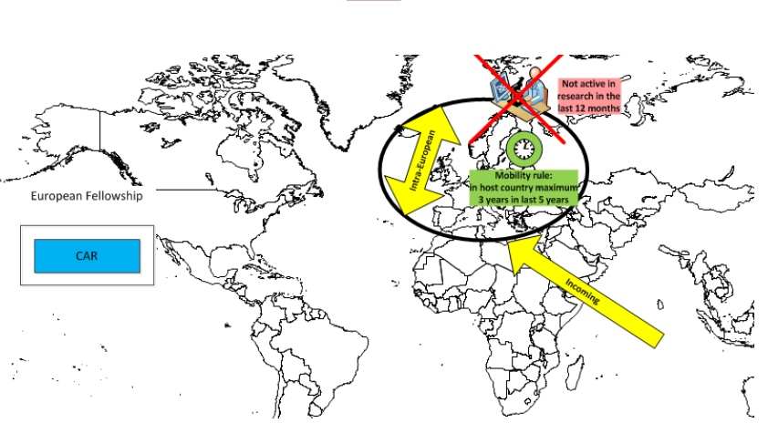
Career Restart Panel

Slide 17
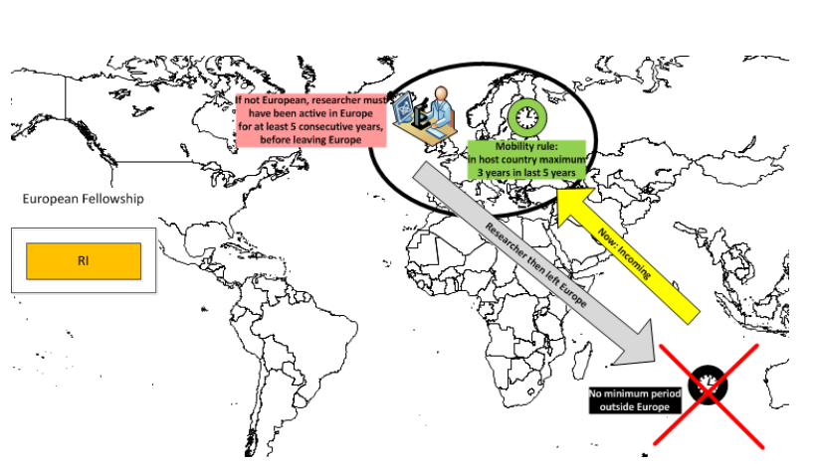
Reintegration Panel

Slide 18
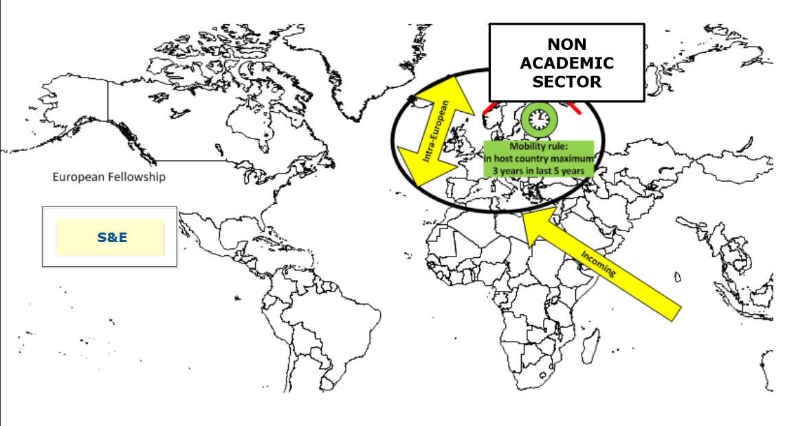
Society and Enterprise
Society and entreprise panel

Slide 19
Global Fellowships
Features
Outgoing phase in a Third Country (from 12 to 24 months)
Mandatory 12 month return phase to the beneficiary located in a MS or AC
Mandatory letter of commitment from the partner organisation
Outgoing phase
Return phase
International (Not MS / AC)
Member State / Associated Country

Slide 20
Global Fellowships
One experienced researcher applies jointly with one host institution located in a MS or AC for a research project that has an initial outgoing phase in Partner Organisation in a Third Country and the whole project can last between 24 and 36 months
Partner organisation
Location : Third Country (not MS or AC)
Sector : Academic or non-academic
International Organisations
Nominates a Supervisor for the researcher
Provides the Commitment Letter signed by the legal representative
Does not sign the Grant Agreement
Does not recruit the researcher
Does not directly claim costs from the action

Slide 21
Global Fellowships

Slide 22
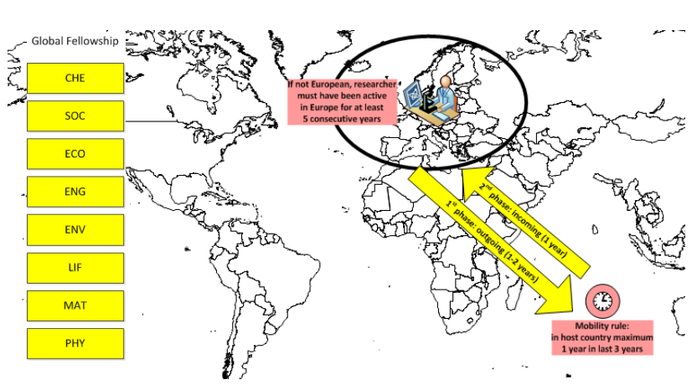
Global Fellowships

Slide 23
Secondments
When : During the implementation of the project
Who : the Experienced Researcher
Where : to partner organisation – another institution including IO located in Europe (MS/AC) or to an IEIO
How long :
Clearly justified and described in Part B
Single period or divided into shorter mobility periods
Can be at more than one partner organisation
Can be to an institution in the same country as the beneficiary
Can be in the same sector (academic-academic)

Slide 24
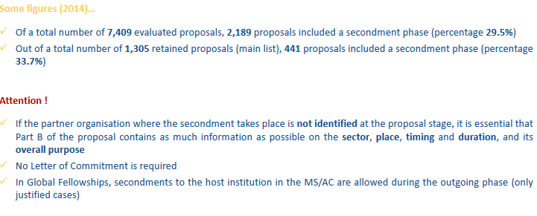
Secondments

Slide 25
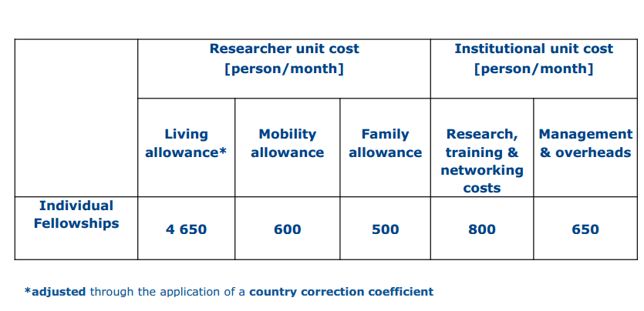

Slide 26
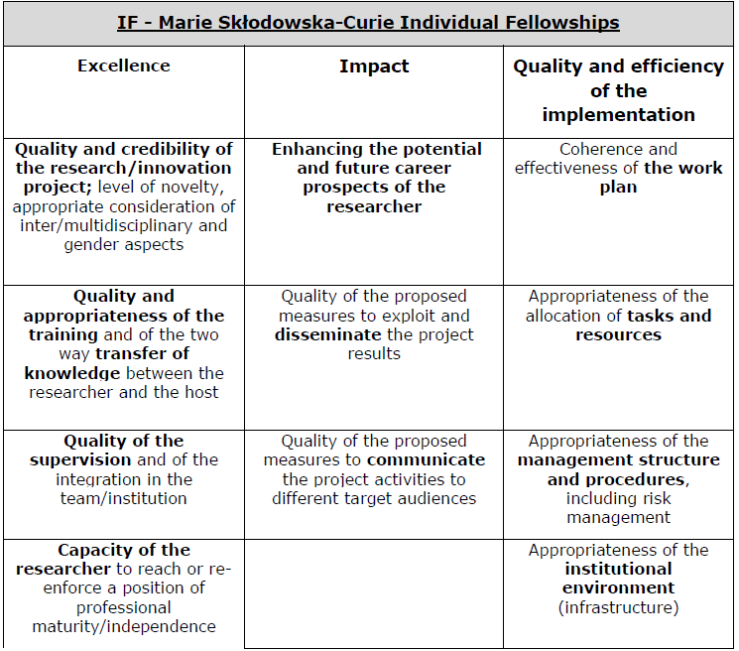
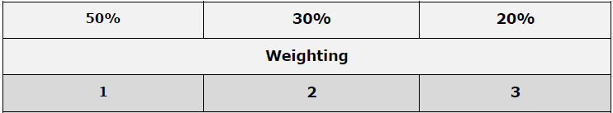

Slide 27
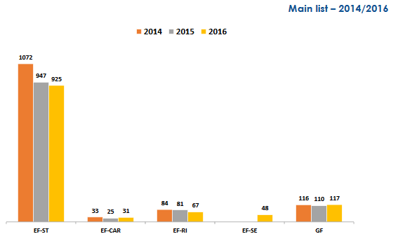
CALL
Results - Statistics

Slide 28
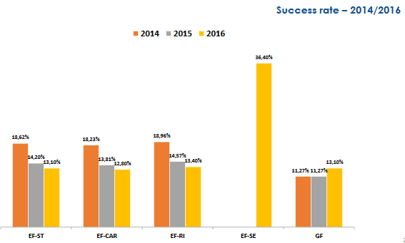
CALL
Results - Statistics

Slide 29
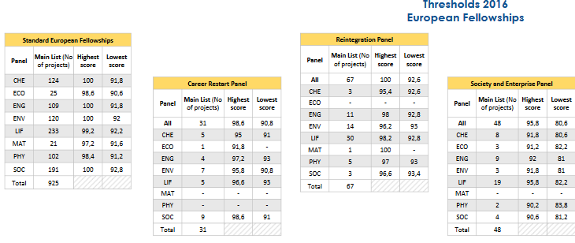
CALL
Results - Statistics

Slide 30
CALL
Results - Statistics

Slide 31
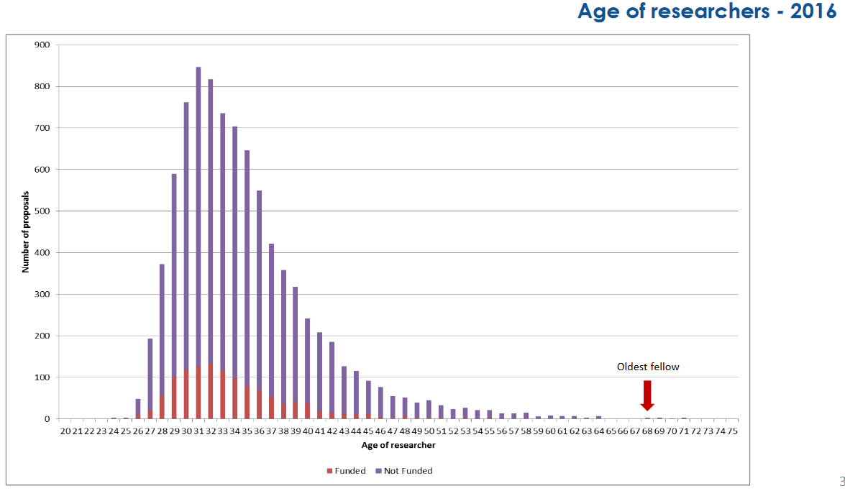
CALL
Results - Statistics

Slide 32
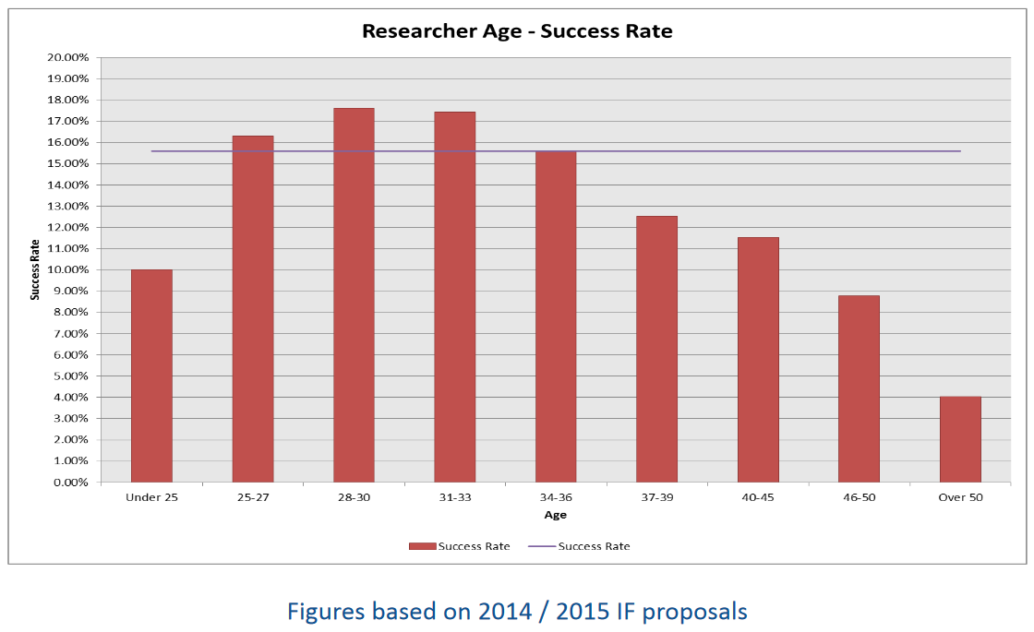
CALL
Results - Statistics

Slide 33
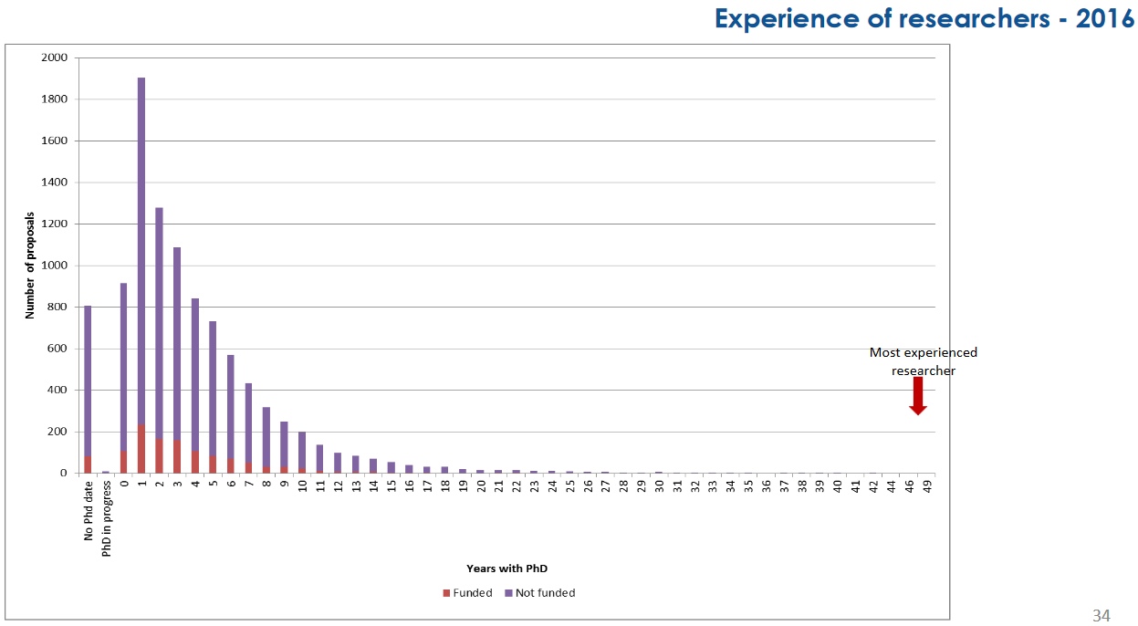
CALL
Results - Statistics

Slide 34
CALL
IF – Next Call
H2020-MSCA-IF-2017
- Opens 11st April 2017
- Deadline: 14th September 2017 (17.00 – Brussels time)
Results of the evaluation: 5 months after the call deadline
Signing of grant agreements: 8 months after the call deadline

Slide 35
ITN Innovative Training Networks

Slide 36
ITN
ITN Objectives
Train innovative early-stage researchers
Excellence in doctoral/early-stage research training
Provide skills to match public and private sector needs
ITN Expected impact
Improved career perspectives of researchers
Structured high-quality research / doctoral training
Collaboration academia with non-academic sectors
Excellence: International network of organisations applies and proposes a joint research training or doctoral programme
Bottom-up (no pre-defined topics)
All domains*: CHE, ECO, ENG, ENV, LIF, MAT, PHY, SOC
Multidisciplinary approach
Meaningful exposure to non-academic sector

Slide 37
ITN typical activities
ITN
Core activity: Training through individual research projects
Network-wide training activities (e.g. seminars, workshops, summer schools).
Training in key transferable skills (e.g. entrepreneurship, management, IPR, communication, ethics, grant writing).
Collaboration and exchange of knowledge within the network
Communication & Dissemination
Public engagement

Slide 38
ITN
Who can be recruited?
Researcher-months requested in proposal
Recruitment after the project starts.
Only Early-Stage Researchers (ESRs):
≤ 4 years of research experience
no PhD yet
Recruitment: 3 to 36 months (typical)
Mandatory trans-national mobility at the time of recruitment.

Slide 39
EU 28 Member States (MS)
Associated Countries (AC)
Other Third Countries (OTC)
ITN
ETN
European
Training Network
Participants implement a joint research programme
Min. 3 beneficiaries from any sector from 3 different MS/AC
Doctoral programme with the non-academic sector
Min. 2 beneficiaries from 2 different MS/AC: min. 1 from academic sector
+ min. 1 from non-academic sector
EID
European
Industrial Doctorates
EJD
European
Joint Doctorates
Doctoral programme to deliver joint degrees
Min. 3 beneficiaries from academic sector awarding PhD
from 3 different MS/AC
Above this minimum: participants from any sector / country
Research fields chosen freely by applicants (CHE, ECO, ENG, ENV, LIF, MAT, PHY, SOC)

Slide 40
ITN - ETN
ETN – European
Training Network
Participants implement a joint research training programme
Mandatory
Min. 3 beneficiaries from 3 different MS/AC
Each beneficiary recruits and hosts at least 1 ESR
Max 540 person-months (e.g. 15 ESRs x 36 months)
Other features
Non-academic participation essential
PhD enrolment typically expected (not mandatory)
Secondments to other countries/sector/disciplines (≤30% time)
Joint supervision recommended
Partner organisations (any country/sector)

Slide 41
ITN - ETN
Participants implement a joint research training programme
ETN
Beneficiaries
Partner organisations

Slide 42
ITN - EID
EID – European
Industrial Doctorates
Doctoral training with the non-academic sector
Min. 2 organisations from 2 different EU/ associated countries 1 academic awarding PhD + 1 non-academic
Max 180 person-months (if 2 organisations) - e.g. 5 x 36 months
Max 540 person-months (if ≥3 organisations) - e.g. 15 x 36 months
Individual research projects under the topic of the doctoral programme
Flexible recruitment rule
Each fellow enrolled in the doctoral programme
Each fellow must spend ≥50% of time in non-academic sector
Secondments possible
Partner organisations (any country/sector)

Slide 43
ITN - EID
EID
≥ 50% time for each ESR
Beneficiaries
Partner organisations
non-academic sector
2 beneficiaries : max 180 PM

Slide 44
ITN - EID
EID
≥ 50% time for each ESR
Beneficiaries
Partner organisations
non-academic sector
≥3 beneficiaries: max 540 PM

Slide 45
ITN - EJD
EJD – European
Joint Doctorates
Universities cooperating to deliver joint/multiple doctoral degrees
Mandatory
Min. 3 beneficiaries from academic sector awarding PhDs, from 3 different MS/AC
Each ESR enrolled in the joint (international) doctoral programme
Joint selection, training and supervision
Commitment to deliver joint/double/multi degrees
Max 540 person-months
Other features
Meaningful stays at joint doctorate beneficiaries
Non-academic participation through secondments to other sector/disciplines possible
Flexible recruitment rule

Slide 46
ITN - EJD
EJD
Joint PhD
Joint PhD
Joint PhD
Beneficiaries
Letters of institutional commitment to deliver degrees are required in the proposal
Partner Organisations

Slide 47
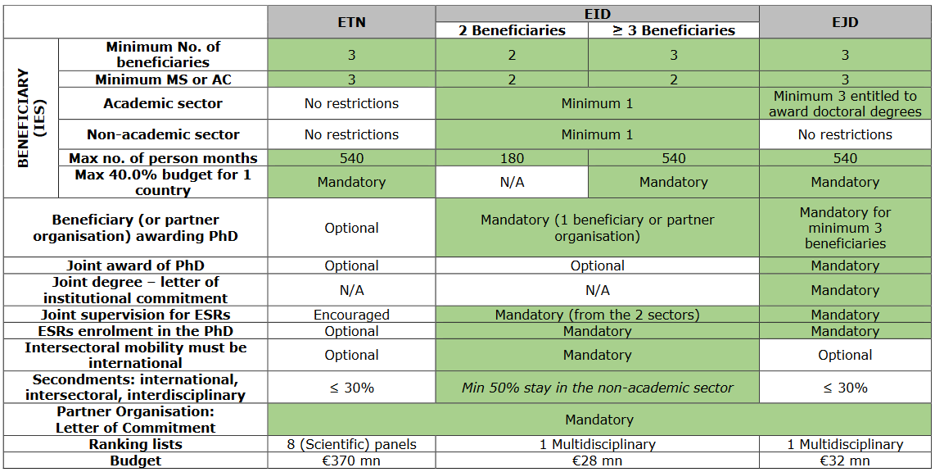
ITN

Slide 48
ITN
Unit costs/1 researcher month:
Marie Skłodowska Curie Actions | Researcher unit cost [person/month] |  |  | Institutional unit cost [person/month]
 | Living allowance | Mobility allowance | Family Allowance | Research, training and networking costs | Management and indirect costs
Innovative Training Networks | 3 110 | 600 | 500 | 1 800 | 1 200
Country correction coefficient applies to the living allowance
Researcher allowances include employer contributions.
Researcher allowances are a minimum to be paid (top-up funds from other sources permitted).

Slide 49
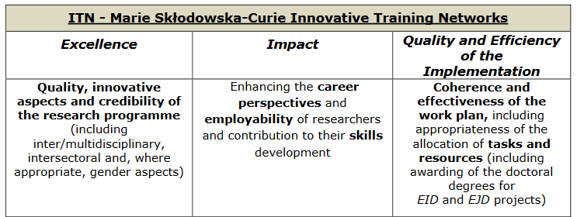
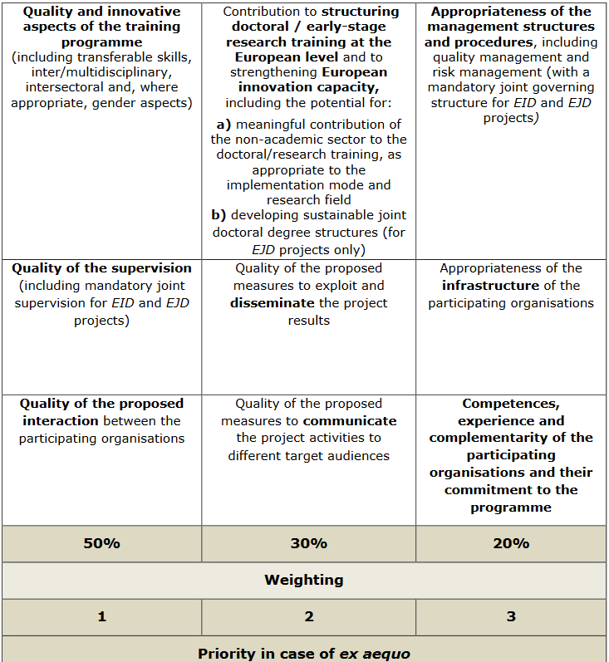

Slide 50
ITN 2018
H2020-MSCA-ITN-2018
Opened 12 october 2017
Closure: 16 january 2018 (17:00:00 Brussels time)
Budget: € 442 Million (ETN: 375 M€, EID: 32 M€; EJD: 35 M€)
Results of the evaluation: 5 months after the call deadline
Signing of grant agreements: 8 months after the call deadline
DRAFT

Slide 51
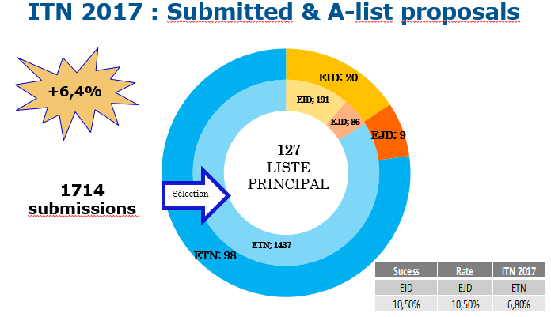

Slide 52
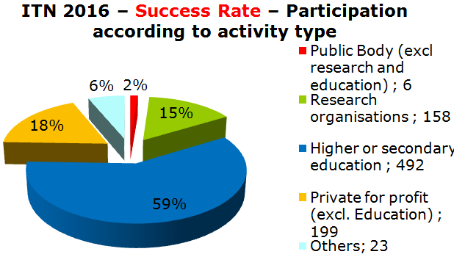
 | Submissions | A-List | A-List ETN | A-List EJD | A-List EID
2014 | 1161 | 121 | 94 | 8 | 19
2015 | 1563 | 106 | 83 | 8 | 15
2016 | 1611 | 109 | 85 | 8 | 16

Slide 53
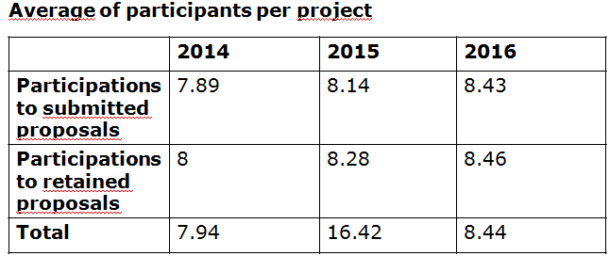

Slide 54
RISE
Research and Innovation Staff Exchange

Slide 55
RISE
New type of exchange of staff action to stimulate transfer of knowledge
Academic and non-academic participants
Flexible inter-sector and international exchange of highly skilled research and innovation staff members
Work with existing staff – no recruitment foreseen
Based on a common project
Bottom-up approach

Slide 56
RISE
2 dimensions of projects promoting staff exchanges :
MS/AC and TC => International
Academic and non-academic sectors => Inter-sectoral

Slide 57
RISE
Project built on joint research and innovation activities
Project implemented through the secondment of staff (no recruitments)
Each staff member seconded for a period of 1 to 12 months
The maximum size for a project is 540 person months
No minimum size explicitly defined for the project, but substantial impact is expected
Maximum project duration is 4 years

Slide 58
RISE
All Countries can participate in RISE, but not all are eligible for funding
All institutions fulfilling the requirements of the Horizon 2020 Rules for Participation can participate in RISE
Beneficiaries : sign the Grant and claim the costs, established in a MS/AC
Partner organisations : Must include a letter of commitment, are established in a Third Country (i.e. neither MS or AC)

Slide 59
RISE
Actively engaged in or linked to research/innovation activities for at least 6 months prior to first secondment
Types of staff members:
ESR (no PhD and < 4 years experience)
ER (PhD or > 4 years experience)
Managerial staff
Administrative or Technical staff
In-built return mechanism

Slide 60
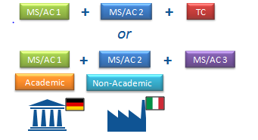
RISE
At least 3 independent participants in 3 different countries of which at least 2 participants from 2 different MS/AC
Add RISE condition for funding secondment :
Always between different countries and
- International (MS/AC Third Countries)
- Intersectoral (Academic Non-Academic)

Slide 61
Countries Eligible For EU Funding
EU Member States
Overseas Countries and Territories linked to the MS
As defined on page 3 of General Annex A to the Horizon 2020 Work Programme 2014-2015)
Horizon 2020 Associated Countries
(In principle, the same as FP7, but subject to the adoption of the association agreements)
The Third Countries listed
(On page 3 of General Annex A to the Horizon 2020 Work Programme 2014-2015)

Slide 62
Countries Eligible For EU Funding
Countries not listed previously are not eligible for EU funding
In practice, those countries are mainly: Australia, Brazil, Canada, China, India, Japan, Mexico, New Zealand, Republic of Korea, Russia, United States.
In very exceptional cases, partners from those countries might be funded. But the following conditions have to be fulfilled:
a) This partner has competences/expertise that no organisation in MS/AC has
b) The relevant transfer of knowledge can only be done via a secondment in the direction TC MS/AC
c) Points a) and b) must be endorsed by the expert evaluators
d) The experts' endorsement (point c) must be confirmed by the REA

Slide 63
EU Contribution
Unit costs per researcher per month
For secondments eligible for funding
Marie Skłodowska-Curie Action | Staff member unit cost * person/month Top-up allowance | Institutional unit cost * person/month
 |  | Research, training and networking costs | Management and indirect costs
Research and Innovation Staff Exchange | 2 000 | 1 800 | 700
*These unit costs are subject to a funding rate of 100% and no country coefficients apply.

Slide 64
EU Contribution
Staff member unit cost : support the travel, accommodation and subsistence costs linked to the respective secondments. Participants are expected to continue paying the salary of the seconded staff during the period of exchange. The EU contribution is fully used for the benefit of the seconded staff members
Paid directly to the seconded staff member
Managed centrally by the beneficiary according to the specific needs of the secondment
Combination of the two
Research, training and networking costs : costs related to the activities of the project (consumables, conferences, workshops, coordination…)
Management and indirect costs : organisation and implementation of the secondment (administrative and financial management, legal advice…)

Slide 65
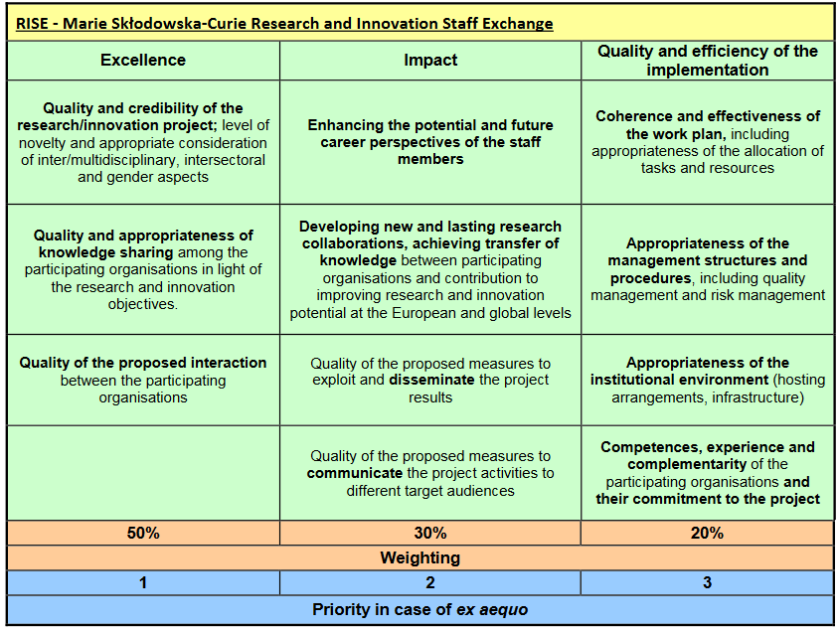

Slide 66
Next call: - H2020-MSCA-RISE-2017
- Opens 07 December 2017
- Deadline: 18 April 2018
- Budget: € 80 Million
Results of the evaluation: 5 months after the call deadline
Signing of grant agreements: 8 months after the call deadline
DRAFT

Slide 67
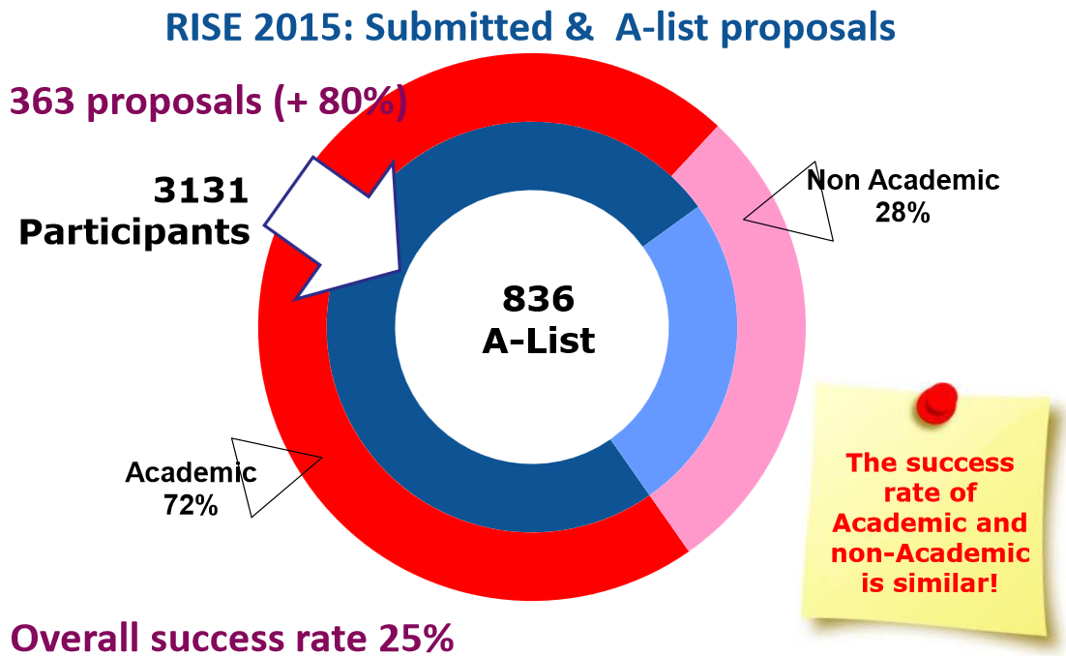
Notes:
ETN proposals represent the bulk of the total (84%) as expected.
Most of proposals were submitted under the ENG panel (30%) that for the first time outweighs the LIF panel.
Increase by 50% of EID submissions compared to 2014 (from 107 to 159). Half of them are in the ENG panel.
Increase by 66% of EJD submissions compared to 2014 (from 53 to 88). Half of them belong to the SOC (26%) and ENG (24%) panels.

Slide 68
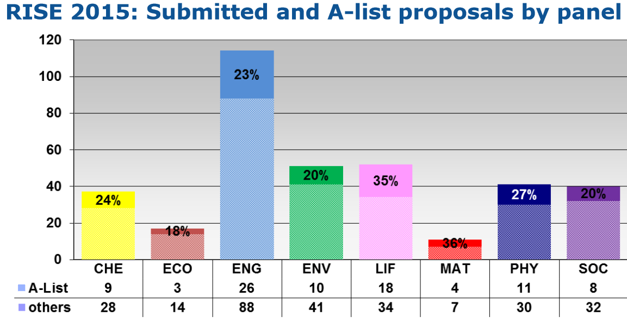
Notes:
ETN proposals represent the bulk of the total (84%) as expected.
Most of proposals were submitted under the ENG panel (30%) that for the first time outweighs the LIF panel.
Increase by 50% of EID submissions compared to 2014 (from 107 to 159). Half of them are in the ENG panel.
Increase by 66% of EJD submissions compared to 2014 (from 53 to 88). Half of them belong to the SOC (26%) and ENG (24%) panels.

Slide 69
Success rates

Slide 70
RISE 2016: A-list – Success rates
22,9% A list
Others | 25 | 14 | 85 | 43 | 33 | 8 | 27 | 47
A-list | 9 | 4 | 28 | 9 | 11 | 3 | 7 | 13

Slide 71
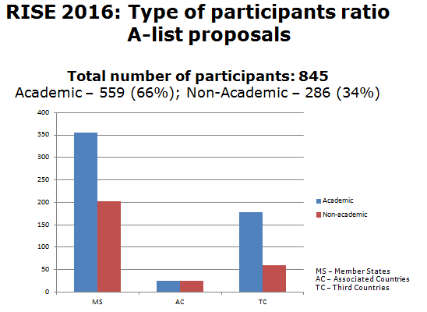

Slide 72
COFUND

Slide 73
COFUND
COFUND
Objectives
to stimulate regional, national or international programmes to foster excellence in researchers' training, mobility and career development
Scope
Co-funding new or existing regional, national, and international programmes to open up to, and provide for, international, intersectoral and interdicisplinary research training, as well as transnational and cross-sector mobility of researchers at all stages of their career
Possibilities of synergies with structural funds
Doctoral Programmes (for ESR) and Fellowship Programmes (for ER)
Researchers to comply with the mobility rules of the MSCA
Minimum support for researchers: 3 months
Implemented by a sole beneficiary
Expected Impact
to exploit synergies between European Union actions and those at regional, national, and international level, and leverage funding

Slide 74
COFUND
Early Stage Researchers
Shall at the time of recruitment, be in the first four years (full-time equivalent) of their research careers and have not yet been awarded a doctoral degree
Experienced Researchers
Shall, at the time of recruitment, be in possession of a doctoral degree or have at least four years of full-time equivalent research experience
Mobility rules
At the time of the recruitment by the host organisation, researchers shall not have resided or carried out their main activity in the country of their host organisation for more than 12 months in the 3 years immediately prior to the reference date

Slide 75
COFUND
Budget
€ 80 Million in 2017 (€ 30 Million reserved for Doctoral Programmes)
Maximum € 10 Million per single applicant per call
EU contribution to cover living allowances for researchers and management costs
50% co-funding for established unit costs
Minimum living allowance established in the WP
Duration
Minimum 3 years, maximum 5 years (including the time taken to publish call and recruit researchers)
Fellowships: minimum 3 months

Slide 76
COFUND

Slide 77
COFUND
Doctoral Programmes
Training follows the EU Principles on Innovative Doctoral Training
Collaboration with a wider set of partners, including from the non-academic sector, which may provide hosting or secondment opportunities or training
Fellowship Programmes
Regular selection rounds following fixed deadlines or regular cut-off dates allowing a fair competition between applying researchers
The selections should be based on open, widely advertised competition, with transparent international peer review and selection of candidates on merits.
Mobility types may be similar to the ones supported under Marie Skłodowska-Curie.
Limitations regarding the researchers' origin and destination should be avoided
Proposed programmes are encouraged to cover all research disciplines

Slide 78
COFUND
Each single application must only address the doctoral or fellowship programme, but
More than one application can be submitted
Recruited researcher must respect the same mobility rule as MSCA actions. Existing programmes can continue with own mobility rule if well-justified.
Unless prohibited by national legislation, all fellows, including doctoral fellows, must be recruited on a work contract.
In the doctoral programme, all fellows must be registered for a PhD

Slide 79
COFUND
Marie Skłodowska Curie Actions | Research unit cost [person/month]*** |  | Institutional unit cost [person/month]
COFUND | Early-stage researchers | 3 710 | 650
 | Experienced researchers | 5 250
*** These unit costs will be subject to a co-funding rate of 50%
The living and mobility allowances provided by the programmes for the benefit of the researchers
Recruited under an employment contract shall in no case be lower than € 2 597 (ESR) and € 3 675 (ER)
Recruited under a status equivalent to a fixed-amount fellowship shall in no case be lower than € 1 298,50 (ESR) and € 1 837,50 (ER)

Slide 80
COFUND
Publication date: 5 April 2017
Deadline(s): 28 September 2017 at 17.00.00 Brussels time
30 M€ are allocated to Doctoral Programmes
Contribution has maximum overall of 10 M€ to a single applicant
Duration: 36 to 60 months. This duration includes also the time that is needed to select or recruit the researchers
Participants having benefited from COFUND under previous calls will explain how the latest proposal relates to and goes beyond the earlier grant and provide evidence for its quality

Slide 81
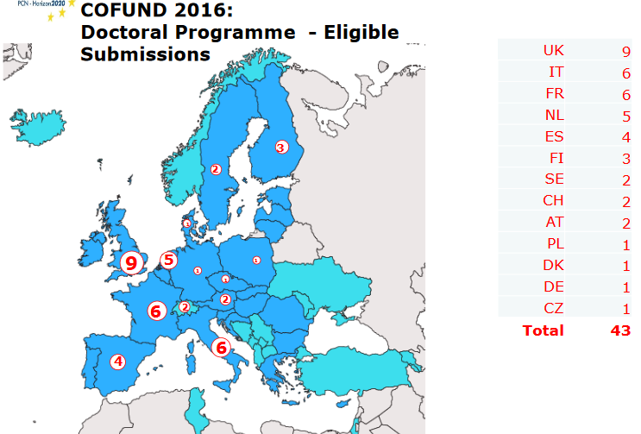

Slide 82
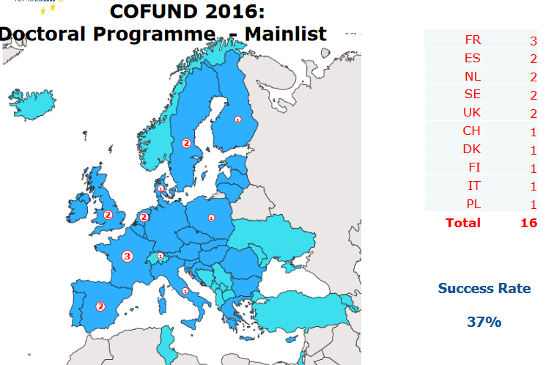

Slide 83
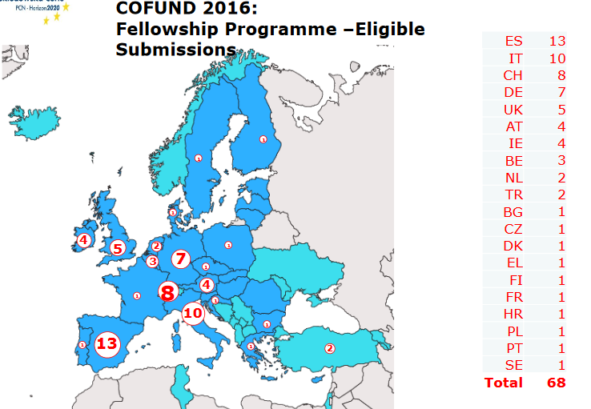

Slide 84
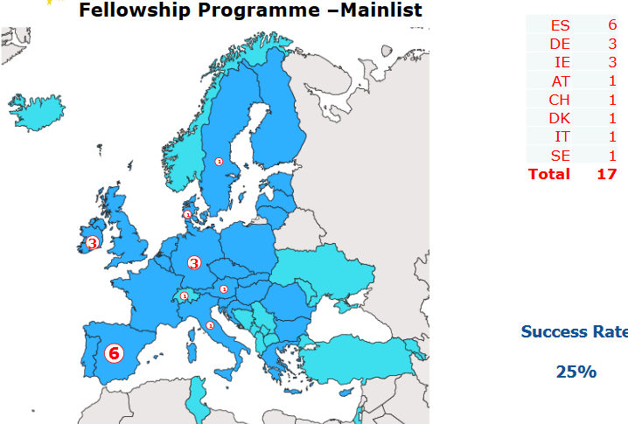

Slide 85
Submission of the proposal and
Evaluation

Slide 86
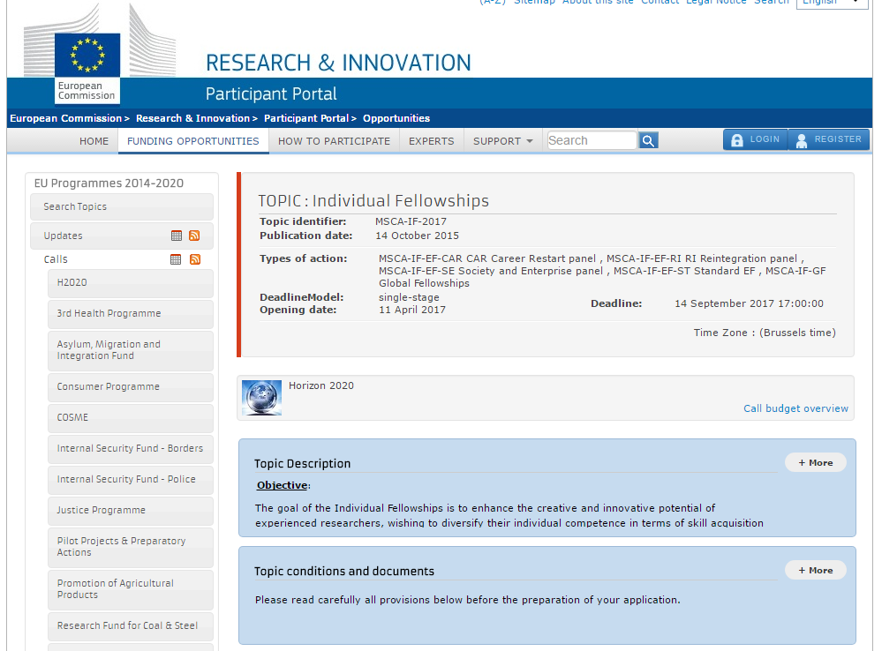
Where to find information ?
Participant Portal
Call pages
Guide for Applicants
Work Programme (2016-17)
FAQ
Descriptors

Slide 87
Contact and useful information
The Europe grant office of the host institution
The National Contact Point : Advice; meetings, trainings but not proof-reading
pcn-mariescurie@recherche.gouv.fr
Work programme 2016/2017
Guide for applicants and templates of the year of the call
European policies
EU principles
(ex. EU principles for innovative training networks :
http://ec.europa.eu/euraxess/pdf/research_policies/Principles_for_Innovative_Doctoral_Training.pdf)

Slide 88
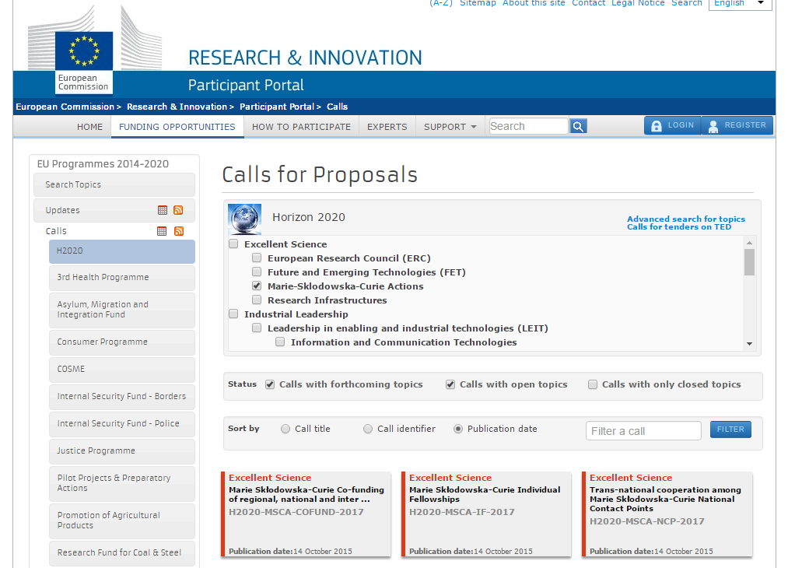
Participant portal

Slide 89
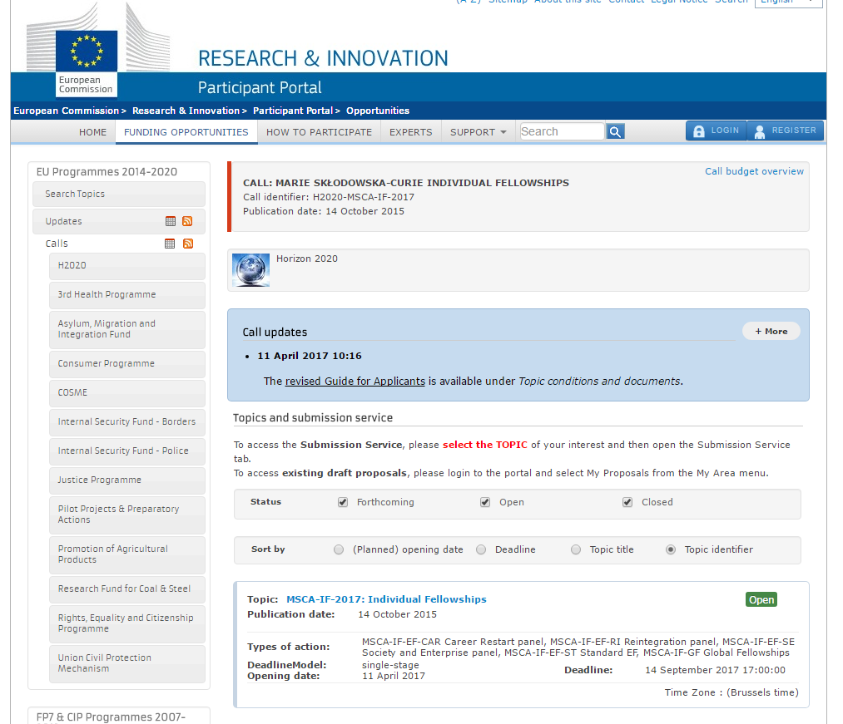
Participant portal

Slide 90
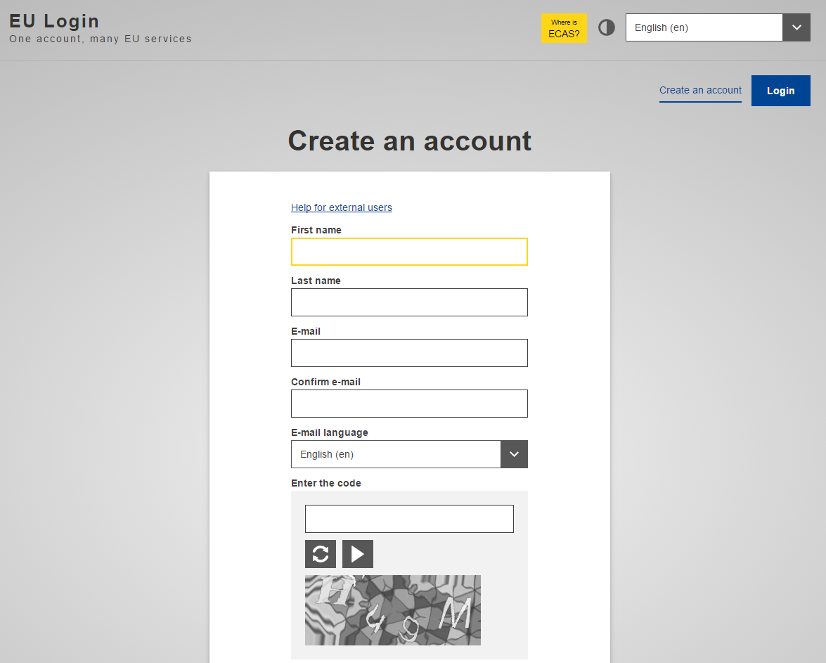
Authentication service
Ensure you have your EU Login account and the PIC number of the host institution (beneficiary)

Slide 91
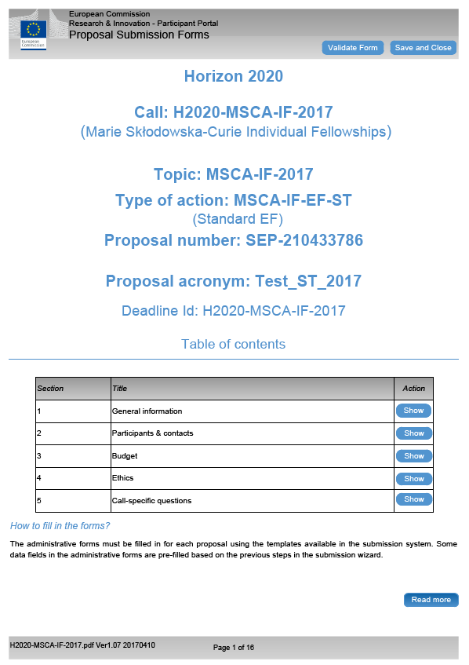
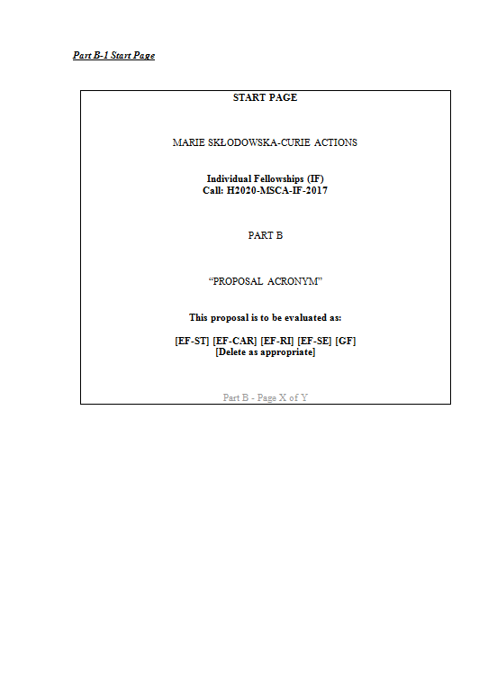
Structure of the proposal
Part A - structured data -
Part B - description of action -

Slide 92
Part A
This part is filled online
General information : title, acronym of the project, abstract (2000 characters max.)
Panels, descriptors and key words will guide the REA in the selection of experts for proposal evaluations
Data of participating organisations : the PIC (Participant Identification Code) is the one of the beneficiary
The budget will be calculated automatically
Ethics issues table
Validate your data, and « Save and close »

Slide 93
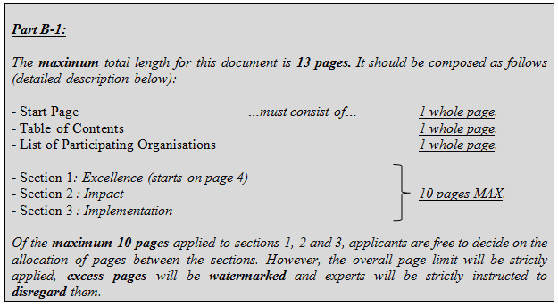
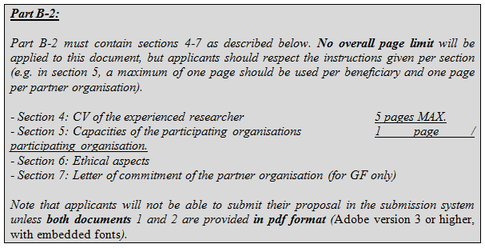
Part B

Slide 94
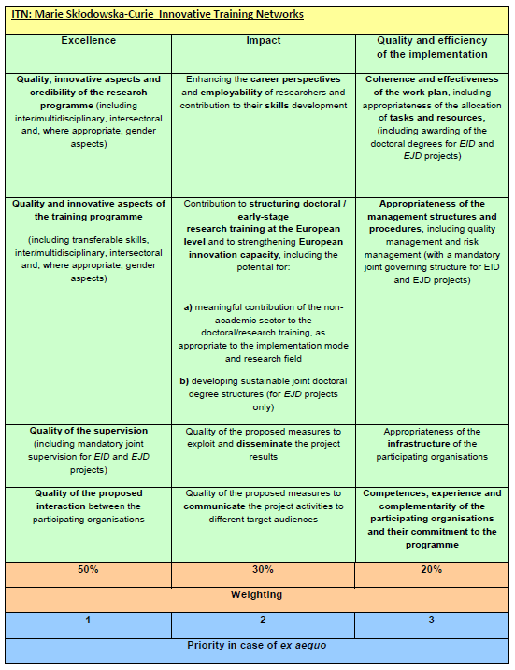
Evaluation criteria

Slide 95
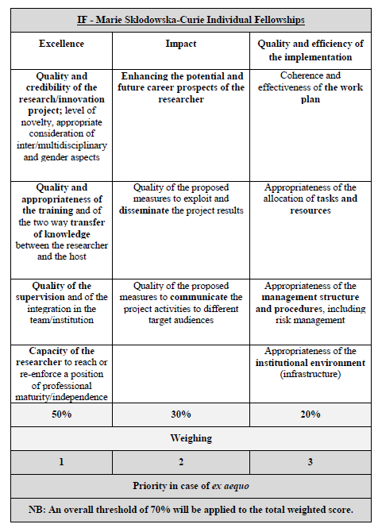
Evaluation criteria

Slide 96
Evaluation process
3 Individual Assessments
Consensus
Proposal A
Ranked list
Proposal B
B > A > C
Proposal C
Remote
Central
NEW : REMOTE CONSENSUS REPORT
➔ to reduce workload during Central week

Slide 97
Panels
Proposals are allocated to one of the eight main evaluation panels:
Chemistry (CHE)
Social Sciences and Humanities (SOC)
Economic Sciences (ECO)
Information Science and Engineering (ENG)
Environment and Geosciences (ENV)
Life Sciences (LIF)
Mathematics (MAT)
Physics (PHY)
In ITN, separate multidisciplinary panels will be created for EID and the EJD
In IF, separate multidisciplinary panels will be created for the Career Restart Panel (CAR), the Reintegration Panel (RI), and the Society and Enterprise Panel (SE).
COFUND evaluation will be organised in two different panels: Doctoral programmes and Fellowship programmes

Slide 98
Procedure
For each panel a ranked list is established
The distribution of the budget of the call will be proportional to the number of eligible proposals received in each panel, except where a specific budget for a multidisciplinary panel has been fixed in the call.
Excess budget will be reallocated to the other panels
Proposals will not be evaluated anonymously.
A panel review will recommend one or more ranked lists for the proposals
Priority order for proposals which have been awarded the same score
If necessary, any further prioritisation will be based on other appropriate characteristics, to be decided by the panel

Slide 99
Award criteria : key features
Evaluation scores will be awarded for each of the criteria, not for their individual elements
Each criterion scored from 0 to 5 - decimal points will be given:
0 - The proposal fails to address the criterion under examination or cannot be judged due to missing or incomplete information
1 - Poor. The criterion is addressed in an inadequate manner, or there are serious inherent weaknesses.
2 - Fair. While the proposal broadly addresses the criterion, there are significant weaknesses.
3 - Good. The proposal addresses the criterion well, although improvements would be necessary.
4 - Very good. The proposal addresses the criterion very well, although certain improvements are still possible.
5 - Excellent. The proposal successfully addresses all relevant aspects of the criterion in question. Any shortcomings are minor.
Total score subject to a threshold of 70%

Slide 100
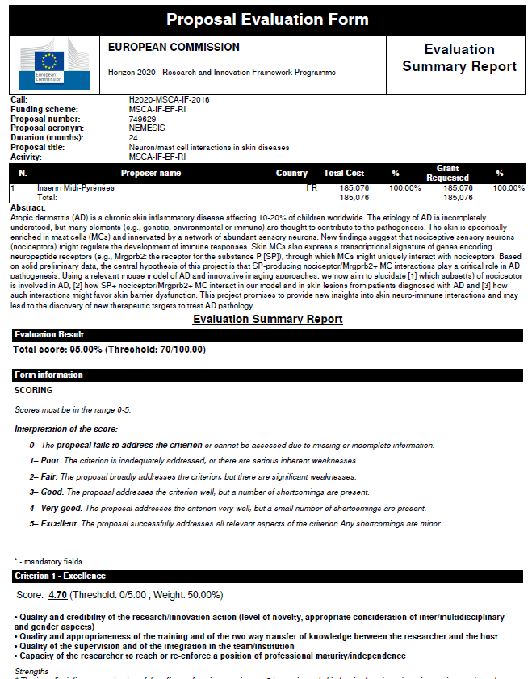
Evaluation summary report

Slide 101
Reminders
Experts will evaluate proposals as submitted (not on its potential if certain changes were to be made)
Proposals selected for funding are converted into description of work of the grant agreement.
Commitment Letters and recommendation letters
No reference to the outcome of previous evaluations in part B
Ethics (part A and part B)

Slide 102
Recommendations

Slide 103
Recommendations : project
1 - Choose the right call, the right area, consult NCP (eligibility)
2 - Respect conditions (participants, full time, budget, etc.)
3 - Show European dimension (scale, populations, cooperation)
4 - Develop perspectives (synergies, future…)
5 - Choose the right duration of your project in line with the objectives
6 - Have a strong partnership (host/you), complementarity, time
7 - Plan research and Training
8 - Have a work programme : use Gantt chart
9 - Mention interdisciplinarity, intersectorality, gender
10 - Describe carefully the methodology (advantages/difficulties)
11 - State of the art should be accurate
12 - Choose a problem-solving approach
13 - Choose clear and measurable objectives
14 - Insist on the innovative part of your project

Slide 104
Recommendations : training
Integrate training about equipment, new tools, new software
Take part in internal seminars, workshops, summer schools, …
Participate to dissemination of scientific culture
How to answer research calls
Financial training + management
Complementarity skills
(communication, Intellectual property, management…)
Inter-sectoral (public/private) relation, employability
Launch new collaborations

Slide 105
Recommendations : host institutions
Choose a well known laboratories, with a good reputation, and their complementarity
Choose a well known supervisors
Choose institutions with a high level of quality
Underline the main achievement of the institutions : patents, publications, number of PhD, contracts, international projects…
Describe carefully the infrastructure/equipment…

Slide 106
Recommendations : implementation
Describe responsibilities (who do what)
Anticipate resolution of conflicts, organise communication (meetings)
Describe the risks
Resources : environment, infrastructures
Describe host institution (library, equipment…)
Describe type of contract (justify stipend)

Slide 107
Recommendations : impact
Interest of your mobility (IF projects) for you, for the lab, etc.
Describe synergies (societal challenges)
Describe the European “added value”
Link your research with European policies : (ex: green papers, recommendations…)
Propose outreach activities with details
Propose links with students, with medias

Slide 108
Recommendations : writing
Respect the number of pages
Write in English and in good English (concision, accuracy)
Take care of the format : separations, tables, bold…)
Avoid redundancies
Give easy access to the information (numbers, tables, references…)
Read all documents : guides, guidelines for evaluators…
Write with the help of the supervisor and host institution (IF projects)
Take time for Abstract and keywords
Think as if you were the evaluator
Evaluators are from all over Europe and beyond
Forget national codes)
Take care of the criteria, weighting, threshold, success rates…
Give your proposal to read
Find an accepted project

Slide 109
Communication and outreach activities

Slide 110
Outreach activities
Marie Curie Ambassadors : visit schools, universities… to promote your research field to students and public audiences
Worshop Day : in areas to the raising of scientific awareness
Summer-school week
University or lab open day
Publick talks : interviews, podcasts, articles in Newspapers
EC Events
Marie Curie Alumni Assocation

Slide 111
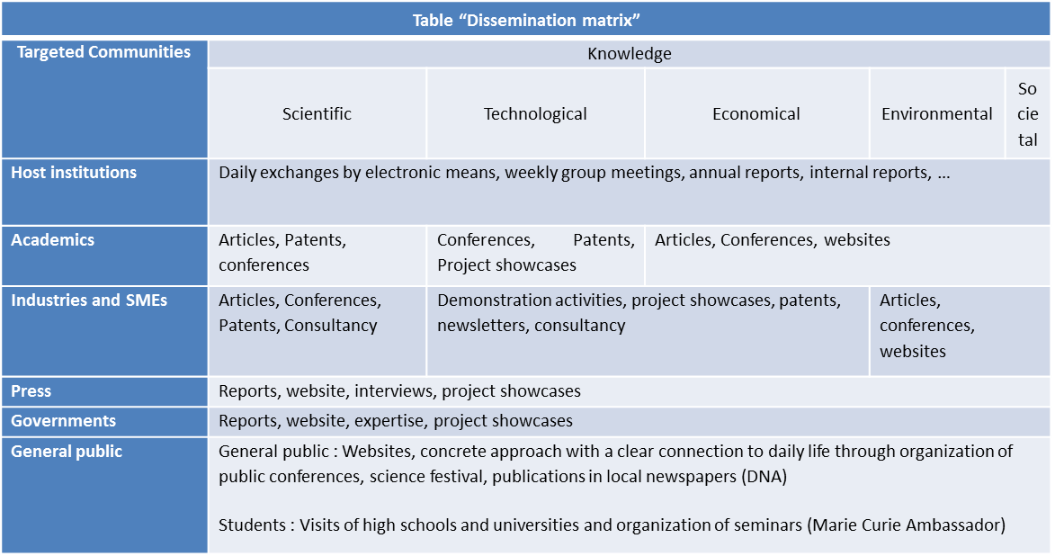
Dissemination and exploitation of results

Slide 112
IP Issues
Présentation des services de l’IPR Helpdesk
La propriété intellectuelle dans Horizon 2020
Conseiller les porteurs de projet sur la propriété intellectuelle
IPR Helpdesk
Fact sheet

Slide 113
Human resources strategy for researcher
HRS4R

Slide 114
EURAXESS
Website

Slide 115
http://www.horizon2020.gouv.fr/cid79134/boite-outils-pour-les-actions-marie-sklodowska-curie.html

Slide 116
National Contact Point : pcn.mariescurie@recherche.gouv.fr
Sandrine Schott-Carrière – Université de Strasbourg
Martine Roussel – RCP – MENESR
Sophie Beaubron – Université de Grenoble Alpes
Jean Jacques Bernadini – Alsace Innovation
Morgane Bureau – INSERM
Koralia Pavlaki – CNRS
Jean Marie Pincemin – Université de Poitiers
Cyrielle Tirman – Université de Lille - SHS

Slide 117
pcn-mariescurie@recherche.gouv.fr

Slide 118
ESR Analysis
Individual fellowships

Slide 119
Excellence (a/c)
Projet scientifique
Etat de l’art
Introduire le projet scientifique avec une description détaillée de l’état de l’art et les challenges actuels à relever
Permettre la justification de l’approche, des méthodes et des activités choisies
Montrer les avancées proposées par le projet pour dépasser cet état de l’art
Projet
Proposer un projet structuré, innovant, crédible, pertinent, opportun, ambitieux, original, stimulant
Choisir des méthodologies adaptées
Avoir une approche inter/multidisciplinaire
Utiliser des technologies de pointe
Souligner les opportunités de formation et d’acquisition de nouvelles connaissances
Rédiger un plan de carrière soutenu et ciblé incluant l’intégration optimale du chercheur, sa formation et des compétences transférables pour booster sa carrière et renforcer sa maturité professionnelle
Transfert des connaissances
Mettre en exergue le transfert des connaissances dans les deux sens : du chercheur vers le laboratoire (bénéficiaire ou partenaire) et inversement
Ne pas oublier de souligner ce transfert de connaissance lors des secondments

Slide 120
Excellence (b/c)
Candidat
Avoir un bon CV et des publications de qualité
Etre indépendant, productif et avoir une expérience passée pertinente :
réalisations significatives
prix internationaux
expériences à l’Europe et à l’International
enseignement et encadrement
obtention et gestion de financements
participation à des projets collaboratifs, des séminaires et des conférences
capacité d’adaptation à différentes cultures et différentes thématiques de recherche
membre de réseaux internationaux
etc.
Etre capable de faire preuves d’initiative, avoir des qualités de meneur et être reconnu dans le domaine
Montrer l’adéquation entre le chercheur et le superviseur, les objectifs du projet et l’organisation hôte
Démontrer un potentiel de maturité professionnelle

Slide 121
Excellence (c/c)
Superviseur
Mettre en exergue sa qualité, ses compétences, son expérience, sa reconnaissance dans le domaine et son engagement dans le projet
Souligner son réseau scientifique et ses collaborations
Démontrer ses capacités à former et encadrer des chercheurs (jeunes et expérimentés)
Laboratoire d’accueil
Démontrer la maîtrise de techniques et de technologies de pointe
Décrire les aménagements afin de garantir une intégration optimale du chercheur
accueil des chercheurs de qualité
taille de l’équipe raisonnable permettant la création d’une synergie entre les membres et l’émergence d’un chercheur indépendant
évènements afin de promouvoir les relations sociales et professionnelles parmi les membres de l’organisme
aide pour le déménagement, la famille
aménagements en adéquation avec la Charte et le Code
Souligner les collaborations du laboratoire dans des réseaux internationaux
Montrer l’excellence et la reconnaissance de l’équipe
Indiquer des résultats d’expériences préliminaires
➔ Nota Bene : Ne pas oublier les superviseurs et les organismes lors des phases aller des Global fellowships et lors des secondments !

Slide 122
Impact (a/d)
Plan de carrière
Acquérir et diversifier les compétences théoriques, techniques, managériales, etc. (ex : rédaction de propositions, gestion de projet, enseignement, encadrement, etc.)
Atteindre une maturité professionnelle et une position autonome et indépendante dans la recherche
Offrir de nouvelles perspectives de carrière
Offrir la possibilité de travailler dans un environnement multidisciplinaire
Améliorer le réseau international du candidat
Profiter d’un domaine de recherche ou d’un laboratoire émergent : permettre au candidat de contribuer aux avancées dans le domaine ou dans l’infrastructure
Définir un plan de carrière

Slide 123
Impact (b/d)
Quelques spécificités…
Career Restart Panel
Reconnecter le candidat à la communauté de recherche (ex : acquisition de compétences aujourd’hui indispensables dans la discipline concernée)
Mettre en évidence comment le projet va permettre la reprise d’une carrière scientifique après une interruption (ex : obtention d’un poste à la fin du contrat)
Reintegration panel
Faciliter la réintégration du candidat en Europe
Global Fellowship
Montrer comment les compétences acquises durant la phase aller vont être transférées directement lors de la phase retour en Europe
Souligner la réintégration en Europe en tant que chercheur expérimenté

Slide 124
Impact (c/d)
Dissémination des résultats & Communication
Détailler une stratégie adéquate, originale, solide, réaliste, planifiée, efficace
Opter pour une stratégie en accord avec les différentes missions (work packages) et les objectifs du projet
Entreprendre des activités :
à différentes échelles : locale, régionale, nationale, etc.
à différents termes : court, moyen, long
par différents canaux : journaux, radio, web, conférences, ateliers dans des écoles, cours, plateforme expérimentale, réseaux sociaux, ambassadeur des Marie S. Curie, etc.
pour différents publics : grand public, étudiants, association de patients, publics ciblés, industrie, etc.
Souligner l’implication et la mobilisation du public au travers de ces actions spécifiques (« public engagement »)
Utiliser l’expérience passée du candidat pour ce type d’activités (ex : expert en communication grâce à la participation à de nombreux séminaires et conférences, qualité de journaliste scientifique free-lance, etc.)
S’appuyer sur les compétences et services existants (ex : département des relations publiques, expérience du bénéficiaire en matière de communication avec des publics non spécialistes, etc.)
Penser à une stratégie d’exploitation des résultats

Slide 125
Impact (d/d)
Retombées
Montrer l’impact sur la thématique de recherche (direct et à plus long terme)
Choisir la bonne stratégie pour maximiser la contribution de la bourse sur l’excellence scientifique et la compétitivité européenne
Créer une synergie de longue durée entre les laboratoires européens
Démontrer les bénéfices pour l’organisation hôte grâce aux connaissances et l’expertise du candidat
Souligner les bénéfices du « secondment »
Penser à la potentielle valeur commerciale
Montrer l’importance de la participation des partenaires industriels
Souligner l’impact sur la carrière du chercheur : opportunité de travailler avec le secteur non académique, projet de recrutement dans l’organisme, projet de nouvelles candidatures pour des financements, etc.
Propriété intellectuelle
Ne pas négliger les détails concernant la propriété intellectuelle (protection, exploitation, commercialisation)
Prévoir une stratégie pour le transfert technologique (le cas échéant)

Slide 126
Implementation a/d
Plan de travail (work plan) :
Rédiger un projet structuré, faisable, crédible, cohérent et de qualité
Le relier avec le plan personnel de développement de carrière
(si applicable) Penser à une chronologie logique : de la recherche fondamentale à la mise sur le marché
Tâches (work packages) :
Articuler les différentes tâches de façon appropriée et efficace
Ne pas négliger le Gantt Chart :
structuré et directement lié aux objectifs du projet
toute activité doit apparaître : formation, dissémination, communication, gestion, « secondments »
Etablir un planning réaliste dans le temps
Préciser la répartition des tâches et des ressources
Etapes (milestones) & objectifs (deliverables) :
Décrire les étapes et les objectifs de façon détaillée, organisée, réaliste et qui répondent aux attentes du projet
Indiquer des objectifs intermédiaires en nombre suffisant pour :
suivre et évaluer la progression du projet
permettre la mise en place de mesures correctives en cas de problème
Différencier les « étapes » des « objectifs »

Slide 127
Implementation b/d
Propriété intellectuelle :
Tenir compte des problèmes liés à la propriété intellectuelle (ex : bénéficier d’un bureau dédié à ces questions, etc.)
Adopter des mesures adéquates pour la gestion de la propriété intellectuelle (ex : signature d’un partnership agreement dans le cas des Global fellowships)
Risques (risks) :
Evaluer les risques qui pourraient nuire aux projets
Prévoir des mesures correctives appropriées, voire des plans B (preuve de la maturité scientifique du candidat)
Procédure de suivi (monitoring process) :
Indiquer le suivi régulier du projet et du développement de carrière du chercheur par le(s) superviseur(s) (organisation bénéficiaire, partenaire, secondment) : réunions, rapports, entretiens, mails, etc.
Montrer l’expérience du/des superviseur(s) en termes de suivi de projet
Démontrer l’interaction entre le chercheur, l’équipe de recherche et le candidat afin de faire avancer le projet, de discuter des avancées et des difficultés rencontrées, etc. et de garantir un développement optimal du projet

Slide 128
Implementation c/d
Laboratoire d’accueil (host lab) & organisation partenaire (pays tiers, secondments)
Décrire les infrastructures, les équipements et les technologies de pointe mis à disposition du chercheur
Montrer l’intégration du chercheur
Souligner la qualité de l’environnement scientifique : expertise scientifique et expérimentale, collaborations, réseaux, reconnaissance internationale, activité multidisciplinaire, etc.
Mettre en évidence la complémentarité entre les objectifs du laboratoire et ceux du projet
Indiquer comment le laboratoire va bénéficier de l’expérience passée du candidat
Institution d’accueil (host institution) & organisation partenaire (pays tiers, secondments)
Souligner les compétences, l’expérience, la qualité et la complémentarité avec les activités du candidat
Montrer l’engagement crédible et le soutien effectif auprès du candidat (administratif, financier, etc.), tant au niveau du projet scientifique que de ses conditions de travail
Mettre en évidence l’expérience en termes d’accueil de chercheur et de gestion de contrats européens
Souligner les interactions avec les publics spécifiques (association de patients, groupes pharmaceutiques, agriculteurs, etc.)
« Secondment » : Démontrer la plus-value et la pertinence pour le projet : collaboration avec un partenaire industriel, formation sur une technique de pointe, etc.

Slide 129
Implementation d/d
Gestion du projet et des ressources financières
Opter pour des procédures et des structures de gestion adaptées et de qualité
Décrire les arrangements pratiques et administratifs pour la mise en œuvre du projet
Mettre en évidence les services mis à la disposition du chercheur (ex : services dédiés chez le bénéficiaire)
S’appuyer sur les compétences du candidat si possible
Respect de l’article 32 dans la mise en œuvre du contrat : Traduction

