Slide 1
Horizon 2020
Marie Skłodowska-Curie Actions

Slide 2
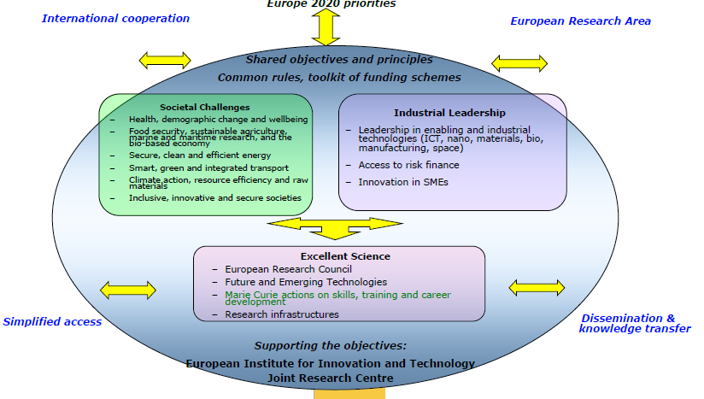
Horizon 2020

Slide 3
Strategic programming approach
    Attract and retain research talent
    Develop state-of-the-art, innovative training schemes, consistent with the highly competitive and increasingly inter-disciplinary requirements of research and innovation
    Promote sustainable career development in research and innovation
    Focus on delivering new knowledge and skills, in line with the key driver identified in the strategic programming approach
    Contribute to a strong partnership with MS via the co-funding mechanism

Slide 4
Key features of the MSCA part
    Open to all domains of research and innovation from basic research up to market take-up and innovation services
    Entirely bottom-up
    Participation of non-academic sector strongly encouraged, especially industry and SMEs
    Mobility as the key requirement - funding on condition participants move from one country to another
    Promotion of attractive working and employment conditions
    Particular attention to gender balance
    Budget 2014/2020 : 6 162 million €

Slide 5
FP7 MCA Achievements
~ 80 000 researchers financed since creation of MCA
> 10 000 PhD supported in FP7
~ 9 200 projects funded so far in FP7 (€4.2 billion)
~ 17 800 participations of host organisations in 83 countries (46 TC)
~ 18 500 participations of MCA researchers coming from all over the world: 130 nationalities (90 TC)
66 000 researcher-months exchanged (~22 000 individuals) in IRSES
SMEs play a major role (IAPP & ITN)
38% women participation in FP7 MCA (target: 40%)

Slide 6
MSCA in H2020
Innovative Training Networks | ITN | Doctoral and initial training
Individual Fellowships | IF | Support for experienced researchers undertaking international and inter-sector mobility
Research and Innovation Staff Exchange | RISE | International and inter-sector cooperation through the exchange of staff
Co-funding of programmes | COFUND | Co-funding of regional, national and international programmes: doctoral programmes fellowship programmes
European Researchers’ Night | NIGHT | Support and policy actions Non call-based activities

Slide 7

ITN : Innovative Training Networks
Education
and Culture

Slide 8
Innovative Training Networks (ITN)
Objective
      to raise excellence and structure research and doctoral training
      to train a new generation of creative, entrepreneurial and innovative early-stage researcher
    Scope
      European Training Networks (ETN), European Industrial Doctorates (EID) or European Joint Doctorates (EJD)
      Triple 'i' dimension of mobility and particular focus on innovation skills
      Support to ESR for 3-36 months
    Expected Impact
      to enhance researchers' employability and provide them with new career perspectives
Education
and Culture

Slide 9
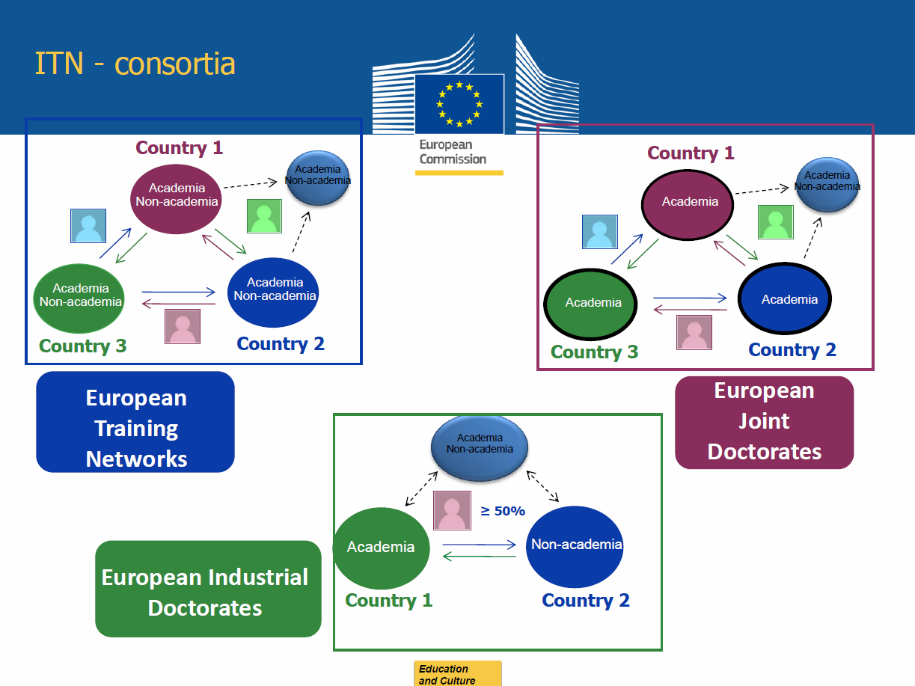
ITN - Consortia

Slide 10
Innovative Training Networks (ITN)
Eligibility conditions
      Created by at least three beneficiaries (or at least two for EID) located in different EU Member States and/or Associated Countries. Above this minimum, the participation of institutions from any country or organisation is possible.
      Support to early-stage researchers only
      Duration of projects : maximum four years
      EID : at least one beneficiary must be entitled to award doctoral degrees and at least one beneficiary must come from the non-academic sector
      EJD : at least three beneficiaries must be entitled to award doctoral degrees.
      Limit : ETN and EJD, recruitment of a maximum 540 person-months (EID180).
      Not more than 40% of the project budget shall be dedicated to hosts in the same country (except for EID).
Education
and Culture

Slide 11
Innovative Training Networks (ITN)
Organisation
      Supervisory board co-ordinating network-wide training and establishing active and continuous communication and exchange of best practice.
      Complementary competences of the participants,
      Networking activities, organisation of workshops and conferences to facilitate sharing of knowledge.
      Meaningful exposure of each researcher to other sectors
      Training modules addressing transferable skills (e.g. entrepreneurship, management of research, intellectual property, ethics, communication…).
      EID and EJD : enrolment in the doctoral programme and creation of joint governance structure with joint admission, selection, supervision, monitoring…
      EJD : award of joint, double or multiple doctoral degrees
      Quality of supervision and mentoring arrangements
      A Career Development Plan
Education
and Culture

Slide 12
Innovative Training Networks (ITN)
Marie Skłodowska Curie Actions | Researcher unit cost [person/month] |  |  | Institutional unit cost [person/month]
 | Living allowance | Mobility allowance | Family Allowance | Research, training and networking costs | Management and indirect costs
Innovative Training Networks | 3 110 | 600 | 500 | 1 800 | 1 200
Education
and Culture

Slide 13
Innovative Training Networks (ITN)
Call 2014
      Publication date: 11 December 2013 (launch of Horizon 2020)
      Deadline(s): 09 avril 2014 at 17.00.00 Brussels time
      Indicative budget: 405,18 M€ from the 2014 budget:
        25.5 M€ are allocated to EID
        30 M€ are allocated to EJD.
      Duration: maximum four years
Education
and Culture

Slide 14
Results 2012
Education
and Culture

Slide 15
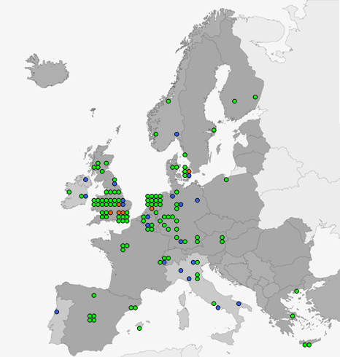
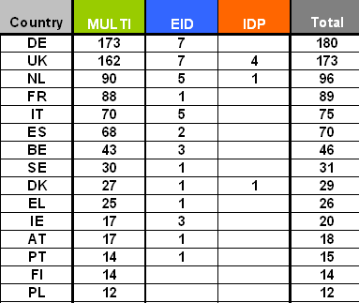
Coordinators 2012
Participants 2012
Education
and Culture

Slide 16
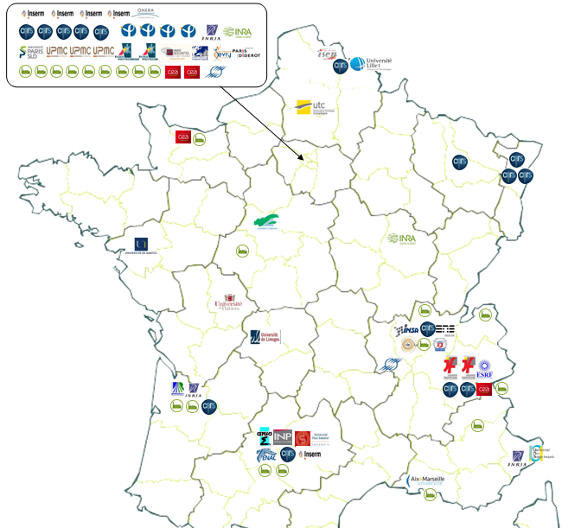
French ITN 2012
Education
and Culture

Slide 17
IF : Individual Fellowships
Education
and Culture

Slide 18
Individual Fellowships (IF)
Objective
      to enhance the creative and innovative potential of experienced researchers
      to provide opportunities to acquire new knowledge, resume a career or return to Europe
      the beneficiary shall be a participant established in EU (MS/AC) and employing the researcher during the project
    Scope
      Trans-national fellowships awarded to the best or most promising researchers
      European Fellowships (12-24 months) or Global Fellowships (12-24 months + mandatory return phase of 12 months)
      Career Restart Panel and Reintegration Panel
      Secondments, notably in the non-academic sector
    Expected Impact
      to release the full potential of researchers and development of their careers in both the academic and non-academic sectors

Slide 19
Individual Fellowships (IF)
European Fellowships
      Open to researchers currently within and outside Europe. The country where the European Fellowship is held is subject to the rules of mobility.
      Support to individuals to resume research in Europe after a career break, e.g. after parental leave, is ensured via a separate multi-disciplinary panel. Researchers must not have been active in research for at least 12 months immediately prior to the deadline for submission.
      Return and reintegration aspects via a separate multi-disciplinary panel. For the reintegration panel, there shall be mobility into Europe and the researcher shall have previously been a long-term resident in Europe.
Global Fellowships
      Based on a secondment to a third country and a mandatory 12 month return period to a European host.
      The country where the Global Fellowship secondment takes place is subject to the rules of mobility, whereas the return phase is not.
    Secondment phase in Europe, e.g non-academic sector : three to six months.
Education
and Culture

Slide 20
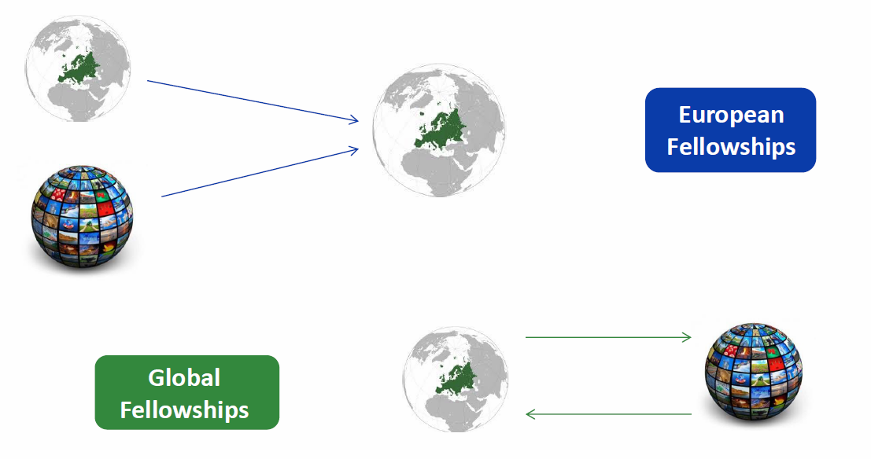
Individual Fellowships (IF)

Slide 21
Individual Fellowships (IF)
Marie Skłodowska Curie Actions | Researcher unit cost [person/month] |  |  | Institutional unit cost [person/month]
 | Living allowance | Mobility allowance | Family Allowance | Research, training and networking costs | Management and indirect costs
Individual Fellowships | 4 650 | 600 | 500 | 800 | 650
Education
and Culture

Slide 22
Individual Fellowships (IF)
Call 2014
      Publication date: 12 March 2014
      Deadline(s): 11 September 2014 at 17.00.00 Brussels time
      Indicative budget: 240.5 M€ from the 2014 budget:
        29 M€ are allocated to Global Fellowships
Education
and Culture

Slide 23
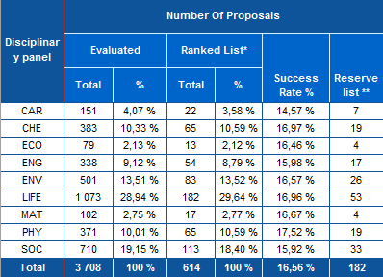
Results (IEF 2012)
Education
and Culture

Slide 24
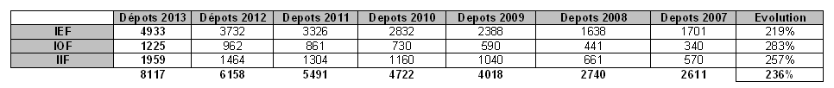
Evolution FP7
Education
and Culture

Slide 25
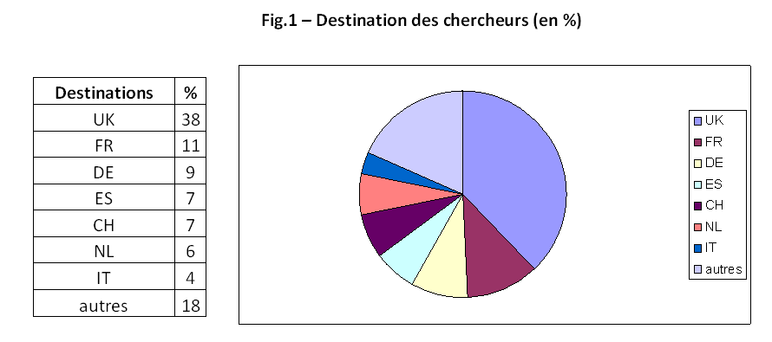
Individual mobility in FP7
Education
and Culture

Slide 26
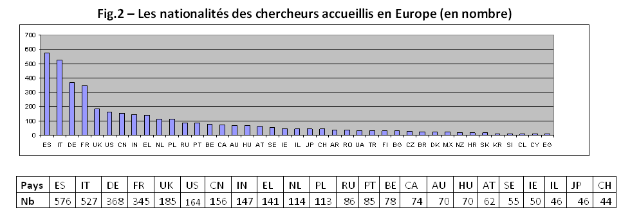
Individual mobility in FP7
Education
and Culture

Slide 27
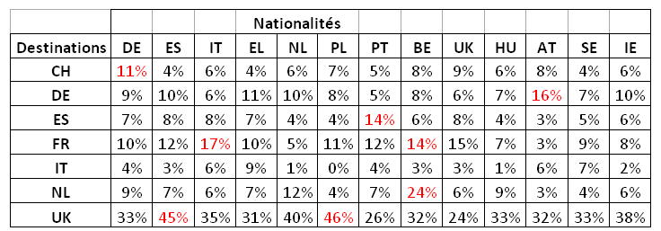
Individual mobility in FP7
Education
and Culture

Slide 28
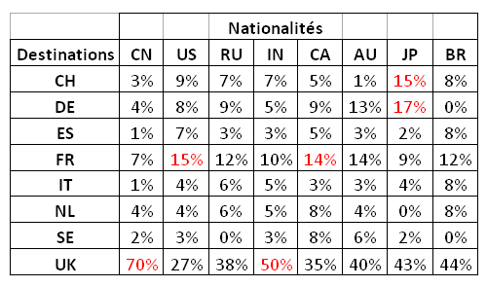
Individual mobility in FP7
Education
and Culture

Slide 29
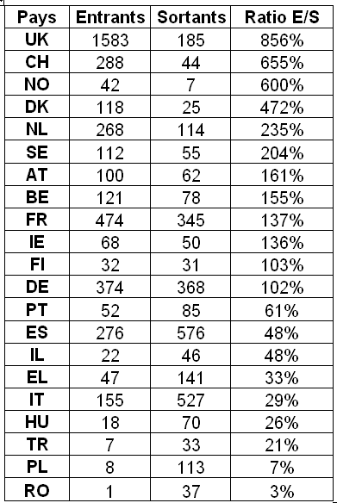
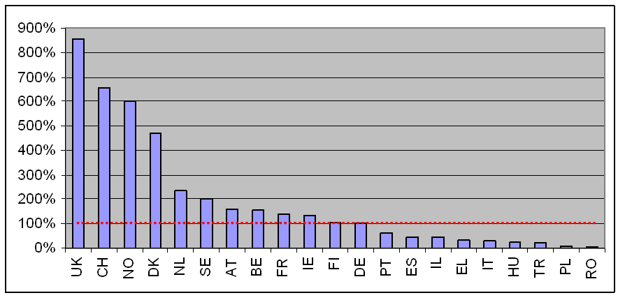
Outgoing / Incoming

Slide 30
RISE : Research and Innovation Staff Exchange
Education
and Culture

Slide 31
Research and Innovation Staff Exchange (RISE)
Objective
      to promote international and inter-sector collaboration through research and innovation staff exchanges
      to foster a shared culture of research and innovation
    Scope
      International and inter-sector collaboration and transfer of knowledge
      Joint research and innovation project
      Secondments of staff members for 1-12 months
      Within Europe: only inter-sector secondments
      No secondments between institutions located outside Europe or within the same MS/AC
    Expected Impact
      to strengthen the interaction between organisations in the academic and non-academic sectors, and between Europe and third countries

Slide 32
Research and Innovation Staff Exchange (RISE)
Eligibility conditions
      Participants established in at least three different countries of which at least two must be EU MS/AC
      If all participants are from the same sector, at least one participant must be from a third country.
      Above this minimum, the participation of institutions from any country or organisation
      Duration of projects : maximum four years
      Limit : maximum 540 person-months
Education
and Culture

Slide 33
Research and Innovation Staff Exchange (RISE)
Staff members
      Researchers (ESR and ER), innovators, administrative, managerial and technical staff supporting the research and innovation activities of the project.
      They shall be actively engaged in or linked to research and/or innovation activities for at least six months at the sending institution prior to the first period of secondment.
      Secondments in RISE are not subject to the mobility rules.
Education
and Culture

Slide 34
Research and Innovation Staff Exchange (RISE)
MS/AC
+
MS/AC
+ …
Same sector …
All in Europe …
MS/AC
MS/AC
MS/AC
MS/AC
Academic sector
Academic sector
Academic sector
Academic sector
+
+
Third country
MS/AC
Academic sector
Non-academic sector
→ International mobility
→ Intersectoral mobility
International and intersectoral mobility …
MS/AC
MS/AC
Non-academic sector
Academic sector
+
Third country
Non-academic sector

Slide 35
Research and Innovation Staff Exchange (RISE)
Marie Skłodowska Curie Actions | Researcher unit cost [person/month] Top-up allowance | Institutional unit cost [person/month]
 |  | Research, training and networking costs | Management and indirect costs
Research and Innovation Staff Exchange | 2 000 | 1 800 | 700
Education
and Culture

Slide 36
Research and Innovation Staff Exchange (RISE)
Call 2014
      Publication date: 11 December 2013 (launch of Horizon 2020)
      Deadline(s): 24 April 2014 at 17.00.00 Brussels time
      Indicative budget: 70 M€ from the 2014 budget
Education
and Culture

Slide 37
COFUND
Education
and Culture

Slide 38
COFUND
Objective
      to stimulate regional, national or international programmes to foster excellence in researchers' training, mobility and career development
    Scope
      Co-funding new or existing regional, national, and international programmes to open up to, and provide for, international, intersectoral and interdicisplinary research training, as well as transnational and cross-sector mobility of researchers at all stages of their career
      Possibilities of synergies with structural funds
      Doctoral Programmes (for ESR) and Fellowship Programmes (for ER)
      Researchers to comply with the mobility rules of the MSCA
      Minimum support for researchers: 3 months
      Implemented by a sole beneficiary
    Expected Impact
      to exploit synergies between European Union actions and those at regional, national, and international level, and leverage funding

Slide 39
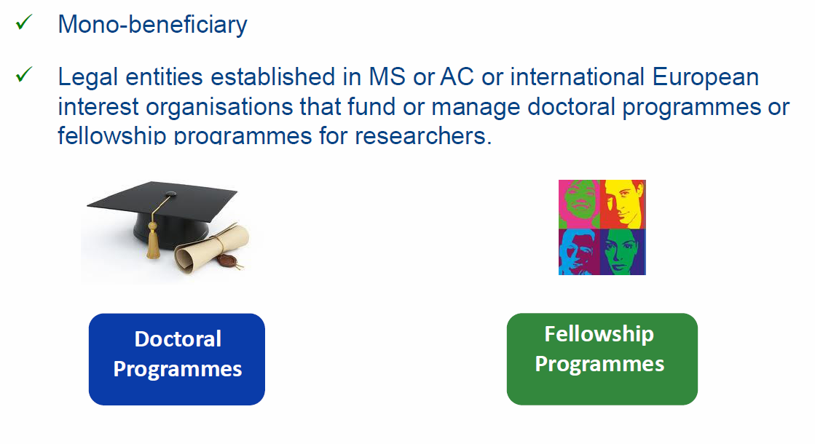
COFUND
Mono-beneficiary
Legal entities established in MS or AC or international European interest organisations that fund or manage doctoral programmes or fellowship programmes for researchers

Slide 40
COFUND
Doctoral Programmes
      Training follows the EU Principles on Innovative Doctoral Training.
      Collaboration with a wider set of partners, including from the non-academic sector, which may provide hosting or secondment opportunities or training
Fellowships Programmes
      Regular selection rounds following fixed deadlines or regular cut-off dates allowing a fair competition between applying researchers.
      The selections should be based on open, widely advertised competition, with transparent international peer review and selection of candidates on merits.
      Mobility types may be similar to the ones supported under Marie Skłodowska-Curie.
      Limitations regarding the researchers' origin and destination should be avoided
      Proposed programmes are encouraged to cover all research disciplines
Education
and Culture

Slide 41
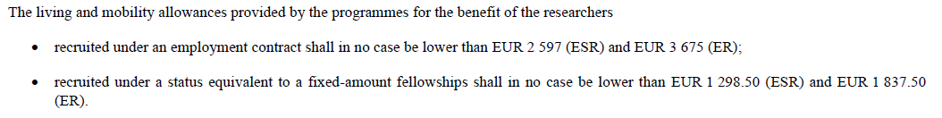
COFUND
Marie Skłodowska Curie Actions | Research unit cost [person/month]*** |  | Institutional unit cost [person/month]
COFUND | Early-stage researchers | 3 710 | 650
 | Experienced researchers | 5 250
*** These unit costs will be subject to a co-funding rate of 50%
Education
and Culture

Slide 42
COFUND
Call 2014
      Publication date: 10 April 2014
      Deadline(s): 02 octobre 2014 at 17.00.00 Brussels time
      Indicative budget: 80 M€ from the 2014 budget:
        30 M€ are allocated to Doctoral Programmes.
      Contribution has maximum overall of 10 M€ to a single applicant
      Duration: 36 to 60 months. This duration includes also the time that is needed to select or recruit the researchers
      Participants having benefited from COFUND under previous calls will explain how the latest proposal relates to and goes beyond the earlier grant and provide evidence for its quality
Education
and Culture

Slide 43
NIGHT : European Researchers’ Night
Education
and Culture

Slide 44
European Researchers’ Night (NIGHT)
Objective
      to bring researchers closer to the general public
      to increase awareness of research and innovation activities
    Scope
      Yearly event, typically on the last Friday of the month of September
      Focus on the general public, addressing and attracting people regardless of the level their scientific background
      Special focus on pupils and students
      Promotion of the European dimension and gender balance in research
      Involvement of researchers funded by Horizon 2020
    Expected Impact
      to raise awareness of the importance of research careers
      in the long term, to encourage young people to embark on scientific careers

Slide 45
European Researchers’ Night (NIGHT)
Call 2014
      Publication date: 11 December 2013 (launch of Horizon 2020)
      Deadline(s): 04 March 2014 at 17.00.00 Brussels time
      Indicative budget: 8 M€ from the 2014 budget
      Duration : maximum 2 years
Education
and Culture

Slide 46
Definitions
Education
and Culture

Slide 47
Participants
Academic sector
      Public or private higher education establishments awarding academic degrees
      Public or private non-profit research organisations whose primary mission is to pursue research
      International European interest organisations
Non-Academic sector
      Any socio-economic actor not included in the academic sector
Education
and Culture

Slide 48
Participants
Beneficiaries : signatory to the agreement
      Full partners with complete responsibility for executing the programme
      Contribute directly to the implementation of the research training programme by appointing, supervising, hosting and training researchers.
      May also provide secondment opportunities
Partner Organisations : non-signatory to the agreement
      Provide trainings and hosting researchers during secondment
      Do not employ the researchers within the project
      Shall include a letter of commitment in the proposal to ensure their real and active participation
Education
and Culture

Slide 49
Researchers
Early Stage Researchers
      Shall at the time of recruitment (ITN, COFUND) or secondment (RISE), be in the first four years (full-time equivalent) of their research careers and have not yet been awarded a doctoral degree
Experienced Researchers
      Shall, at the time of the relevant deadline for submission of proposals (IF), recruitment (COFUND) or secondment (RISE), be in possession of a doctoral degree or have at least four years of full-time equivalent research experience
Nationality, residence
      Global fellowships and Reintegration panel in IF are open to nationals or long-term residents of EU Member States and Associated Countries.
      Long-term residence means a period of full-time research activity of at least 5 consecutive years
Education
and Culture

Slide 50
Mobility Rules
    At the time of the relevant deadline for submission of proposals (IF), or recruitment by the host organisation (ITN), researchers shall not have resided or carried out their main activity in the country of their host organisation for more than 12 months in the 3 years immediately prior to the reference date
    Compulsory national service and/or short stays such as holidays are not taken into account
    International European interest organisations : researcher shall not have spent more than 12 months in the 3 years immediately prior to the reference date in the same appointing organisation
    Career Restart Panel and the Reintegration Panel in IF: researchers shall not have resided or carried out their main activity in the country of their host organisation for more than 3 years in the 5 years immediately prior to the relevant deadline for submission of proposals
Education
and Culture

Slide 51
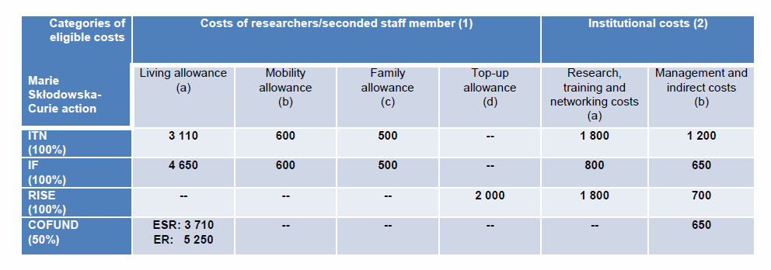
EU Contributions / Amounts

Slide 52
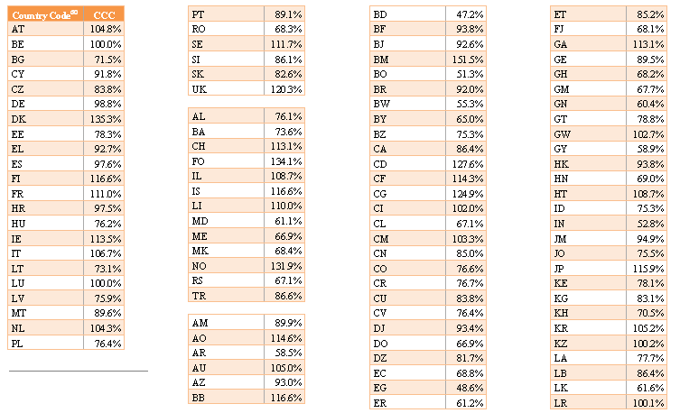
Country Correction Coefficients
Education
and Culture

Slide 53
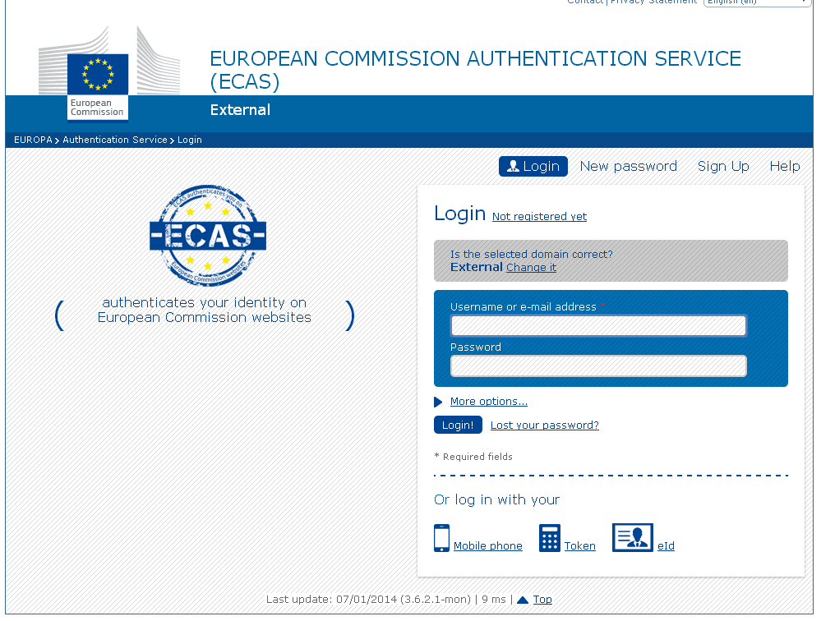
Participant portal

Slide 54
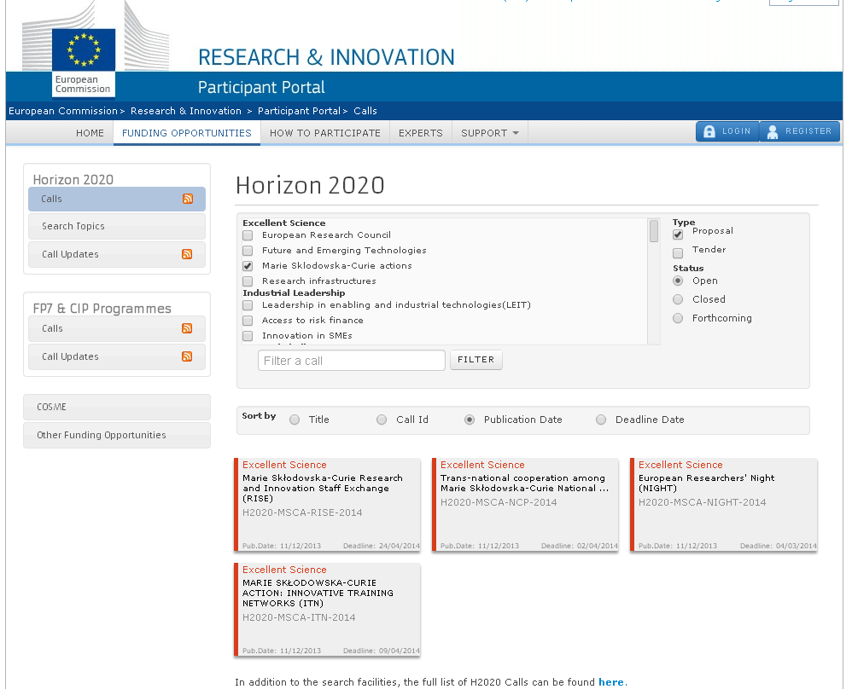
Participant portal

Slide 55
Panels
    Proposals are allocated to one of the eight main evaluation panels:
      Chemistry (CHE)
      Social Sciences and Humanities (SOC)
      Economic Sciences (ECO)
      Information Science and Engineering (ENG)
      Environment and Geosciences (ENV)
      Life Sciences (LIF)
      Mathematics (MAT)
      Physics (PHY)
    In ITN, separate multidisciplinary panels will be created for EID and the EJD
    In IF, separate multidisciplinary panels will be created for the Career Restart Panel (CAR) and the Reintegration Panel
    COFUND evaluation will be organised in two different panels: Doctoral programmes and Fellowship programmes
Education
and Culture

Slide 56
Evaluation procedure
    For each panel a ranked list is established
    The distribution of the budget of the call will be proportional to the number of eligible proposals received in each panel, except where a specific budget for a multidisciplinary panel has been fixed in the call.
    Excess budget will be reallocated to the other panels
    Proposals will not be evaluated anonymously.
    A panel review will recommend one or more ranked lists for the proposals
    Priority order for proposals which have been awarded the same score
    If necessary, any further prioritisation will be based on other appropriate characteristics, to be decided by the panel
Education
and Culture

Slide 57
Proposals
Format
      Proposal page limits and layout: 30 pages,
      Except IF : 10 pages, excluding the CV of the researchers and the annexes
      Experts will be instructed to disregard any excess pages
Timetable
      Information on the outcome of the evaluation : maximum 5 months after the deadline
      Indicative date for the signing of grant agreements: maximum 3 months from the date of informing applicants
Education
and Culture

Slide 58
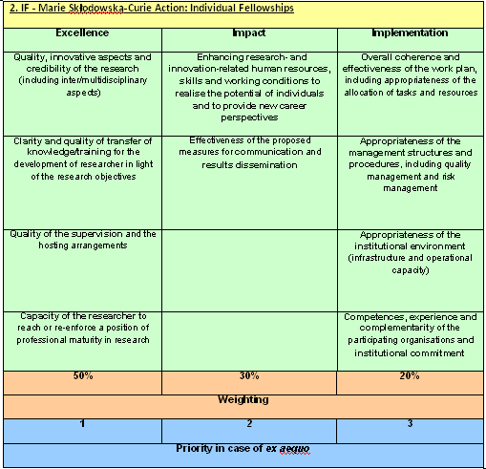
Award criteria
    Excellence : 50%
    Impact : 30%
    Implementation : 20%
Education
and Culture

Slide 59
Award criteria :
Key features
Evaluation scores will be awarded for each of the criteria, not for their individual elements
Each criterion scored from 0 to 5 - decimal points will be given:
0 - The proposal fails to address the criterion under examination or cannot be judged due to missing or incomplete information
1 - Poor. The criterion is addressed in an inadequate manner, or there are serious inherent weaknesses.
2 - Fair. While the proposal broadly addresses the criterion, there are significant weaknesses.
3 - Good. The proposal addresses the criterion well, although improvements would be necessary.
4 - Very good. The proposal addresses the criterion very well, although certain improvements are still possible.
5 - Excellent. The proposal successfully addresses all relevant aspects of the criterion in question. Any shortcomings are minor.
Total score subject to a threshold of 70%
Education
and Culture

Slide 60
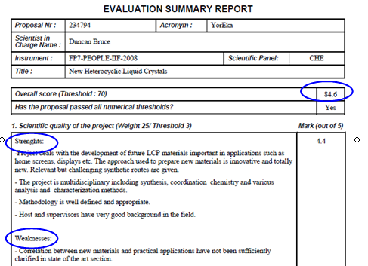
Evaluation
Summary
Report
Education
and Culture

Slide 61
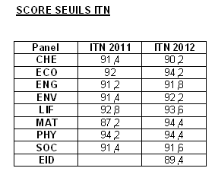
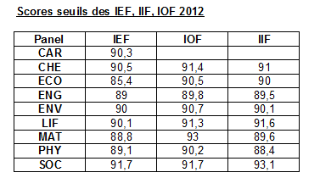
Thresholds
Education
and Culture

Slide 62
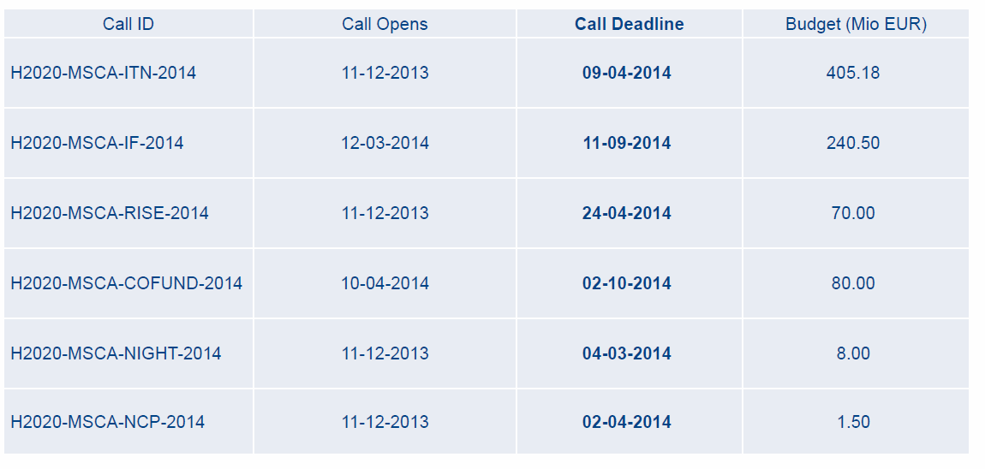
Calls 2014

Slide 63
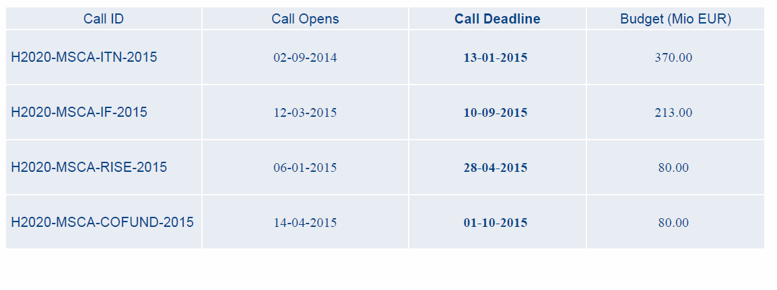
Calls 2015

Slide 64
Recommandations : the project
1 - Choose the right call, the right area, consult NCP (eligibility)
2 - Respect conditions (participants, full time, budget, etc.)
3 - Show european dimension (scale, populations, cooperations)
4 - Develop perspectives (synergies, future…)
5 - Choose the right duration of your project in line with the objectives
6 - Have a strong partnership (host/you), complementarity, time
7 - Plan research and Training
8 - Have a workprogramme : use Gantt chart
9 - Mention interdisciplinarity, intersectorality
10 - Describe carefully the methodology (advantages/difficulties)
11 - State of the art should be accurate
12 - Choose a problem-solving approach
13 - Choose clear and measurable objectives
14 - Insist on the innovative part of your project

Slide 65
Recommandations : researcher
15 - Plan research and Training : show the training capacities
16 - Argue about your career (leadership, maturity…)
17 - Choose an effective mobility (genuine)
18 - Underline your major publications
19 - Underline the perfect appropriatness of your profil and the project

Slide 66
Recommandations : training
20 - Integrate training about equipments, new tools, new softwares
21 - Take part in internal seminars, workshops, summer schools, …
22 - Participate to dissemination of scientific culture
23 - How to answer research calls
24 - Financial training + management
25 - Complementarity skills
(communication, Intellectual property, management…)
26 - Intersectoral (public/private) relation, employability
27 - Launch new collaborations

Slide 67
Recommandations : host laboratory
28 - Choose a well known laboratory, with a good reputation
29 - Choose a well known supervisor
30 - Choose an institution with a high level of quality
31 - Underline the main achievement of your host laboratory
(patents, publications, number of PhD, contracts, international projects…)
32 - Describe carefully the infrastructure/equipments…

Slide 68
Recommandations : implementation
33 – Describe the management of the project
34 - Describe responsabilities (who do what)
35 - Anticipate resolution of conflicts, organise communication (meetings)
36 - Organise your budget (even with flat rate) :
37 - Resources : environment, infrastructures
38 - Expenses : summer schools, conferences, consumables
39 - Describe host institution (library, equipments, C&C…)
40 - Describe type of contract (justify stipend)

Slide 69
Recommandations : impact
41 - Interest of your mobility (for you, for the lab, etc.)
42 - Describe synergies (societal challenges)
43 - Describe the European “added value”
44 - Link your research with European policies
(ex: green papers, recommendations…)
45 - Propose outreach activities
(ex: Science week, researchers night)
46 - Propose links with students, with medias

Slide 70
Recommandations : writing
47 - Respect the number of pages for each part
48 - Write in English and in good English (concision, accuracy)
49 - Take care of the format (diagrams, tables, bold…)
50 - Avoid redundancies
51 - Give easy access to the information (numbers, tables, references…)
52 - Read all documents : guides, guidelines for evaluators…
53 - Write with the help of the supervisor and host institution
54 - Take time for Abstract and keywords
Think as if you were the evaluator
(3 persons, interdisciplinarity/intersectoriality of the panel…)
55 - Evaluators are from all over Europe and beyond
(Forget national codes)
56 - Take care of the criteria, weighting, threshold, success rates…
57 - Give your proposal to read
58 - Find an accepted project

Slide 71
Conclusions
Education
and Culture

Slide 72
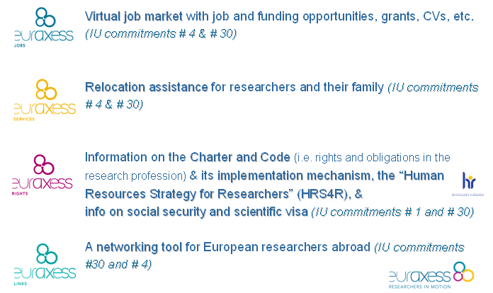
Other initiatives : Euraxess
Education
and Culture

Slide 73

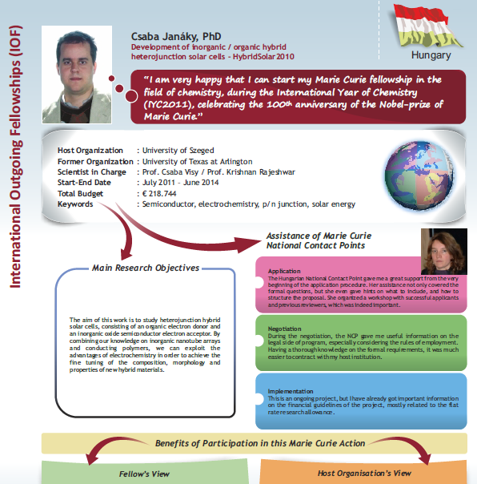
Success Stories
Education
and Culture

Slide 74

horizon.gouv.fr
Menu de navigation
Agenda
Zone « Actualités »
Zone « Trouver un appel »
Contacts PCN
GTN, RCP
Zone « Les programmes »
Outils juridiques
et financiers
7ème PCRDT
Education
and Culture

Slide 75

pcn-mariescurie@recherche.gouv.fr
Education
and Culture

